Slide 1
KS1 Fire Safety Education
Notes:
ChildSafe KS1 Fire Safety Education Session
Deliverer Notes (In-Person Delivery)
To access –
www.lancsfirerescue.org.uk/resources
Username: LFRS
Password: LFRSSafety
(both case sensitive)
The aim of the ChildSafe KS1 session is to deliver an educational package that challenges the behaviour of children and their parents/carers by increasing their knowledge about the risk that fire presents and generates awareness of the actions to be taken in the event of a fire.
Intended Outcomes:
To enable pupils to:
Recognise some of the jobs we do in the Fire & Rescue Service
Recognise useful/good uses of fire and bad uses, particularly the dangers associated with playing with matches and lighters
Explain the importance of having a working smoke alarm
Describe what to do in the event of a fire at home – if possible by demonstrating through interactive/role play)
Note –
Not all the children may have a clear view of the screen so ask the teacher to arrange them so that they can.
We all have different learning styles and reading abilities so it is important that it is read out and not skipped over or left to the children to read. Additional detail can be added as appropriate.
Consider the target audience before and during delivery so that the message is pitched appropriately, including language (such as acronyms and fire service terminology.
You may wish to share local examples of incidents, however remember the age of the children (Year 2 – 6-7 years old) and what is appropriate to share.
Potential Homework Tasks
There are 4 clear opportunities to give the children some homework. Check with the teacher beforehand that this is ok to do.
Stop, Drop and Roll
Ask the children to teach the method to their family and friends. Reinforce that if they realise their own, or someone else’s, clothes are on fire to “Stop, Drop and Roll”.
Importance of working smoke alarms
Ask the children to check that they have a smoke alarm, test it and then make sure that it is tested regularly.
Why you need a Fire Plan
Refer to the handouts and ask the children to look at them with the people they live with and, explaining what they have learnt in the session, make their own family Fire Plan together.
Learn your address (and especially your postcode) in case of an emergency.
Introduction
Introduce yourselves and your role within LFRS.
Briefly explain that the session is going to be a mixture of listening, talking and taking part! As the screen will be being used make sure all the children can see it.
Own Notes

Slide 2
What sort of things does the Fire and Rescue Service do?
Notes:
What sort of things does the Fire and Rescue Service do? - Activity
Ask the children if they know what we do as a fire and rescue service - try to think of at least three things.
Children to feedback.
With the responses do not elaborate too much on them – a ‘yes’ or ‘good idea ‘ is fine as you can refer back to them after the next slide.
Own Notes

Slide 3
Notes:
Firefighter’s uniforms and types of incidents attended – Short film
Press the play button (centre of screen).
Photos appear showing the types of incidents firefighters attend. From this (don’t need to click again) a short film plays showing the types of uniforms/PPE fighters wear depending upon the situation. The photos appear again at the end.
Talk about some of the types of incidents that can be seen - refer back to the answers the children gave earlier.
Own Notes

Slide 4
Fire risks and the dangers of playing with matches and lighters
Why and how to Stop, Drop and Roll
Why you need a working smoke alarm
What a Bedtime Routine is
How to make a Fire Plan with your family
Notes:
What we will learn - Learning Objectives
Briefly go through the slide point by point. There is no need to expand too much as this will be done during the session.
Own Notes

Slide 5
Can fire be dangerous?
Can fire be useful?
Notes:
Good fire/Bad fire - Activity
Explain that fire can be dangerous, but it can be very useful too if used properly and sensibly by adults in a controlled way.
Allow children to briefly talk to their partner or in a small group about how fire can be useful and in what ways it can be dangerous - try to think of at least three ways or things.
Children to feedback.
With the responses do not elaborate too much on them – a ‘yes’ or ‘good idea ‘ is fine as you can refer back to them after the next slide.
Own Notes

Slide 6
Notes:
Good fire/Bad fire – Activity follow up
Ensure that as well as through the responses given, refer to the following common or well-known examples of good/useful and bad/dangerous uses of fire shown on the screen.
Good/Useful -
Lighting barbecues and campfires for cooking
Wood fires for warmth
Candles for light and celebrations
Bad/Dangerous -
House/building fire
Playing with matches & lighters
Faulty electrical equipment or nor using it properly or safely e.g. overloading plug sockets
Stress the following points –
Good fires can become bad fires if important fire safety rules are not followed.
Fire is always in our lives but it has to be used properly and carefully by adults and not to let it get out of control or it can cause a lot of damage and harm to people and property.
Own Notes

Slide 7
Notes:
Never Play with Matches or Lighters – Discussion
Ask the children to think of when matches and lighters can be used for good reasons and when they can be used for bad reasons.
You could allow them to briefly talk to their partner or in a small group and feedback.
Stress that matches and lighters can be very useful but they can be very dangerous too and only adults should use them for the right reasons.
Ask the children to be ‘fire detectives’. If they spot that matches or lighters have been left lying around they should tell a grown up as younger brothers or sisters could find them and play with them. Stress that they should never play with matches or lighters.
Own Notes

Slide 8
What would you do if…
your clothes
caught on fire?
Notes:
Stop, Drop and Roll
Without mentioning Stop, Drop and Roll, pose the question and encourage the learners to give their answers. Explain why inappropriate answers, such as ‘run around’ won’t help and may only make it worse. Guide the learners to the concept of Stop, Drop and Roll (see next slide).
Own Notes:

Slide 9
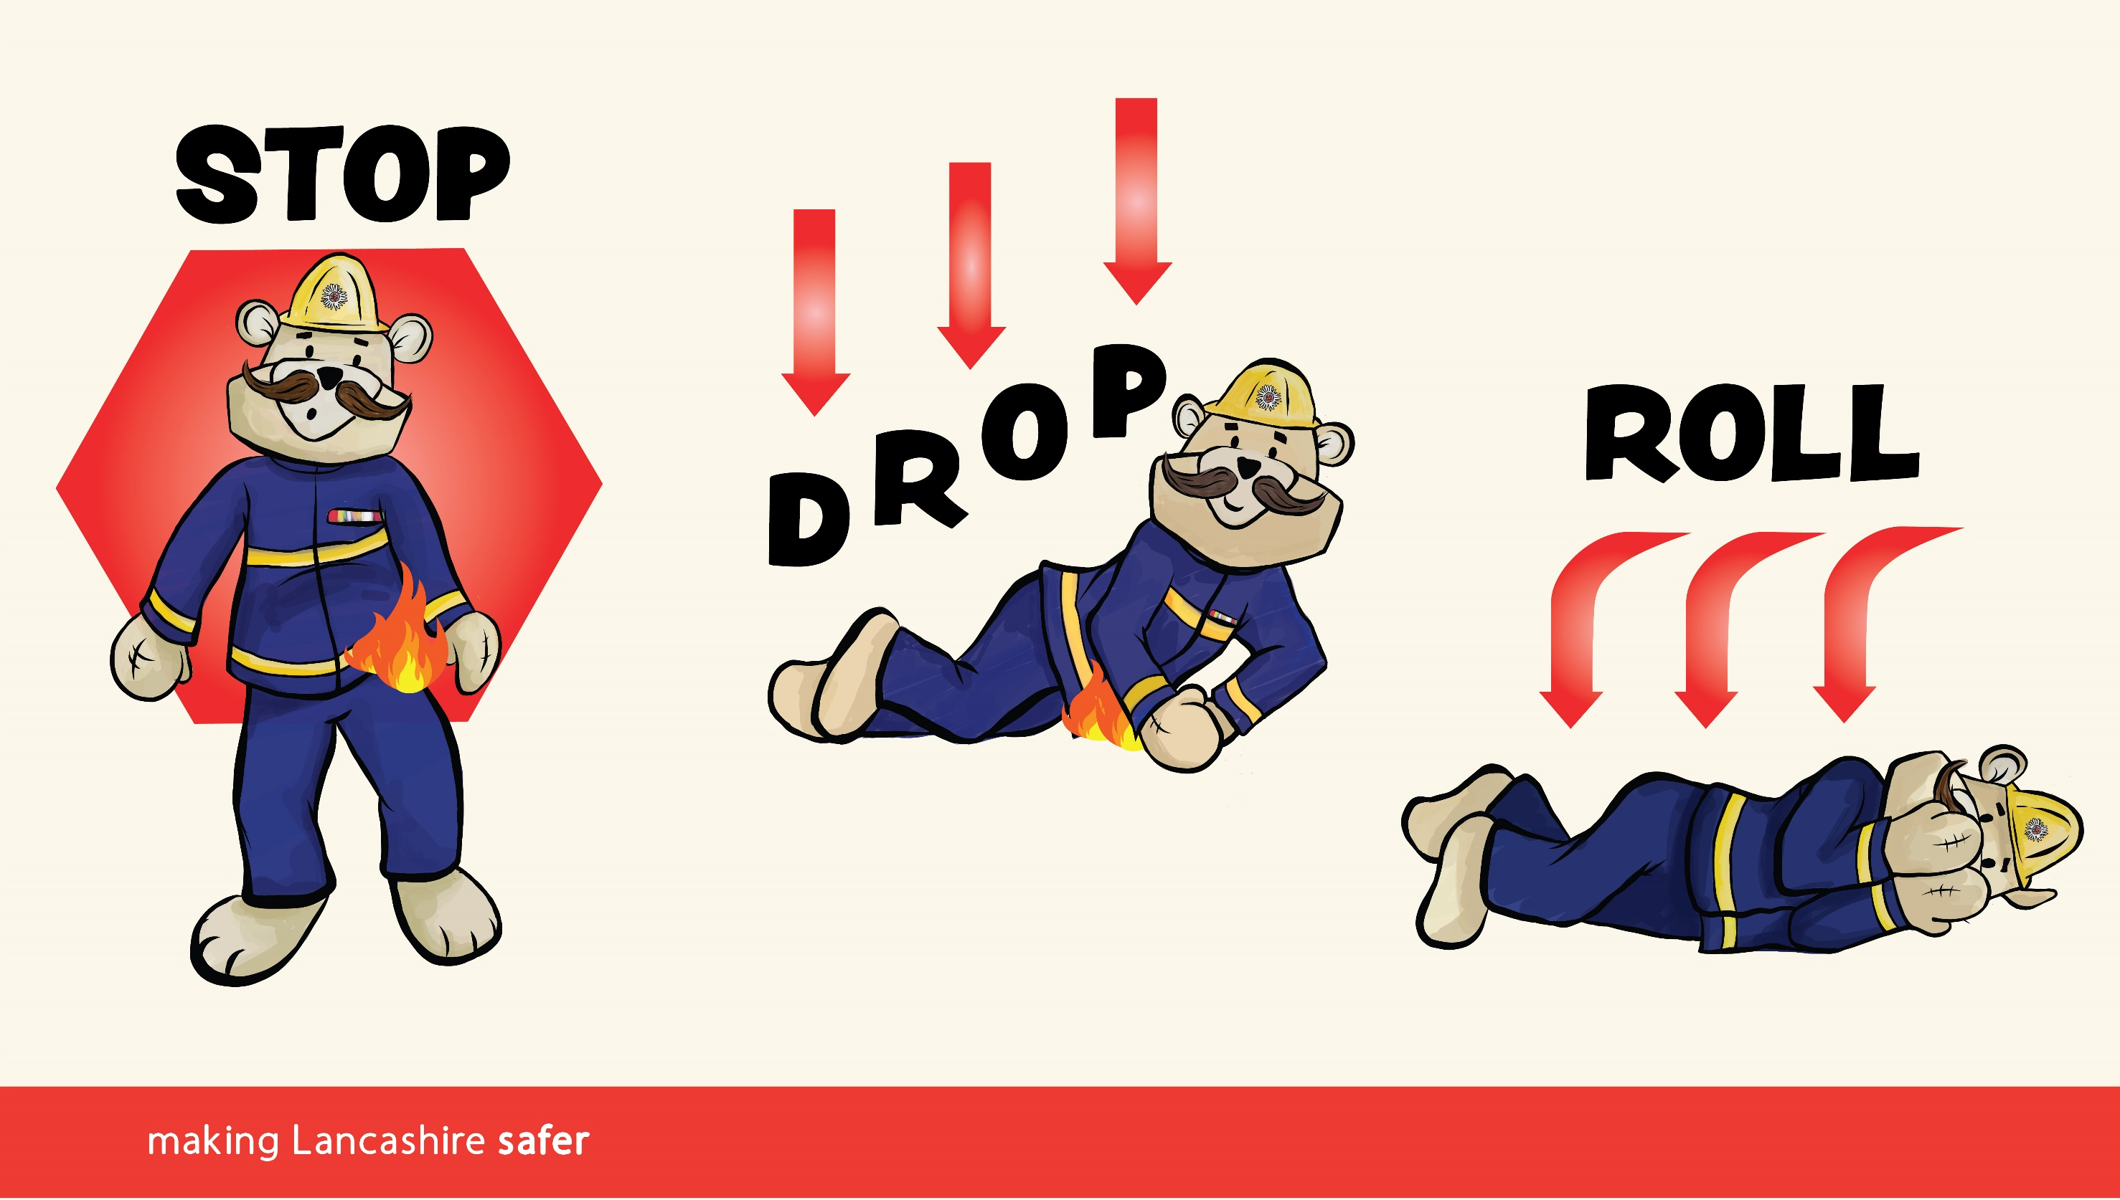
Notes:
Stop, Drop and Roll - Demonstration
Explain that sometimes accidents do happen and people’s clothing can catch fire, however reassure the children that this is very rare and if people are careful it should never happen.
Stress that they do need to know what to do just in case and that it may help someone else if they tell and even show them what to do.
Explain that if clothing does catch fire we use the “Stop, Drop and Roll” method -
Stop - Stop what you are doing – don’t run around.
Drop - Drop to the ground.
Roll - Cover your face with your hands, keep your legs straight and roll over and over and back and forth to put the fire out.
Explain that by doing this you are stopping air get to the flames and giving the flame less chance to burn – in effect, you are squashing the fire out.
One of the presenters could demonstrate this in a safe space and then, if space and time allows, small groups of children can have a practise. Ask the teacher to help organise this.
Potential Homework Task
Ask the children to teach the method to their family and friends. Reinforce that if they realise their own, or someone else’s, clothes are on fire to “Stop, Drop and Roll”.
Own Notes

Slide 10
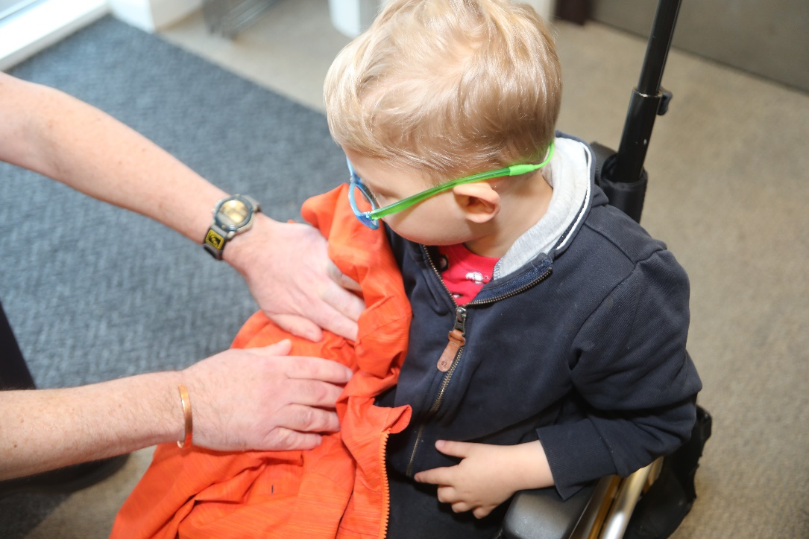
Stop, Drop and Roll -
Wheelchair Users
Notes:
Stop, Drop and Roll
Explain that for those who can’t Stop, Drop and Roll (such as wheelchair users) they or someone else can use a piece of material such as a coat or a blanket to put over the flames and firmly pat it down to smother them and put them out. Demonstrate with a colleague or ask for a volunteer.
Own Notes:

Slide 11
Notes:
Importance of working smoke alarms - Demonstration
Show the children a smoke alarm (or refer to the picture on the slide) and ask them if they know what it is, what it does and how it works. This could be done in pairs or small groups.
Ask the children to feedback.
Explain what smoke alarms are and what they do (if working).
Sound the smoke alarm.
Note: Check with the teacher first in case there are children who may be sensitive to the sound. Once ok, tell the children that they can cover their ears slightly if they want to.
Stress that only working smoke detectors can help save lives as they can give early warning so it is important that the children help their family to:
Check at home that they have a working smoke alarm – check for other family members, such as grandparents;
Test the alarms weekly;
Clean them regularly with a vacuum cleaner;
Know that with battery powered alarms the batteries should never be taken out to be used in other things.
The factsheet letter they will be given after the session gives them information about how to get one.
Potential Homework Task
Ask the children to check that they have a smoke alarm, test it and then make sure that it is tested regularly. They can do this at home and with other family they visit.
Own Notes

Slide 12
Hard of hearing smoke alarms
Strobe light.
Vibrating pad for under the pillow.
These should help the person to wake up in an emergency.
Notes:
Hard of hearing smoke alarms
Explain that smoke alarms work by alerting people with a loud sound. However, those who are hard of hearing may need a different type of smoke alarm to help them. The one in the picture works by the main smoke alarm sounding as normal but it then sets off a separate flashing light and a vibrating pad that goes underneath their pillow.
Ask the learners to think about if they know anyone who this sort of alarm might help. The fire and rescue service may be able to help arrange this.
Own Notes

Slide 13
Smokey’s Fire Plan
Notes:
“Smokey’s Fire Plan” - Film (6:45 mins)
Click the central ‘play’ button to begin the film.
The film introduces Smokey the Bear who is asleep and is woken up by the smoke alarm leading to 2 main Fire Plan scenarios:
Fire Plan A - Escape via a usual route (emphasise this is the priority)
Checking doorhandles, raising the alarm by shouting ‘fire’ and crawling low where the air is clearer and cleaner – get out, stay out, call 999.
Stress not to go back for anything, including pets – the firefighters will get these.
Fire Plan B - What to do if trapped in the room (not able to get out of your normal exits)
Keep the door shut and put cushions, duvets etc. over the gaps to block out the smoke, open the window and shout for help. Do not hide.
Whilst this is not shown on the film to avoid any possible confusion if appropriate you could refer to Fire Plan C – Having to lower out of a window. However, to avoid worrying the children stress that this is the absolute last resort and only if from a low height e.g. first floor).
Throwing soft things out to cushion fall, then lowering if safe to do so and dropping down as you would when turning and lowering yourself into a swimming pool. Don’t jump.
At the end of the film there are several questions which reinforce these points. Clarify the key points in a reassuring way.
Ask the children if they have any other questions and answer in a reassuring way.
Pausing the film for discussion/clarification
If you wish and time allows the film can be paused at any point by clicking on the screen to expand on things or question the children about what is happening. Click again to restart.
Own Notes

Slide 14
Notes:
Bedtime Routine - Recap
Refer back to “Smokey’s Fire Plan” and ask the children to think about how we can help to stop a fire starting in the first place.
Referring to the slide, stress to the children the need to make sure you and your house are as safe as possible when you go to bed. It could be thought of as “putting your house to bed”. The adults have things they should do (see below) but encourage the children to help by going through the points on the screen.
Note – many children of this age will sleep with their door slightly open for light. Any questions should be handled sensitively and reassure them that the smoke alarm can still be heard when asleep.
If appropriate and time allows mention some of the things the adults should do and which they can help with such as, closing all inside doors, checking any fires or candles are out and not leaving the washing machine/tumble-dryer/dishwasher on when they go to bed.
Own Notes

Slide 15
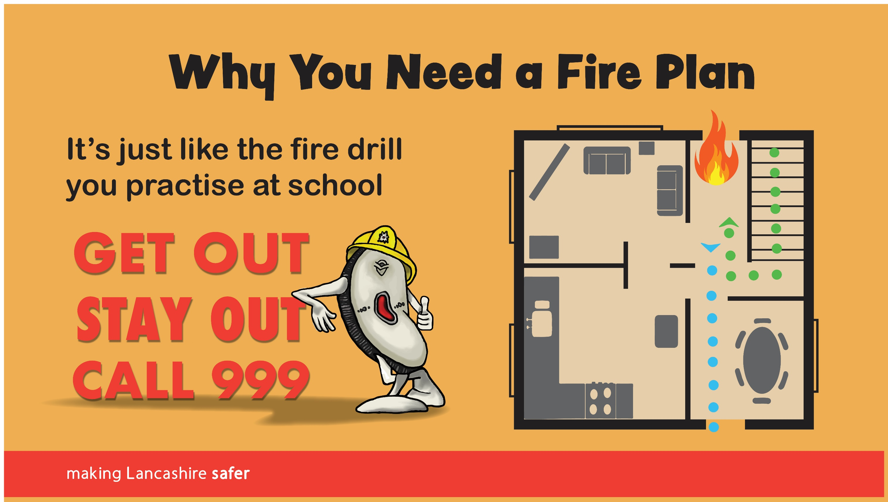
Notes:
Why you need a Fire Plan - Recap and role play activity
Refer back to “Smokey’s Fire Plan” and reinforce the need to have a Fire Plan so the whole family knows what to do if the smoke alarm goes off and/or they need to leave the building quickly.
Compare this to their School Fire Drill and ask the children what they do when the Fire Alarm goes off in school. All schools will have a very similar process but if you aren’t sure ask the teacher to go through it step by step.
Stress the key points of a Fire Plan and what to do when making one with their family -
Plan an escape route, making sure everyone knows the drill
Practise the escape route as a family – your main exit is your normal way in and out
Keep all exits clear
Keep keys handy (ideally not in the kitchen)
Think about having a second plan if the normal way out is blocked
Stress what not to do during a fire -
Don’t hide in wardrobes or under the bed
Don’t gather belongings or toys
Don’t return to your home or room for any reason
Role Play Activity
Ensure there is enough space and that it is a safe area for a practical activity. If needs be, ask if it is possible to relocate to another area, such as the hall or even outside.
Use equipment such as chairs, tables, carpeted area to create a basic ‘footprint’ of a home. e.g. between two chairs could be a doorway.
Explain to the children that you are going to do a Fire Plan activity. This will involve some of the children actively taking part and the others helping and giving feedback.
The teacher should choose children for the following roles and give them the equipment needed:, 4/5 to be a family and 5 to hold Fire Plan flashcards
Give the groups the following from the ChildSafe bag -
Firefighters (3 - 1 x OIC, 2 x FF) - PPE style uniform jackets and trousers, helmets, hose (ask school staff to assist with dressing if needed)
Family (4/5) - toy pet (supporting person to have 999 prompt cards and help with door handle)
Helpers (5) - Fire Plan flashcards (1 each)
Helper (1) – to act as Control operator (supporting person to have 999 prompt cards)
Each group, which should be in a different part of the space (in ‘the house’, ’at the fire station’, ‘in Control’, at the side of the action (flashcards), should be supported by someone who explains what they have to do -
Firefighters –
wait for 999 call and command to attend from Control, go to incident on ‘blue lights’, check family is ok, put out fire, rescue pet
Family –
be asleep, get woken by smoke alarm, raise the alarm, get out (checking door handles, staying low, keeping together), stay out,
pretend to call 999, give details to Control, including an address (the prompt cards can be used to help), wait for firefighters, tell them their pet is still inside
Control operator –
take the 999 call and mobilise the fire engine using the prompt cards
Helpers (Flashcards) –
hold up the flashcard at the appropriate time as the activity progresses and at the end when a recap of the Fire Plan is done
In addition, there should be a ‘narrator’ who explains what is/should be going on at each stage. This person can also act as the ‘Control’ operator support.
Potential Homework Tasks
Refer to the handouts and ask the children to look at them with the people they live with and, explaining what they have learnt in the session, make their own family Fire Plan together.
Learn your address (and especially your postcode) in case of an emergency
Own Notes

Slide 16
Notes:
Fire Safety Top Tips - Summary
Remind the children of the key points from the session by reading the top tips out from the slide.
Stress that these are the messages you want them to take home to the people they live with and other family they see regularly.
Conclusion
Leave the slide up
Refer to KS1 factsheet which should be given to each child to take home.
Own Notes

Slide 17
Notes:
Optional Activity - if time allows
No Dragons for Tea - Pre-recorded Story (5:07 mins) -
The story is a pre-record and is about a little girl who meets a dragon while out with her mum. She invites the dragon back for tea but it starts a fire when it sneezes! The little girl knows what to do and enacts their family’s fire escape plan even stopping the dragon from going back in to get something.
Click the central ‘play’ button to start.
Pausing the story for discussion/clarification
If you wish and time allows the story can be paused at any point by clicking on the screen to expand on things or question the children about what is happening. Click again to restart.
When the story has finished discuss the key aspects with the children and reassure them as appropriate.
Own Notes

