Slide 1
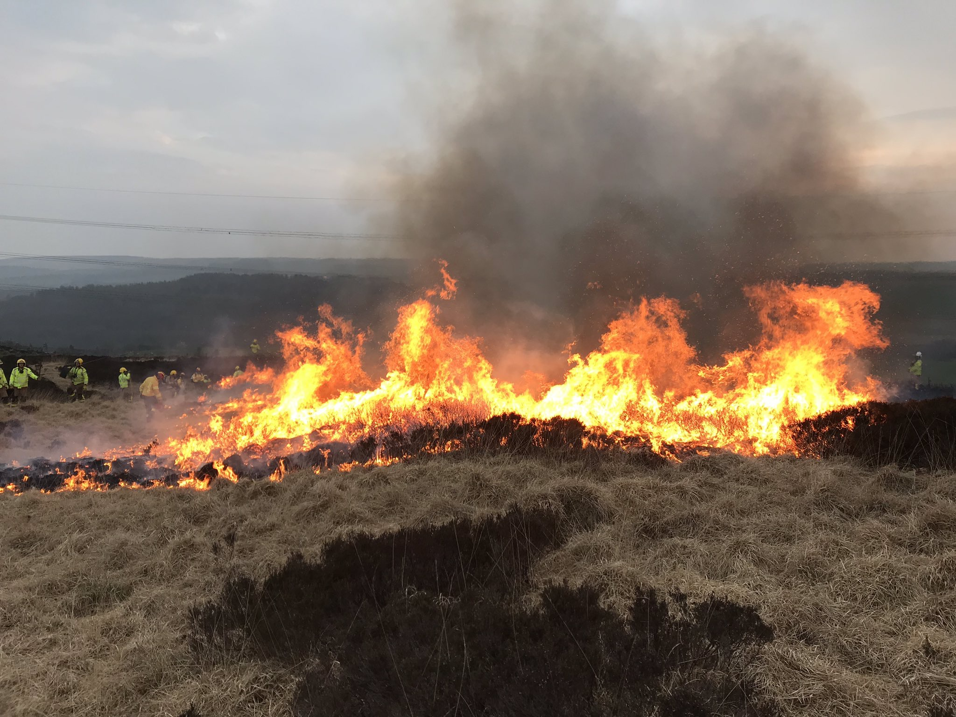
Grass Fires
Notes:
Grass Fires
Introduction
Introduce yourself and go through any housekeeping.
Explain how you want the learners to engage in the session and set ground rules.
Own Notes:

Slide 2
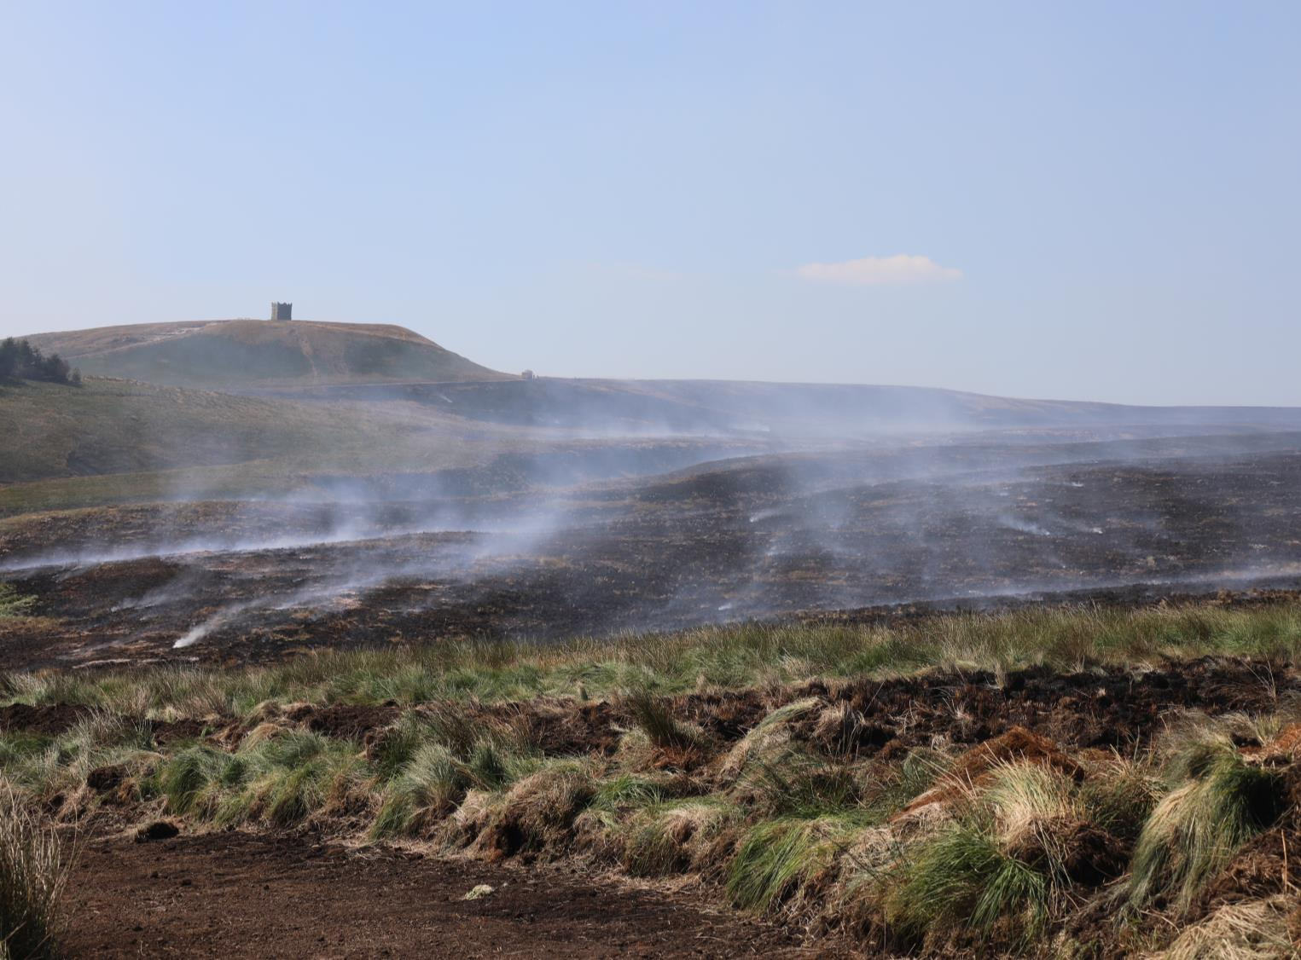
What we will talk about
By the end of today’s session you will:
Be aware of the impact grass fires can have -
to humans, wildlife and the environment
Understand how grass fires can be prevented from starting
Know what to do if you think a grass fire has started
Notes:
What we will talk about (Objectives)
Read out the objectives from the slide. Click to bring each one up in turn. It will give you an opportunity to tell the learners of key points that will be brought up as part of the session.
As the session develops try to refer to local hazards and places where incidents may have occurred.
Own Notes:

Slide 3
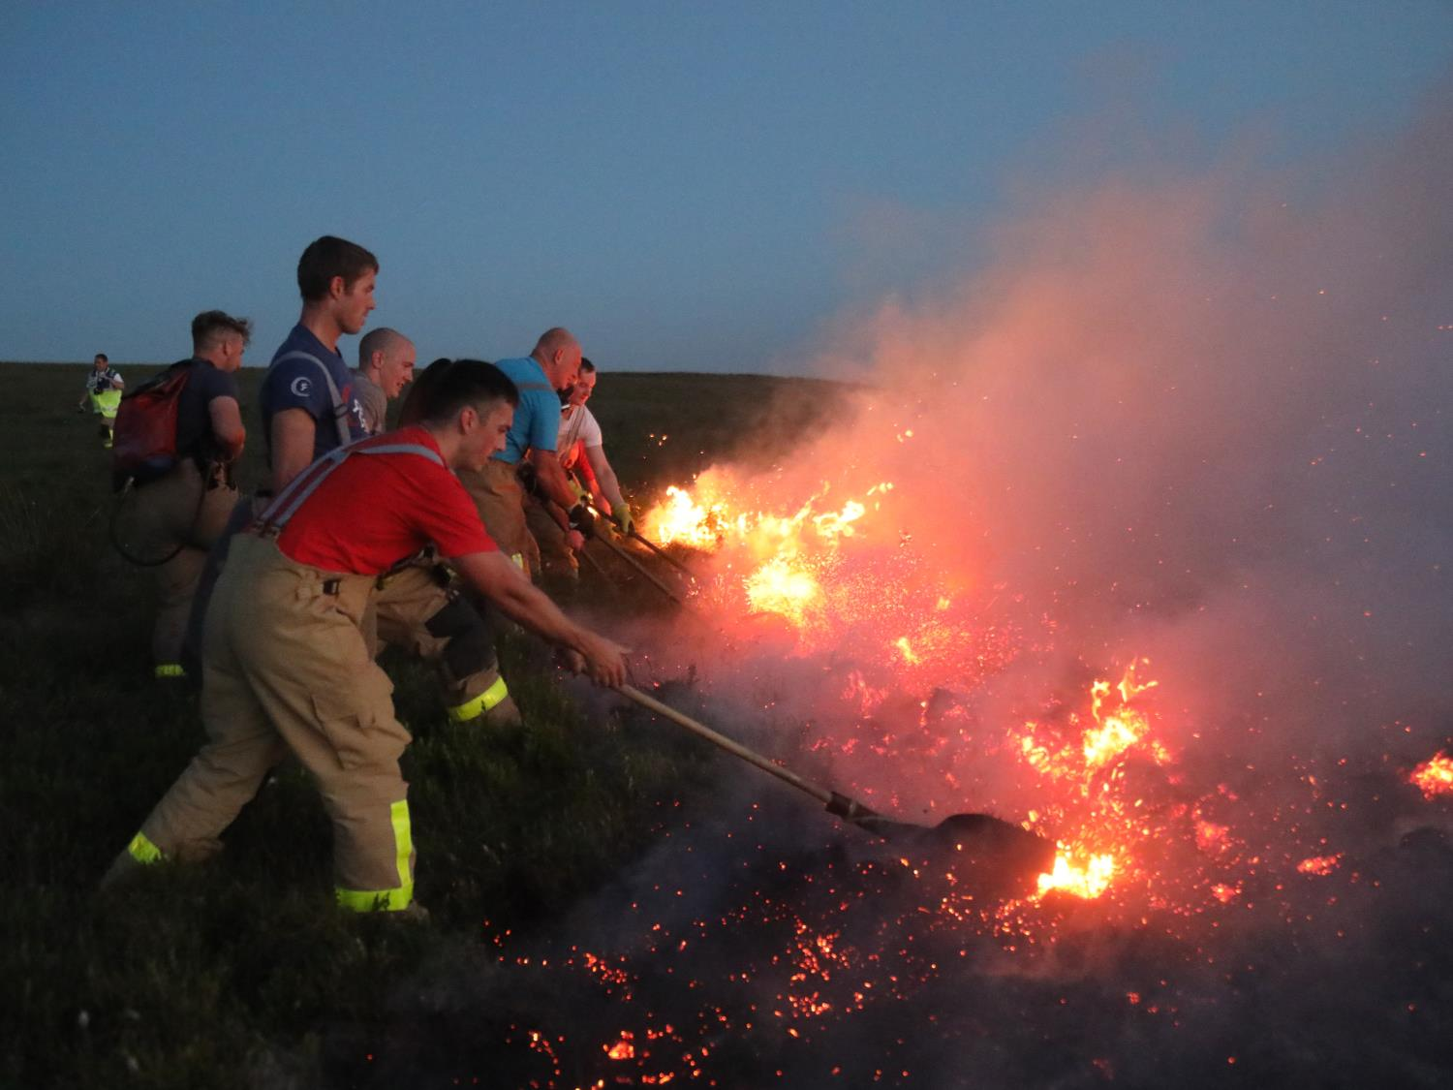
Winter Hill Fire 2018
Notes:
What causes Grass Fires? - Group discussion activity
The slide introduces the section about why grass fires happen.
Ask learners to think about why fires happen on grass and moorland.
Expand on any examples given as appropriate.
Own Notes:

Slide 4
So why do grass fires happen?
In the spring and summer, if there is little rain,
grasslands can become very dry and fires can easily start.
Often on moorlands winds can be quite high, which
can mean a fire can spread extremely quickly - faster than many people can run.
Over the winter months the heather and grass die out so in the spring there is lots of dry fuel that can burn.
Notes:
Why do grass fires happen?
Explain what a grass fire is and that they are often referred to as Wildfires
Basically it is an open fire on areas of dry grass and heath/moorland which can very quickly become out of control.
Explain why grass fires happen.
In the spring and summer, if there is little rain, large areas of grass and other vegetation/grasslands become very dry and fires can easily start. If a fire is started it spreads extremely quickly because of the dry conditions. Over winter the heather and grass dries out and the foliage/grass that has died off over winter burns fast and furious. Open moorland is usually quite exposed so winds can be high which can mean the fire will burn and spread faster. This also makes it much more difficult to fight the fire, especially if the wind changes direction.
Own Notes:

Slide 5
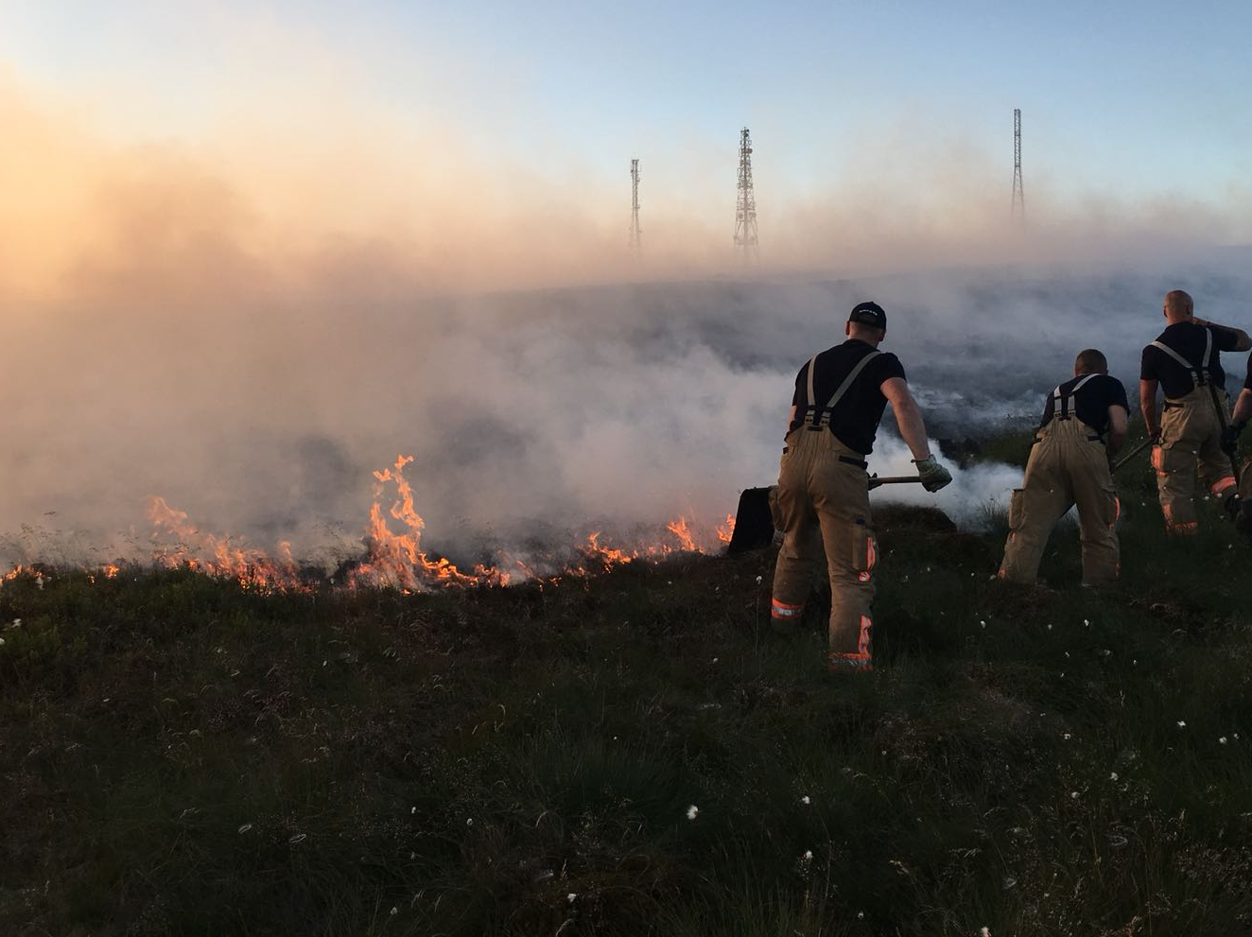
What damage can grass fires do?
Grass fires can be very dangerous and unpredictable.
They spread quickly and cause a huge amount of damage. This is especially true on moorland as the ground is made of peat however they can just as easily occur in towns or cities.
The damage is long-term, environmental and economic and can affect both people and wildlife.
Notes:
Damage grass fires can do - Group discussion activity (As a whole group, in small groups or with a partner)
It may be possible to encourage the learners to consider the impact grass and moorland fires can have on the immediate area and the potential knock-on effects. Give them a few minutes to think or discuss with a partner/small group.
Gather responses and discuss as appropriate without going into too much detail.
Ensure the learners ultimately understand that a grass or moorland fire can have a wide range of consequences for people who live, work and visit these places as well as the wildlife whose habitat it is. It can even affect local, regional and national infrastructure.
Own Notes:

Slide 6
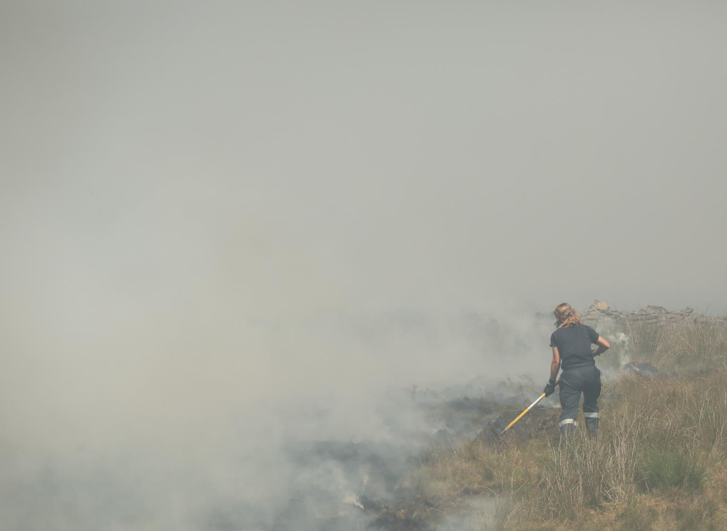
The impact of grass fires
Public Health - Air Quality
Smoke from grass fires reduces air quality in the surrounding area.
As air quality reduces, vulnerable people, such as the elderly or those suffering from pre-existing conditions, are particularly affected.
Notes:
Damage grass fires cause - Public Health - Air Quality
This slide focuses on the impact grass fires can have on public health.
As the air quality suffers vulnerable people, such as the elderly and those suffering from pre-existing conditions, (such as asthma) are particularly affected.
This will have knock-on effects for the medical services such as doctors, walk in centres and even A&E in terms of both time and money. Those people who are affected and who work or who are carers will also have their lives disrupted.
Discuss how poor air quality can also have a detrimental effect on wildlife and vegetation.
Own Notes:

Slide 7
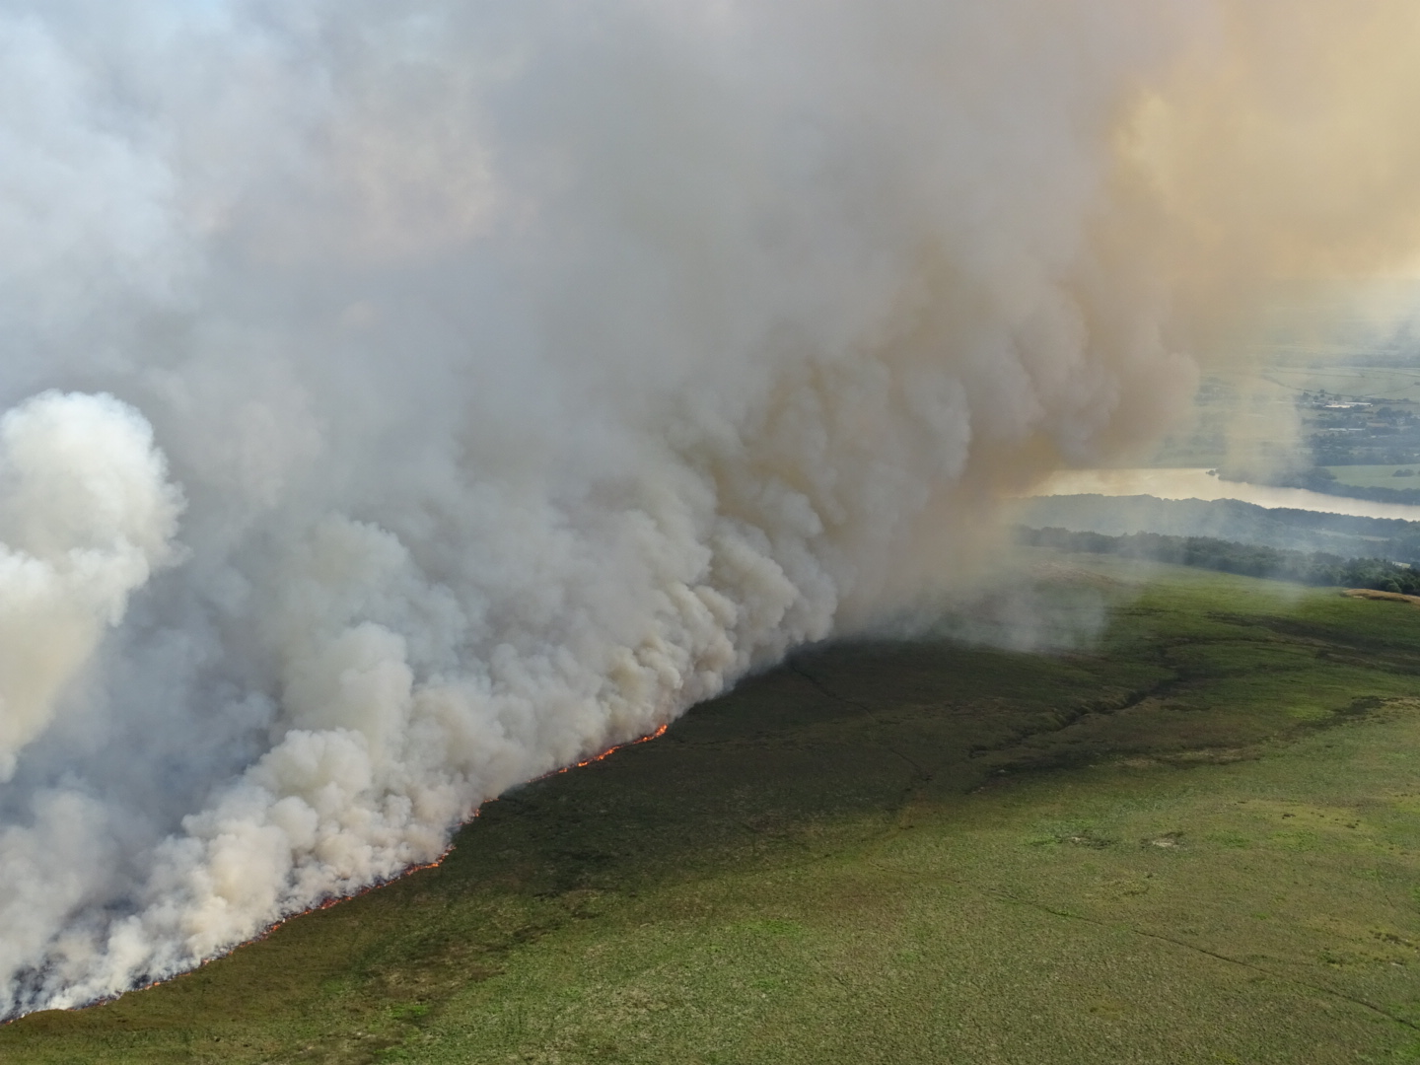
The impact of grass fires
Water Supply
Our drinking water comes from areas of the moors called uplands.
If the vegetation is burnt drinking water may be affected as natural filtration is reduced and Water Companies have to work much harder to make the water drinkable.
Notes:
Damage grass fires cause - Water Supply
This slide focuses on the impact grass fires can have on the water supply.
There can also be a significant financial impact as water that is intended to be used as drinking water and passes through the burnt moorland will need to be ‘cleaned’. The water company may then pass that additional cost on to the public in the way of higher water bills.
Own Notes:

Slide 8
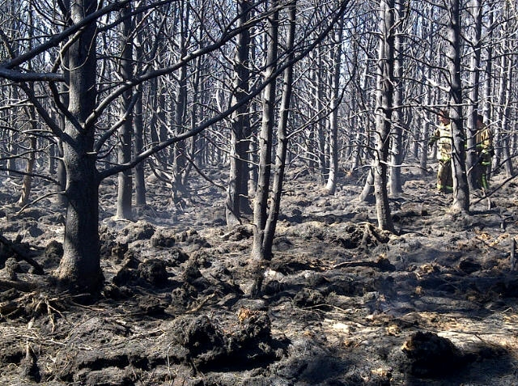
The impact of grass fires
Vegetation
Trees and plants are destroyed
by fire and can struggle to grow back.
They are also an important part of the food chain and are habitats for wildlife.
Notes:
Damage grass fires cause - Vegetation
This slide focuses on the impact grass fires can have on vegetation. In addition to the effect on the water supply, as already mentioned, there are also impacts in terms of contamination and destruction of habitats and potential food supply. There can also be serious consequences for trees/plants and the wildlife that depends upon them.
In a recent fire hundreds of trees were destroyed that had been planted 30 years ago. The trees were planted to shelter heather and wildlife from winds and also to stabilise the ground from landslides. Trees are also planted as part of United Utilities promise to reduce their carbon footprint.
Own Notes:

Slide 9
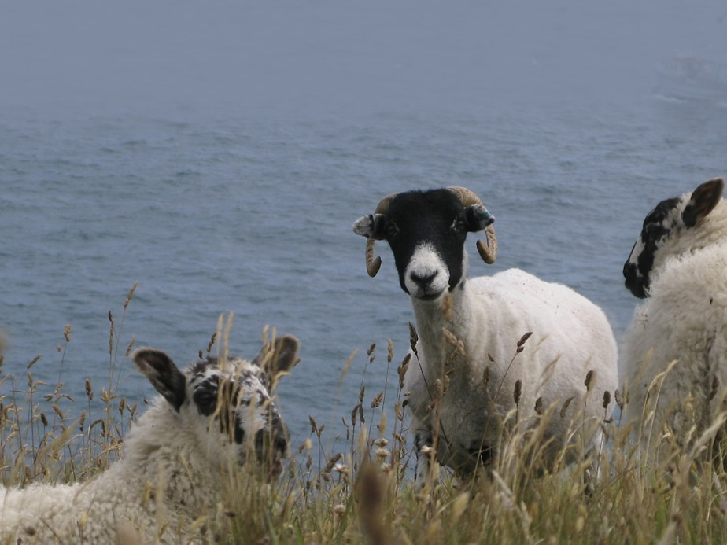
The impact of grass fires
Animals
Grasslands and moorlands are home to a diverse collection of wildlife.
Sadly wildlife and farm animals can be hurt or killed in grass fires.
Notes:
Damage grass fires cause - Animals
Some animals may be able to flee from the flames of a grass fire, however spring is a time when the majority of wildlife breed and a large number of newborn animals would be killed in the fires.
Ask the learners to think of the types of animals/wildlife that may live on the moors or on the surrounding land.
Gather and discuss the responses.
Answers may include -
Wild animals - rabbits, hares, foxes, badgers, deer, snakes, moles, newts, frogs etc.
Farm animals - sheep, possibly cattle
Birds - falcons, owls, kestrels
It also means that each of those species that have fled have no home and with regards to the farm animals this has serious consequences for the farmer in terms of cost and time.
Own Notes:

Slide 10
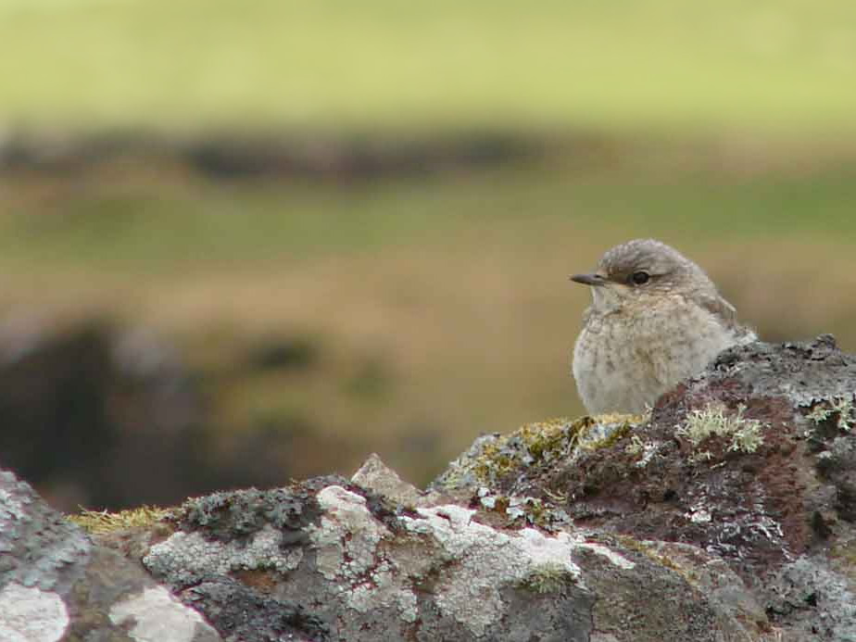
The impact of grass fires
Birds
Many moorland birds feed and nest on the ground and a fire can be devastating for them.
Notes:
Damage grass fires cause - Birds
One of the firefighters who worked during recent fires near Darwen told of how the trees burnt from the roots upwards and they found eggs literally cooked in their nests and dead birds, which presumably had flown back to protect their eggs. Example of moorland birds which nest on the ground are Golden Plover, Red Grouse, Short Eared Owl and Hen Harriers.
Own Notes:

Slide 11
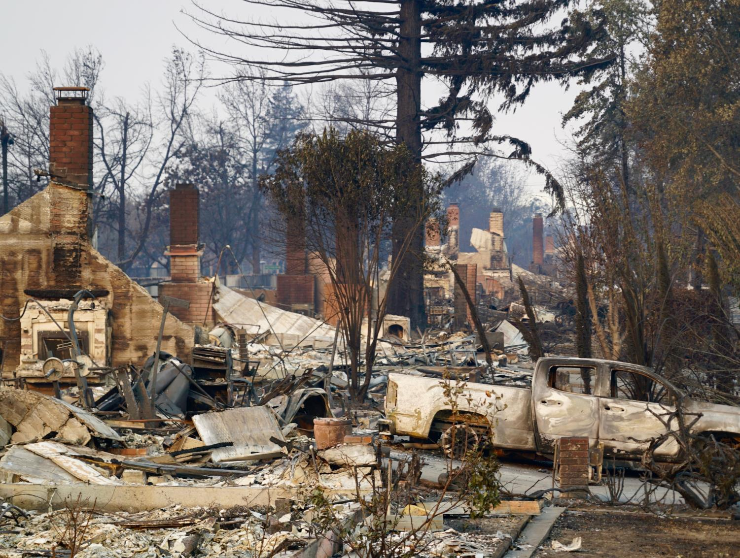
The impact of grass fires
Fire spread in rural and urban areas
Grass fires don’t just happen in rural areas. In hot weather patches of grass in towns and cities are equally at risk.
As grass fires spread so quickly any buildings in their path are at risk of catching fire and lives can be put at risk.
Notes:
Damage grass fires cause - Fire spreading in rural and urban areas
Whilst there may not be too many buildings in rural areas and they can be spread out and fairly isolated, each one is important to its owner and users, whether that be people or animals. A key aspect when fighting the grass fires is to be aware of all the buildings and protect them as much as possible.
Ask the leaners to think about the types of buildings that may be affected and what could be done to try and protect them.
Gather and discuss the responses.
Stress that this is also relevant in more built-up areas as grass fires don’t only happen in isolated rural areas. Discuss the sort of places where this might have happen such as grass areas by the coast, playing fields and farmland on the edge of towns and villages and the effect such fires might potentially have.
Own Notes:

Slide 12
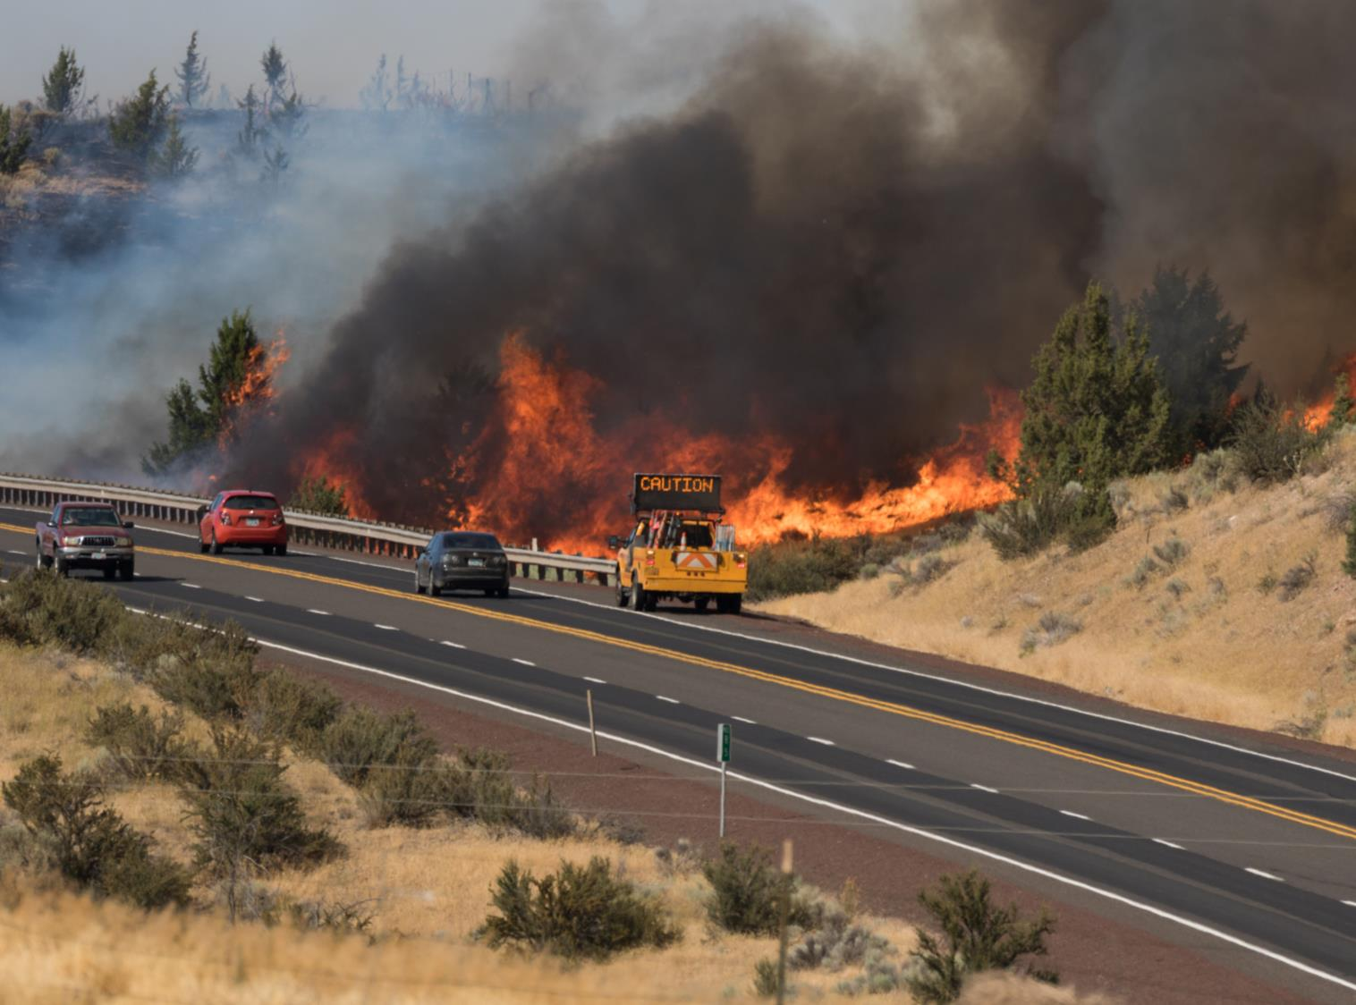
The impact of grass fires
Road closures and Evacuations
Road closures are put in place to ensure public safety and so those dealing with the fire have clear access to it. Road closures have serious implications for people living or operating businesses in the area.
To protect life sometimes a full evacuation of the area has to take place which is inconvenient and costly.
Notes:
Damage grass fires cause - Impact of road closures and evacuation
When tackling large scale grass fires it is quite common for local road closures to take place. This is done for public safety and to ensure the emergency services and supporting agencies/organisations can have clear access to the immediate firefighting area and its environs where any incident command ground/supporting site may be located.
It also stops possible incidents of the public coming too close to observe. When this happens they are putting themselves in danger and potentially getting in the way of those dealing with the fire. In addition, if the smoke is particularly thick and unpredictable due to potential changes in wind direction it could make driving conditions hazardous.
In some cases where people, businesses, schools or livestock normally located in the area are considered at risk an evacuation procedure may have to take place. This can be complicated and costly to organise and carry out and will have knock-on effects to those involved, including personal disruption and possible loss of income.
Own Notes:

Slide 13
The impact of grass fires
Cost to the economy
The short-term impact of road closures can prevent visitors entering an area which immediately reduces income for all businesses.
Any damage to the landscape which reduces its appeal/accessibility for tourists can then have long term effects on the leisure sector.
Notes:
Damage grass fires cause – Cost to the local economy
Large scale grass fires in areas that are popular for leisure activities, such as walking or mountain biking, will suffer. The landscape is damaged making it less attractive or even out of bounds to visitors and this can significantly impact upon local businesses such as visitor attractions, cafes, shops, pubs and hotels/guest houses. In addition, landowners and farmers will be adversely affected.
Stress again that local roads and motorways may be closed, which can affect how people move about their everyday business and this can have a significant effect on the local and even national economy.
Own Notes:

Slide 14
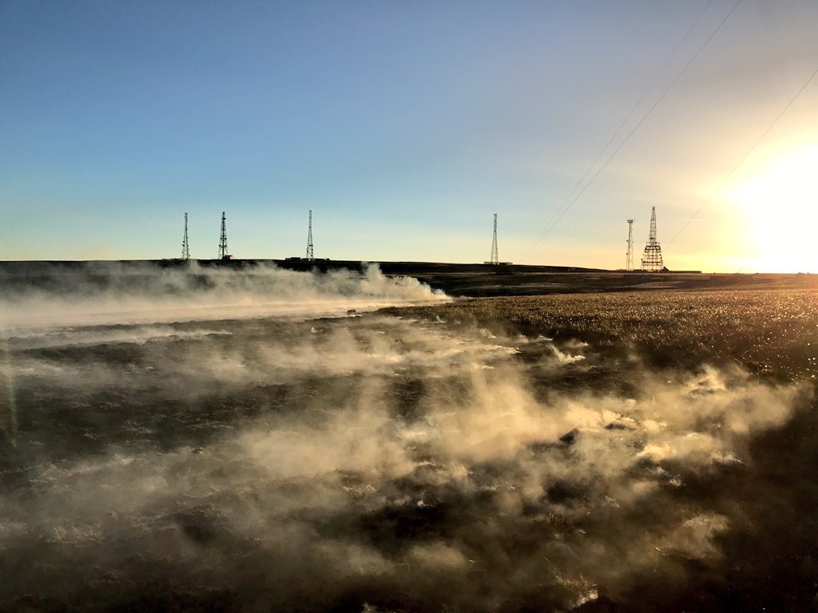
The impact of grass fires
Utilities we rely on
Large grass fires put vital services such as TV, radio and mobile phone masts, electricity cables and gas supplies at very serious risk.
Modern life depends on these services and any damage can take a long time to repair and be very costly.
Notes:
Damage grass fires cause - National Infrastructure
This slide focuses on the impact grass fires can potentially have on the National Infrastructure.
Explain to the learners what is meant by the term ‘National Infrastructure’.
“National Infrastructure are those facilities, systems, sites, information, people, networks and processes, necessary for a country to function and upon which daily life depends.”
Source: The Centre for the Protection of National Infrastructure (CPNI)
Explain that those in charge of major incidents, particularly large scale grass fires, have to try to ensure that the national infrastructure and security isn’t affected. This might mean concentrating on protecting key buildings, such as military bases and energy sites and structures such as electricity pylons and mobile phone masts. This happened at recent fires on Winter Hill, near Chorley.
Doing this can divert the firefighters from protecting other areas where the fire is burning.
Stress to the learners the possible knock-on effects if one of these key buildings or structures is damaged or even destroyed.
Own Notes:

Slide 15
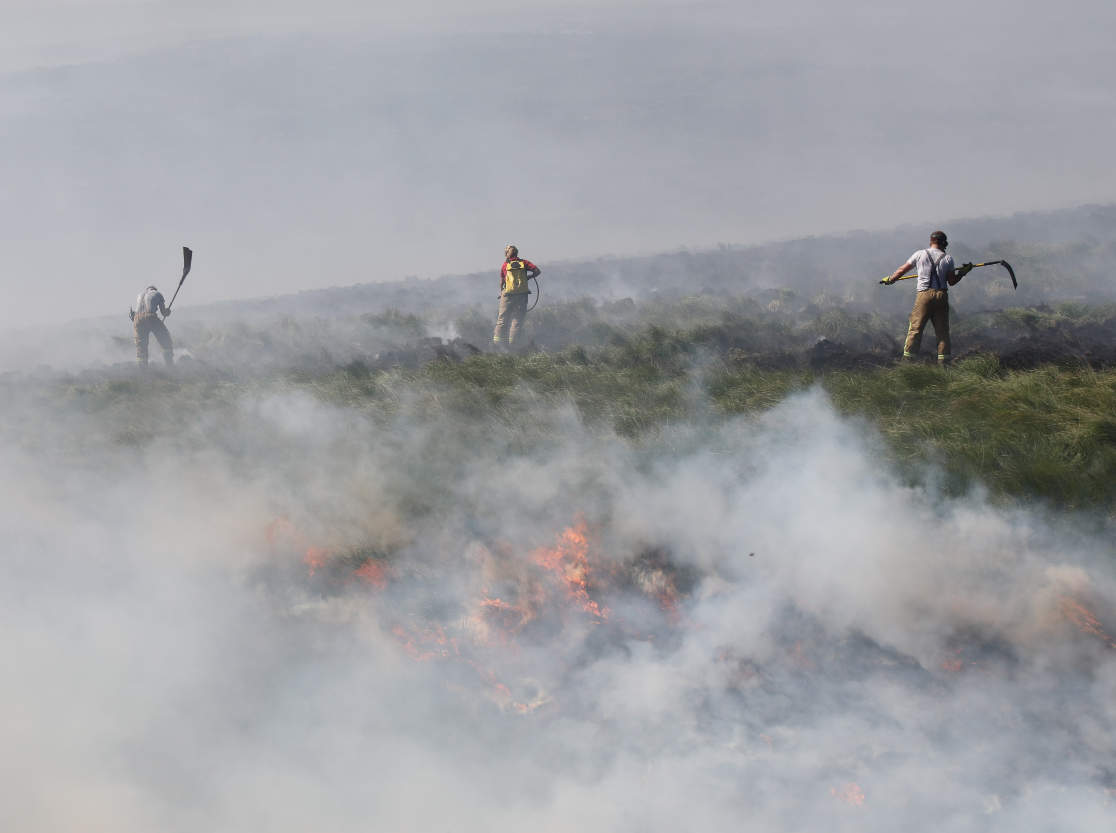
The impact of grass fires
Time and Money
It can take the Fire and Rescue Service days, weeks or sometimes even longer to deal with a grass fire. They can burn out of sight underground and appear again without warning.
Grass fires have a terrible effect on the economy as they cost a huge amount of money to get under control and repairing the damage caused costs even more.
Notes:
Damage grass fires cause - Time, money and the effect on firefighters
Fire Cover/Fire Engines
Ask the learners to think about how they feel a large scale grass fire could affect the Fire and Rescue Service and other supporting agencies/organisations.
Gather and discuss the responses and then go over the main points.
Consider –
How many firefighters, fire engines and other vehicles may be required?
This will vary - use knowledge of recent events to highlight the large scale deployment.
Where will they come from?
Not just from Lancashire but all over the UK. Crews from as far away as London have been to Lancashire to help fight moorland fires.
Who will cover the areas the fire engines have come from?
This means that the response time will increase as fire engines in other areas are spread more widely.
What will happen about the welfare of the crews?
Water, food and toilets needs to be arranged - this takes a good deal of organising and is costly.
Case Study
A fire which started on Darwen Moors led to there being 20 fire engines in attendance for over three weeks.
Further fires started. At one point fire engines had to be called in from Greater Manchester Fire and Rescue Service as Lancashire Fire and Rescue Service did not have enough to provide cover to key stations and fight the three moorland fires in three different locations -
20 fire engines at Darwen
8 fire engines at Ormskirk
8 in Bacup
Lancashire Fire and Rescue Service only have 39 fire stations and 60 fire engines and specialist vehicles to cover the whole of Lancashire. Lancashire is one of the biggest geographical areas, by size, in the country.
The Fire and Rescue Service have to attend a range of different types of incidents - grass fires, house fires, road traffic collisions, chemical incidents, deliberate fires, rescues (animals/people) and floods to name a few but if two thirds of the Service’s fire engines are at grass fires at one time it becomes more difficult to attend these other incidents promptly.
Stress to the learners that it could be them or their family/friends who needs to be rescued but they will have to wait for a fire engine to travel from another part of Lancashire to help them as their local fire engine is busy dealing with a fire on the moors. Ask them to think about what the result might be.
Own Notes:

Slide 16
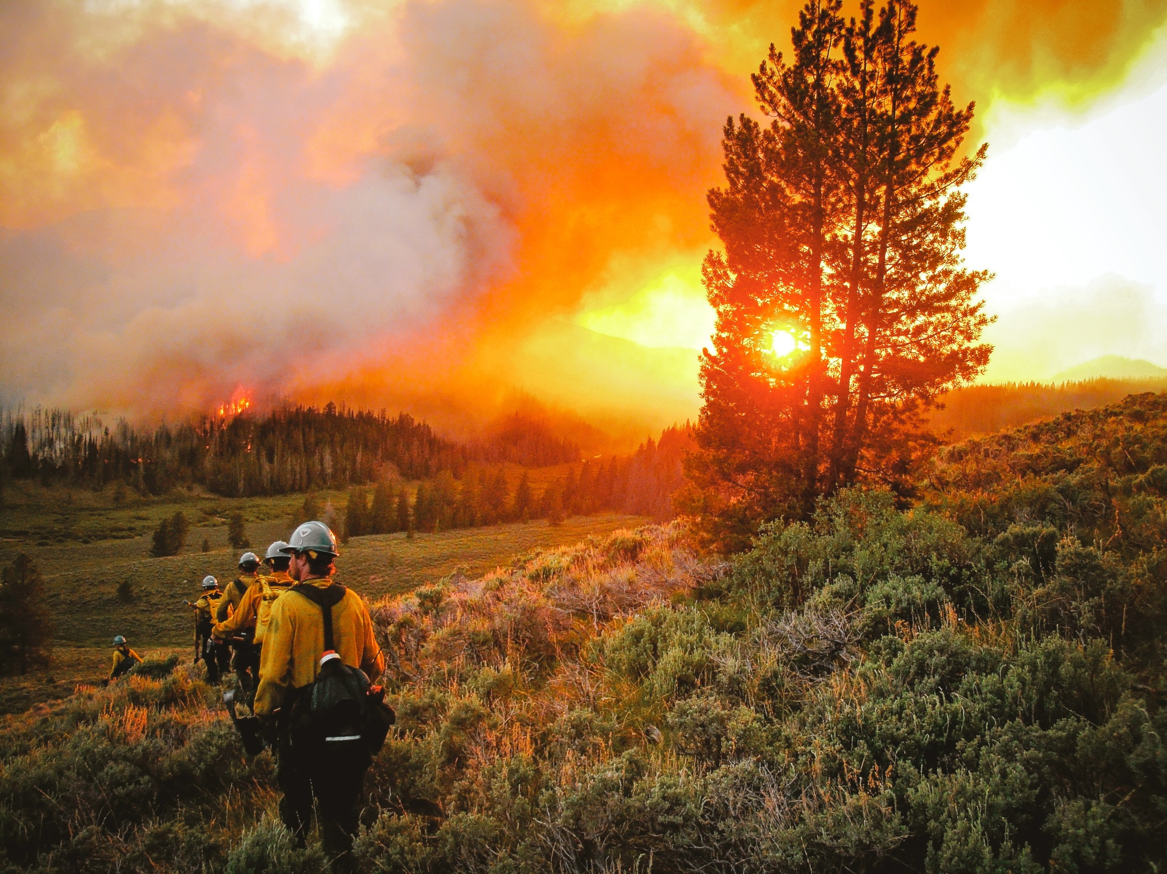
The impact of grass fires
Impact on the Emergency Services
Due to the impacts talked about in the previous slides LFRS puts a lot of resources into putting them out. But we cannot be in two places at once. So this reduces the number of fire engines and fire fighters available for other emergencies.
Notes:
Fighting the fires - Impact on the Emergency Services
Firefighters’ lives/health
When the heather burns it continues to burn the peat which then makes the land unstable to walk across creating pits which firefighters could stumble into and injure themselves. A firefighter injured his ankle at the Darwen Moors fire last year. This is then a problem for the crew on the moors at the time but also it may mean that s/he may not be able to work operationally for a lengthy period of time.
The prime time to fight moors fires is about 5/6am, when it is becoming light and there is dew on the ground, until 11am when it becomes warmer.
Firefighters start at various times - depending on their shift pattern - and then will travel to the fire where they may have to walk long distances to where they will fight the fire. They will begin to beat the fire, dig the peat and use water packs which will need re-filling which they may only be able to do some considerable distance away.
All of this can have a further impact on retained firefighters who may have other full time jobs. It will mean they may be away from their normal place of work for some time which again can have a detrimental knock-on effect there.
Anyone involved in tackling such large scale fires may be doing so for a full day or night shift - this can be both physically and mentally demanding. Much of this also applies to other agencies who will probably be involved, such as the Mountain Rescue and Salvation Army back-up support teams.
In addition, there is then the impact on the personal lives of those involved as it will affect family time.
The Aftermath
Just because the flames are out it does not mean that the fire is out. The soil, especially if it is peat, could continue to smoulder or burn for some time afterwards so the firefighters will have to stay at the scene until they are sure it is safe to leave. Again this is tiring and time consuming and keeps fire engines away from the day-to-day fires and other incidents such as RTCs.
Give examples of real-life incidents but only if you feel comfortable in doing so.
Own Notes:

Slide 17
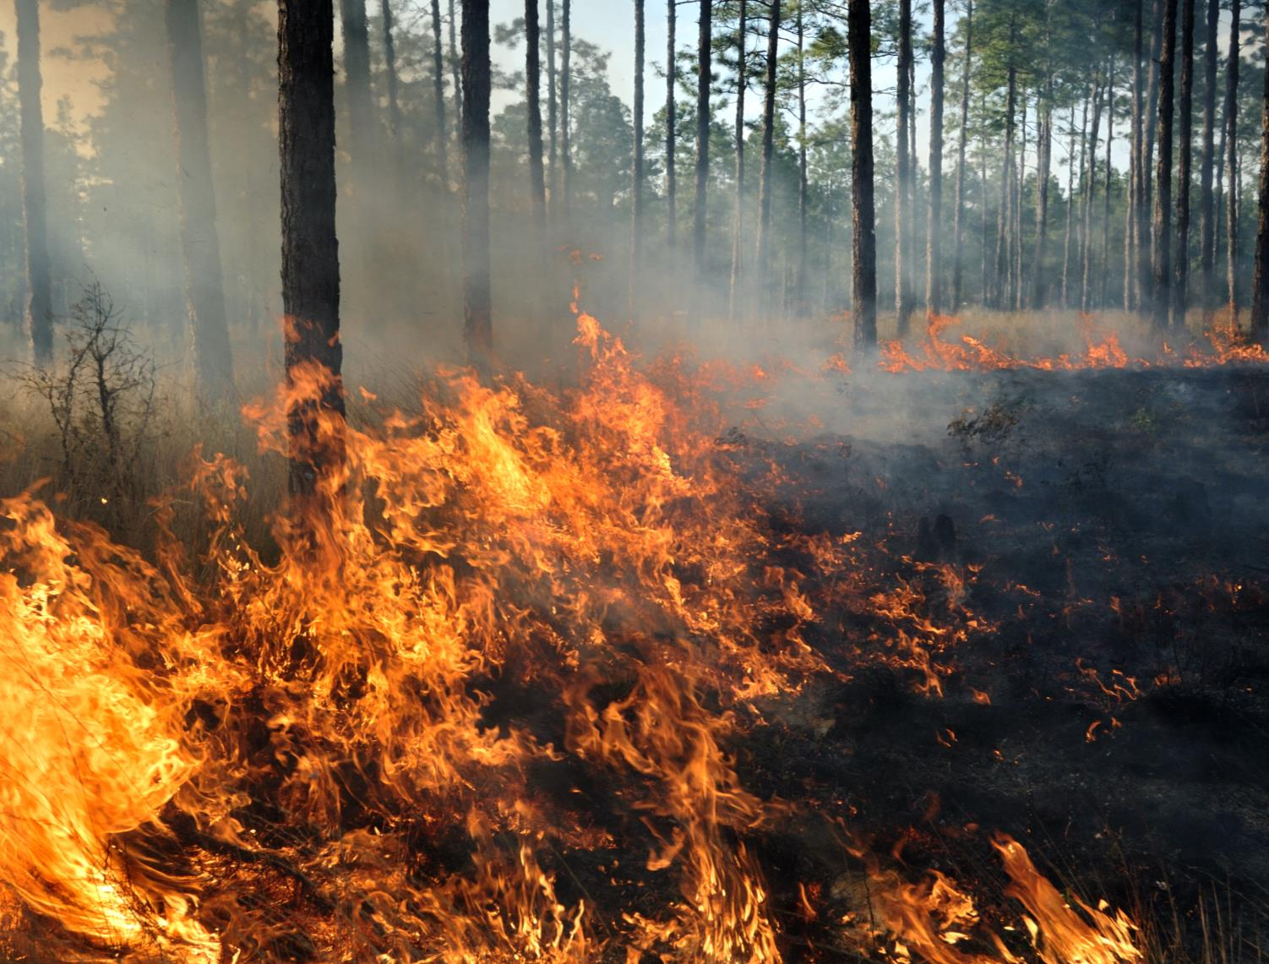
What causes grass fires?
Notes:
What causes grass fires? - Group Discussion Activity
The slide introduces the section about how grass fires can start and what can be done to prevent them.
Ask learners what they think could start fires on grass and moorland.
Gather and discuss the responses and then move forward to show a short animation which shows some of the ways the fire might start.
Own Notes:

Slide 18
What causes grass fires?
Notes:
Film - What causes grass fires?
Short animated film (13 secs) showing common causes of grass fires.
The slides/content following the film will reinforce the messages and go into more detail.
Click to start film
Own Notes:

Slide 19
Notes:
Film - What causes grass fires?
Short animated film (13 secs) showing common causes of grass fires
The slides/content following the film will reinforce the messages and go into more detail.
Once the film has finished click to move on.
Own Notes

Slide 20
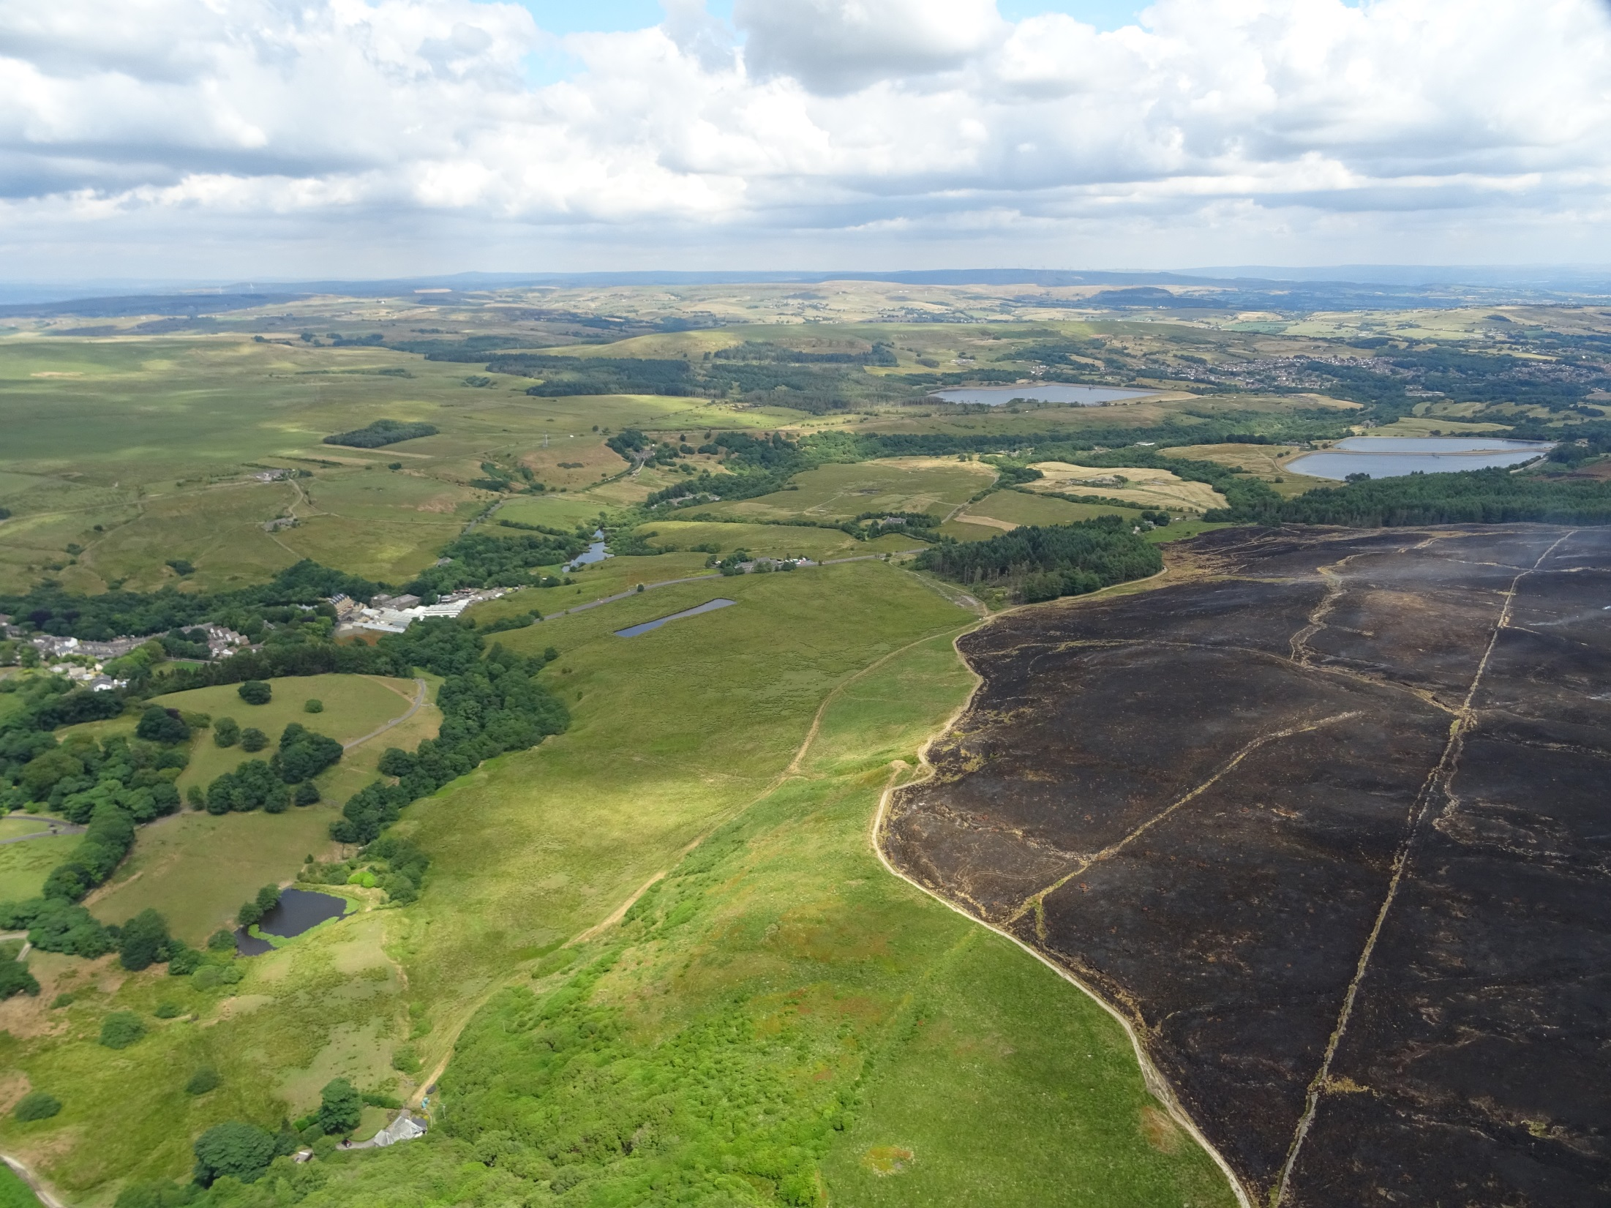
Preventing grass fires
This image demonstrates how large and devastating grass fires can be, but together we can prevent this from happening.
Notes:
Preventing grass fires
Following the discussions related to:
what grass fires are and why they happen
the damage they can do
how they can start.
Introduce the next theme -
The Prevention of Grass Fires
Refer to the fact that grass fires can be started deliberately. Sometimes this is done by landowners and is called “Controlled Burning”.
“Controlled burning” is “the planned use of fire within a specified area. The main type of controlled burning operation undertaken in the UK is to remove uncut heather and moorland vegetation which may act as a fuel source in the event of an uncontrolled fire.” (Forestry Commission)
However, if someone is not authorised to start a fire it is ‘Arson’ and not only is it illegal but carries severe punishments due to the potential serious consequences that the fire can have.
Sometimes though the fires can begin due to careless behaviour which isn’t malicious but the results can be just as devastating. The following section details how reasonably straight forward steps can be taken to stop such fires occurring in the first place. They focus on BBQs, litter and cigarettes/matches.
If appropriate, remind the learners about the current situation such as the weather/time of year (this will vary so ensure you have checked the latest information prior to the session).
Own Notes:

Slide 21
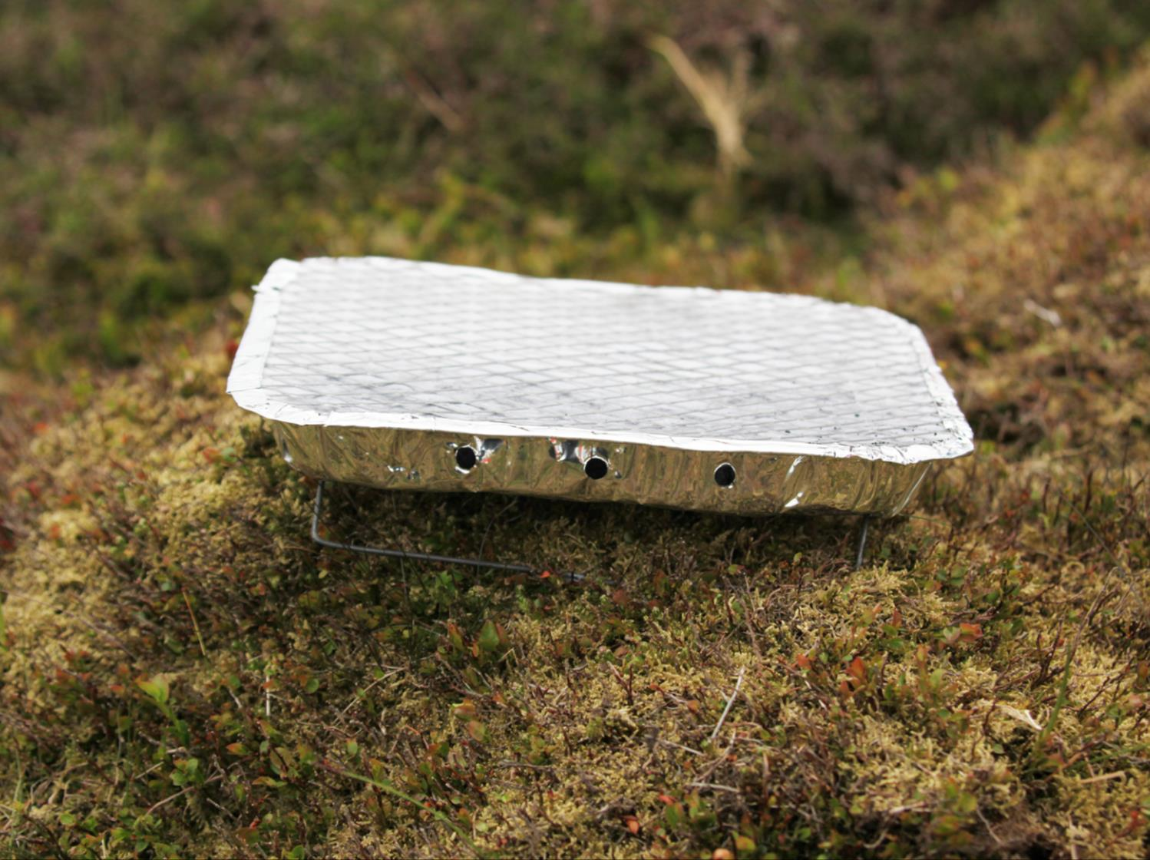
Preventing grass fires
Barbecues
Barbecues or camp fires should never be lit on grasslands, such as moorlands or dry areas, as this can easily start a fire which will spread quickly.
Notes:
Preventing grass fires - Barbeques and camp fires
It is not recommended or safe to have BBQs or camp fires on grasslands.
It is not be practical to take a large garden style BBQ on a day trip so people sometimes take small disposable ones instead. However, in a garden or on the beach if a non standard BBQ, such as a disposable one, is used the user has some control over it. If one is used on grass lands and particularly on peat areas the grass/heather is burnt but the peat holds the heat. The peat is also a fuel and when it gets hot enough it can start a fire.
If appropriate for the audience, refer to the triangle of combustion -
Heat - BBQ Fuel - Peat Oxygen – it is outside and this is readily available
Own Notes:

Slide 22
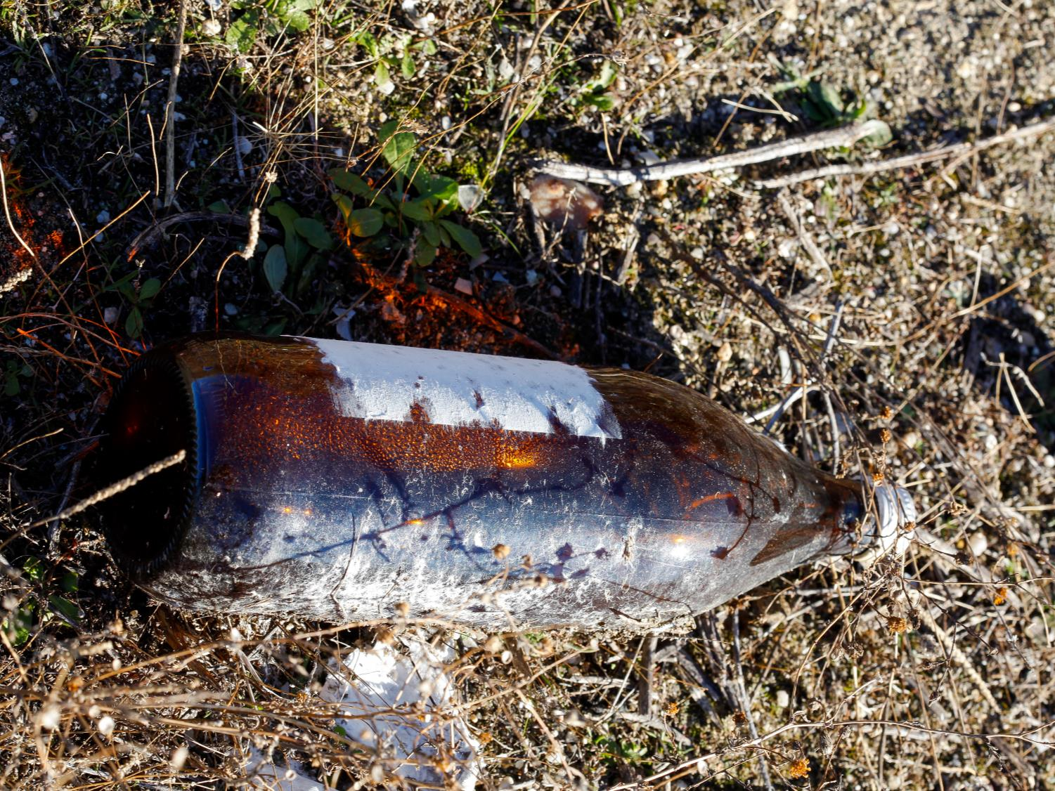
Preventing grass fires
Litter
Please make sure that you take any rubbish home with you, especially glass. On a sunny day this can focus the Sun's rays and start a fire.
Notes:
Preventing grass fires - Litter
Explain that litter is a major problem on grasslands. It is -
an eyesore
a potential danger to wildlife who might ‘eat’ inappropriate items and harm themselves or be injured by them
a fire hazard
Bins are rarely found on large areas of grassland or moorland. It isn’t always practical to ‘collect’ them and there is no guarantee they would be used. People should take their litter home to dispose of appropriately. However many don’t, either deliberately or ‘accidently’ due to it blowing away. Litter left, such as glass bottles, can act as inadvertent fire starters during periods of strong sunshine.
Own Notes:

Slide 23
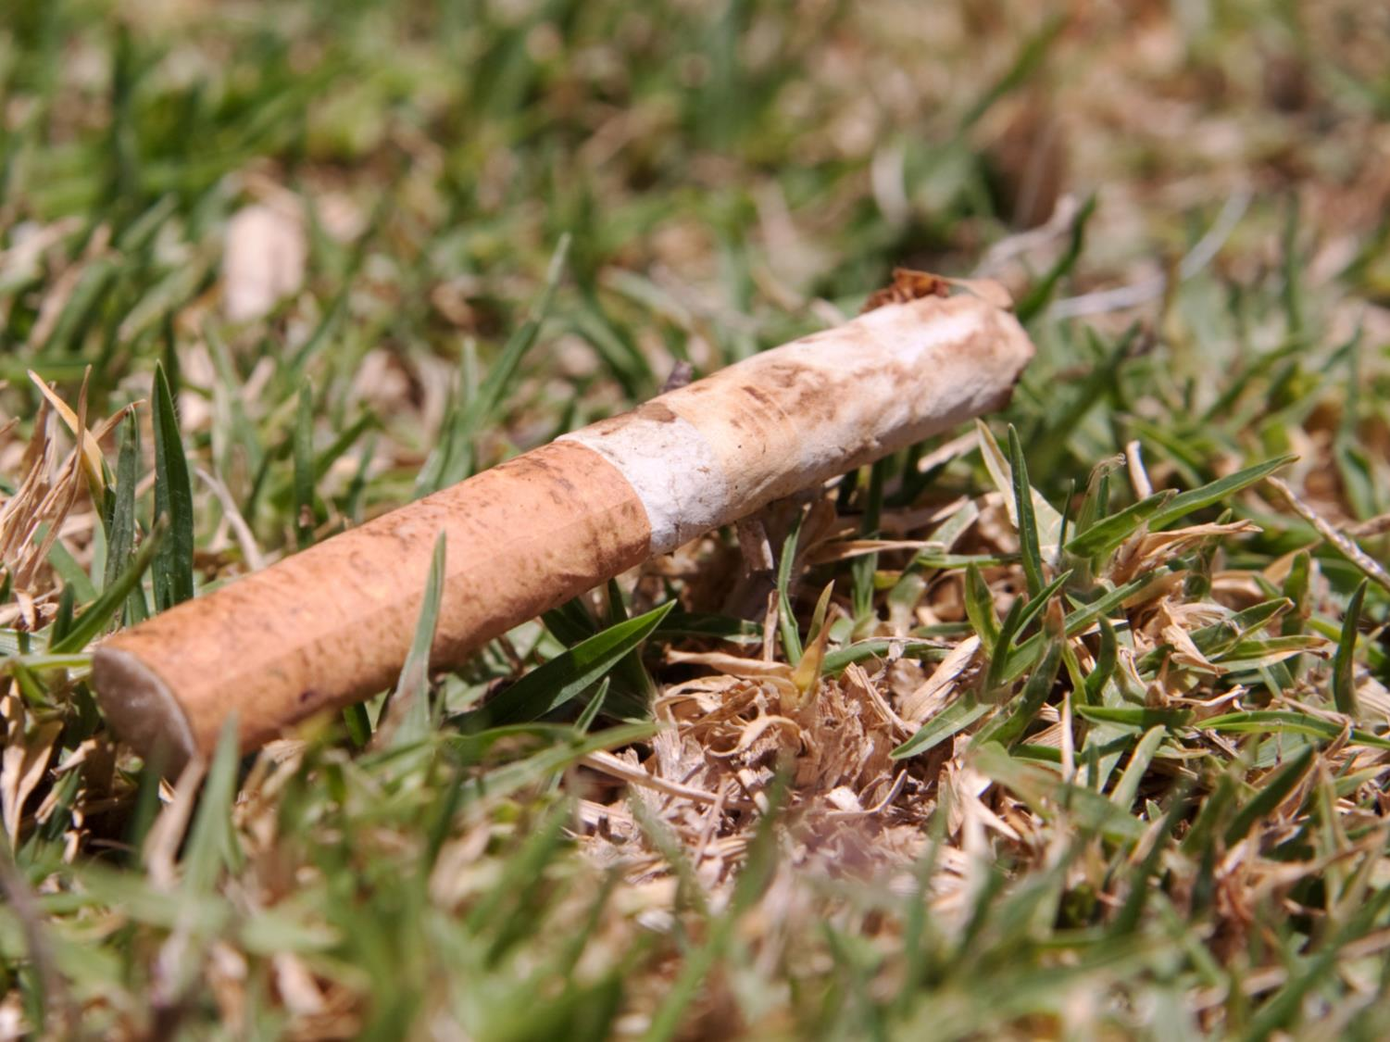
Preventing grass fires
Cigarettes
Be careful how cigarettes and matches are disposed of. They should not be thrown out of car windows or dropped on the ground. They should be fully extinguished in a safe way.
Notes:
Preventing grass fires - Cigarettes and Matches
Cigarettes and matches may be thrown away deliberately or thoughtlessly (stress that this isn’t quite the same as accidently).
Explain that cigarettes that have not been put out properly are clearly a risk - even if put in a bin. The cigarette could smoulder away for a while and if it has landed on other ‘fuel’, such as paper or dry vegetation there is potential for a fire to start. It is naturally windier on open moorland too, which can fan any flames and increase the speed of fire spread.
Recent fires in Lancashire have been caused because of smoking and matches. These have been devastating and been extremely costly in terms of money, time taken to extinguish the fire and danger to people (including the firefighters), animals and vegetation.
Encourage the learners to take care if on the moorland or on large areas of grassland. If they are with someone who smokes suggest to them that they don’t because of the fire risks. At the very least make sure that smoking materials and matches are put out properly, taken away with them (not thrown to the ground) and then disposed of safely.
Own Notes:

Slide 24
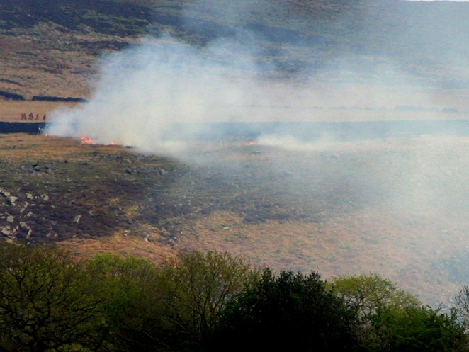
Reporting a grass fire
CALL 999
If you do see a fire when you are out in the countryside, such as on the moors, call 999 and ask for the Fire and Rescue Service immediately.
Tell the operator as much information as you can about your location and the location of the fire.
Do not try and tackle the fire yourself.
Notes:
Preventing grass fires - Calling 999
Stress that if a grass fire starts it needs to be put out as quickly as possible – refer back to the reasons for this (these have already been covered).
State that when calling 999 it is important to say what the problem is and where.
Give as accurate a location as you can. Mention local features or landmarks if possible e.g. named farms, reservoirs, picnic areas, car parks and places such as ‘Darwen Tower’.
Stay on the phone to answer questions from the operator for as long as you are asked to and give as much detail as possible.
Ask the learners to think about their mobile phones. If their phones have GPS grid reference mapping or location apps (e.g., What3Words) on them then using this and telling the emergency services the information can be a great way of helping out.
As the image indicates - such large scale fires should only be tackled by the Fire and Rescue Service due to the risks they pose.
Own Notes:

Slide 25
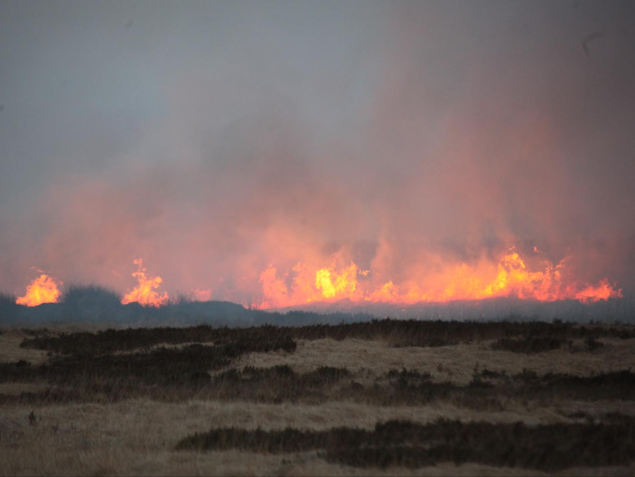
Summary
Remember:
The damage grass fires can do - to humans, wildlife and the environment
The ways a grass fire can be prevented from starting
What to do if you think a grass fire has started
Notes:
Summary
Summarise the session with reference to the objectives of the session. Click to bring up each point in turn.
The damage grass fires can do - to humans, wildlife and the environment
Refer back to what can happen when large grass and moorland fires start and who or what can be affected including people, farm animals and wildlife, birds, plants, air quality, water supply, buildings and the national Infrastructure.
Stress the environmental and economic cost, including the time and risk spent dealing with the fire.
The ways a grass fire can be prevented from starting
Refer to the Country Code and stress the importance of –
not lighting campfires, including BBQs, on open grassland
not leaving litter lying about, especially glass which can focus the Sun’s rays
being careful with smoking materials and matches
Reinforce that starting a fire deliberately is against the law and can lead to fine and/or custodial sentence, which carries a criminal record.
What to do if you think a grass fire has started
Reinforce the impact the fire can have not only on the landscape but those who live, work or visit there and what to do if they think a grassfire has started.
If appropriate, remind the learners about the current situation such as the weather/time of year (this will vary so ensure you have checked the latest information prior to the session).
Own Notes:

Slide 26
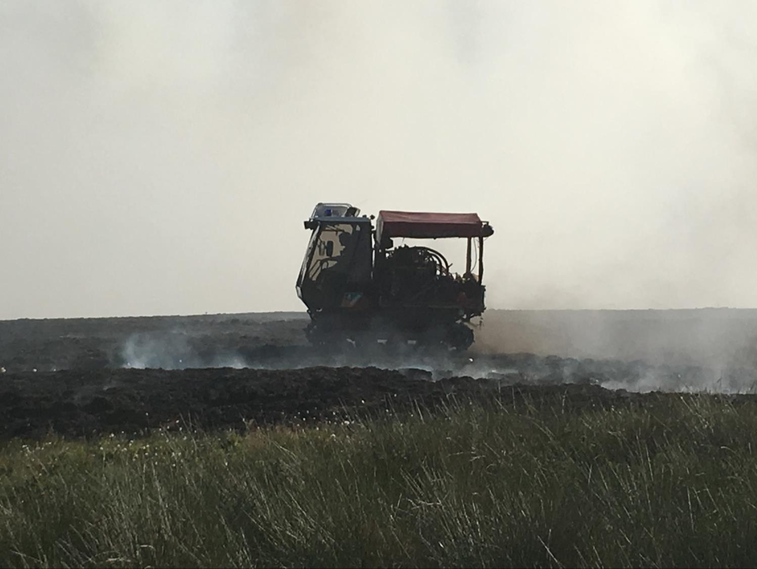
Look after Lancashire
Make the right choice –
look after yourselves, everyone else and Lancashire!
Notes:
Any questions?
Give the learners chance to ask any questions about wildfires.
Leave the slide up as the session finishes for the learners to consider.
Own Notes:

