Slide 1
Notes:
Mud and Sand Safety
Introduction
Introduce yourself and go through any housekeeping.
Explain how you want the learners to engage in the session and set ground rules.
Own Notes:

Slide 2
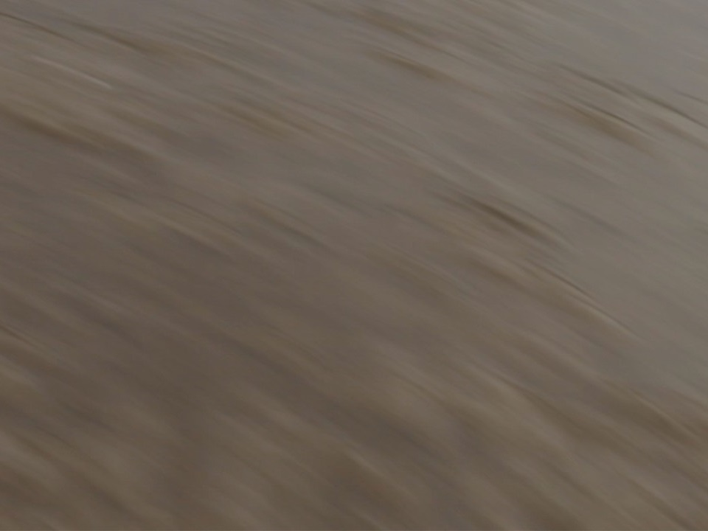
What we will talk about
By the end of today’s session you will:
Be aware of the dangers associated with mud and sand
Develop an understanding of tidal movements and how you can become cut off on the beach and even further inland on a river
Know what to do if you or someone else gets stuck
Notes:
What we will talk about (Objectives)
Read out the objectives from the slide. Do not go into too much detail as the themes will be expanded on during the presentation.
As the session develops, if appropriate, try to refer to local hazards and places where incidents may have occurred. In effect, this can be wherever you get sand, mud and water - beaches, rivers, reservoirs, lakes.
Own Notes:

Slide 3
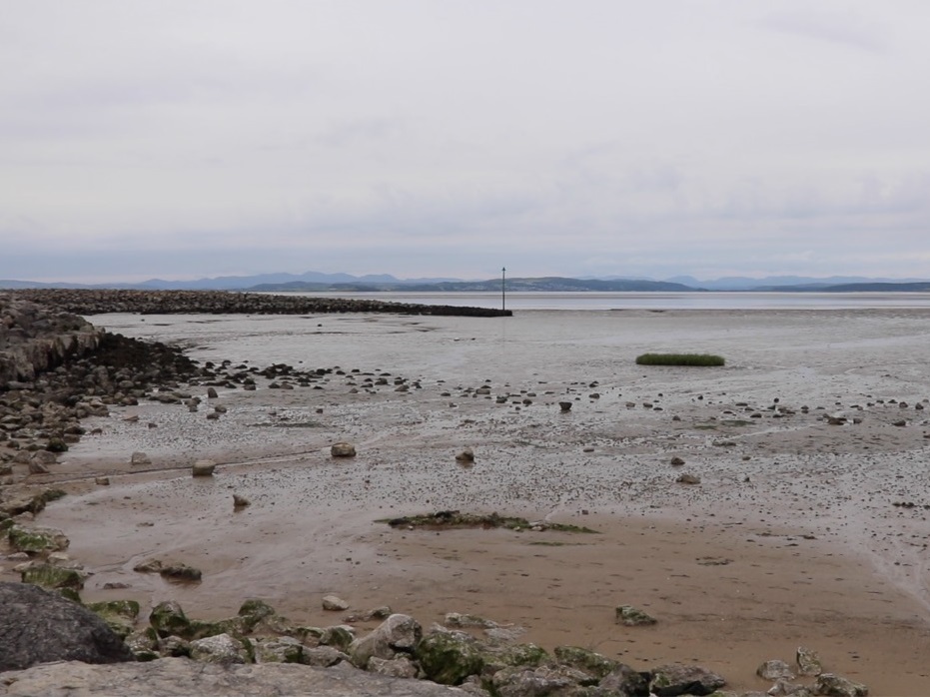
Having fun
Playing on the beach
Paddling or swimming in the sea and/or rivers
Walking and playing with dogs
Fishing
Notes:
Having fun
Refer to the fun part of playing on the beach and/or rivers.
Ask the learners to think about other activities that could be done at these places.
Expand on any examples given as appropriate.
Own Notes:

Slide 4
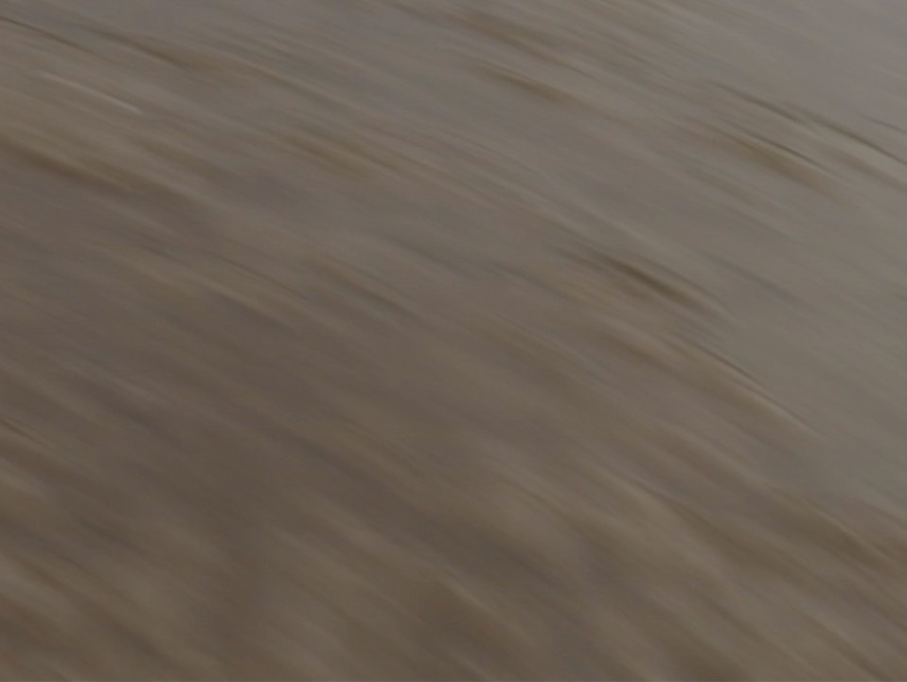
Dangers
Soft mud or sand with no noticeable differences/tell-tale signs
Areas of danger can move from tide-to-tide or day-to-day
You can get stuck a long way from shore
Tidal movement - this can easily creep up on you
If you do get stuck the more you move about the deeper you could sink
Notes:
Dangers
For each of the statements use the information below to go through the dangers, referring to local examples where possible and as sensitively as the situation demands.
Soft mud or sand with no noticeable differences/tell-tale signs
Mud and sand mixed with water can cause what is often referred to as ‘quicksand’ and it is very difficult to see danger areas. There are not always noticeable signs to tell you that the area where you are about to walk is dangerous.
Areas of danger can move from tide-to-tide or day-to-day
In a coastal bay or wherever the water is tidal, including rivers near the coast, dangers will move from tide to tide, day to day. One day you might have felt safe and the mud/sand appeared stable however this does not mean it will be the same the following day. It can become very dangerous in terms of the underfoot conditions.
You can get stuck a long way from shore
It is quite easy to lose track of time and distance when walking on the beach and you may end up a long way from the promenade or land. This makes it difficult for you to be heard if you are alone and difficult to be seen by others.
Tidal movement - this can easily creep up on you
Tides come in quickly. Due to the contours of the beach you may be stood on the sand and think you are safe, but if you are not vigilant the tidal water can move around, trapping you.
However, you do not have to be too far from shore for the mud or sand to be dangerous. Explain to the learners that some rivers are tidal a long way from the coast and that the height of the water also changes with the height of the tide. This means it is possible to be cut off on ‘islands’ that are exposed and easily reached at low tide but that quickly become surrounded and covered at high tide. These can even be found running through built up areas, such as
River Lune in Lancaster
River Ribble running through Preston
River Wyre on the Fylde coast around the Fleetwood area
If you do get stuck the more you move about the deeper you could sink
You may have been on the beach before and your feet have sunk into the wet sand. Some areas of the beach are particularly dangerous and you would begin to sink very quickly – moving around once your feet have become stuck can make the situation worse. In no time at all you could be up to your knees or waist and unable to free yourself.
Stress that it is highly unlikely you would sink completely, however the danger is that you would become stuck and the tide would come in, potentially rising up over you.
Own Notes:

Slide 5
Stuck on the beach
Notes:
“Stuck on the beach” - Film of someone getting into difficulty on a beach (4:04 mins)
Only give very brief details before starting the film e.g. The film begins by showing a girl walking on the beach using her phone.
Synopsis
The film begins by showing a girl walking on the beach using her phone. As the action progresses she becomes so distracted by the phone call she does not realise that she has walked into a dangerous area. She then stands still for a while as she continues to talk and begins to sink.
She begins to panic and though she can tell the person on the other end of the phone what is happening she is panicking so much that she cannot give or explain her exact position. Her phone then stops working and she throws it down in desperation and out of reach.
She shouts for help but at first, even though she is not that far from the shore, she is unable to attract help. Eventually, as the situation develops someone does hear and see her and they are able to raise the alarm.
The Emergency Services arrive just in time as the tide is beginning to come in. She is incredibly shaken up by the whole experience and is very lucky!
Click to start film
Own Notes:

Slide 6
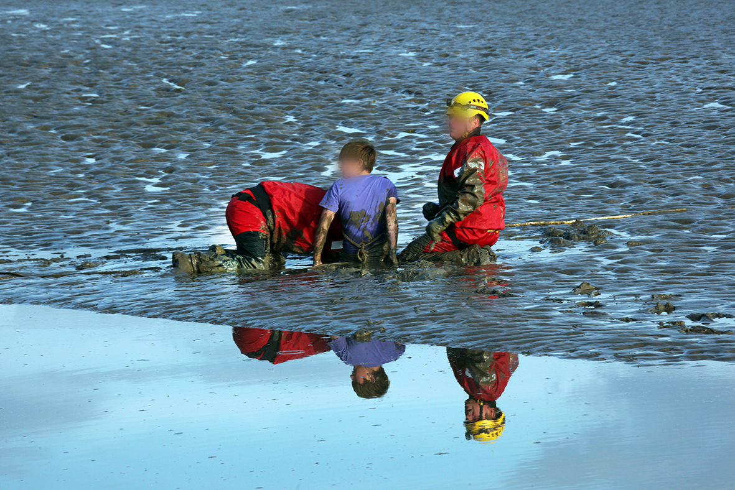
Real life incident
Notes:
Real life incident at Morecambe Bay
(Slide 1/5)
This is a real life incident that happened in Morecambe Bay. The boy had gone out onto the mud and became stuck. He had not actually gone that far out!
At the same time local crews from Bay Search and Rescue and the Fire and Rescue Service were practising mud and sand rescue techniques as part of an exercise and fortunately were on hand to rescue him. They were also being filmed for a local news programme.
Own Notes:

Slide 7
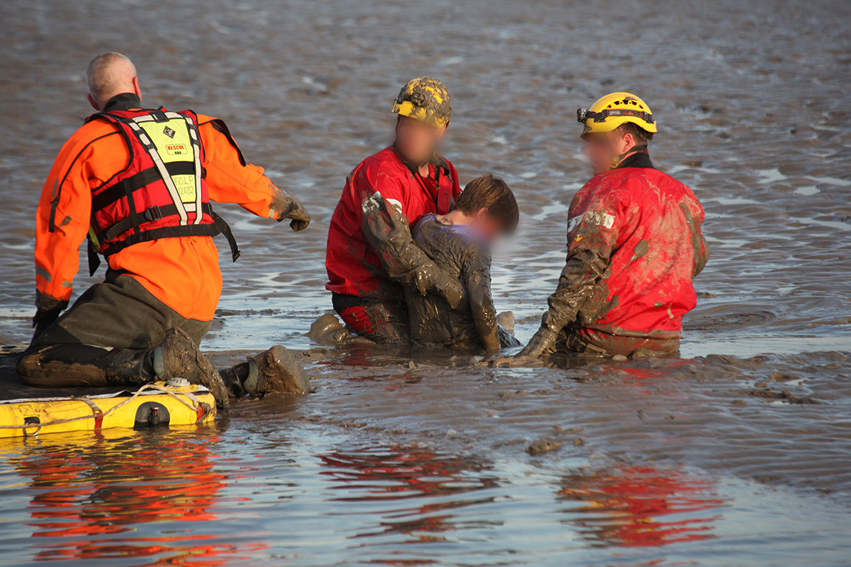
Real life incident
Notes:
Real life incident at Morecambe Bay
(Slide 2/5)
The image shows the boy looking exhausted. He is being supported by the rescuers who are kneeling down to spread their weight on the wet sand.
Although the sun is shining the boy just has normal clothes on which will have become wet, cold and heavy. He may be developing hypothermia.
Own Notes:

Slide 8
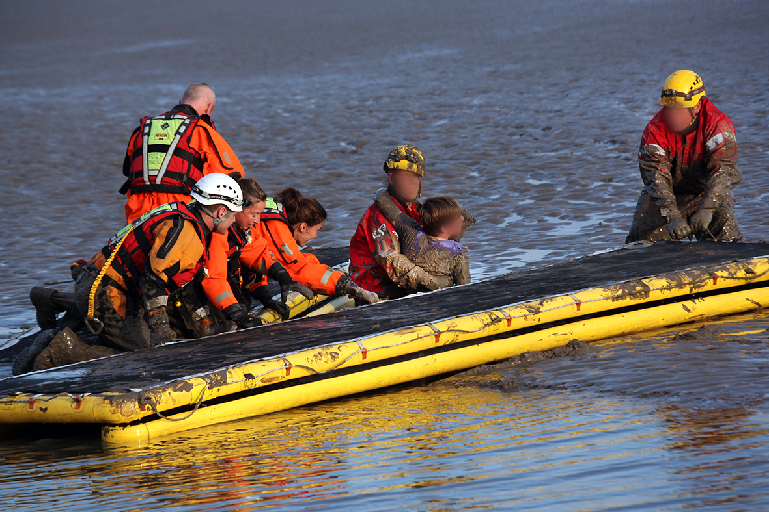
Real life incident
Notes:
Real life incident at Morecambe Bay
(Slide 3/5)
For anyone stuck it will take many trained personnel with specialist equipment to be able to attempt a rescue. It also puts them at risk.
Own Notes:

Slide 9
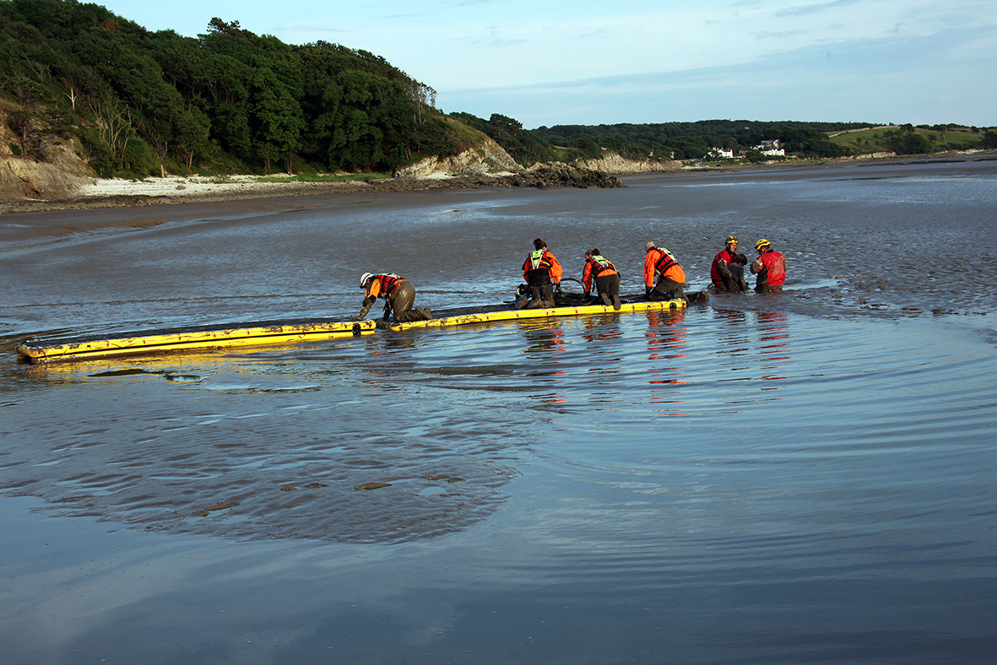
Real life incident
Notes:
Real life incident at Morecambe Bay
(Slide 4/5)
If you look closely you can see the water is in the shape of a horse shoe because of the tides and currents. This has the potential to make the situation a whole lot worse and reduces the amount of time available for rescue.
The image also shows that even though the boy hadn’t gone too far out he had got himself into serious difficulties.
Own Notes:

Slide 10
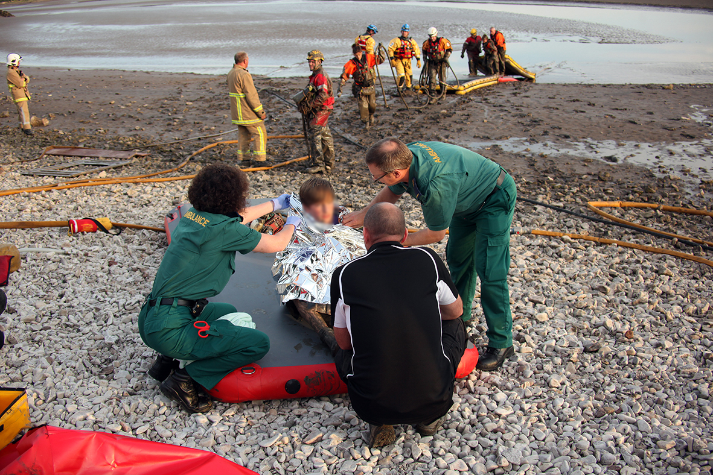
Real life incident
Notes:
Real life incident at Morecambe Bay
(Slide 5/5)
This boy was very lucky to have the Emergency Services close by. If this had not been the case, it could have ended very sadly.
Stress to the learners not to let it be them!
Own Notes:

Slide 11
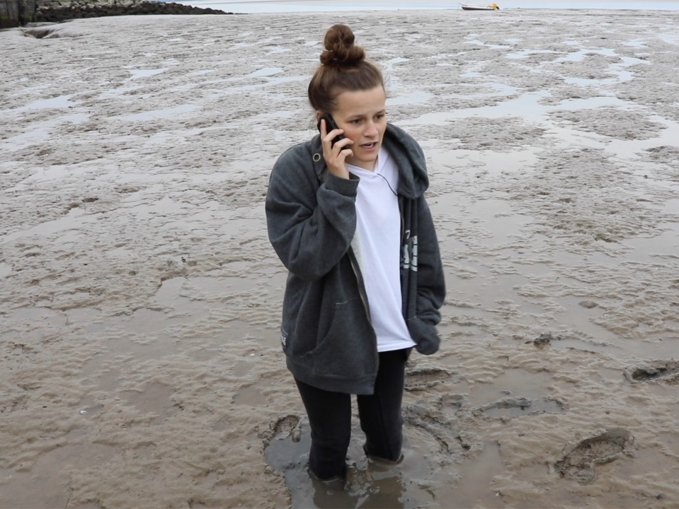
What NOT TO DO if you get stuck?
It will be frightening - but try not to panic
Panicking and wriggling about can make the situation worse and you could end up sinking quicker and deeper
Notes:
What NOT TO DO if you get stuck?
Getting stuck in mud or sand is likely to be one of the most frightening things that could ever happen to you.
The golden rule is - not to panic. Panicking and wriggling about can make the situation worse and you could end up sinking quicker and deeper.
Own Notes:

Slide 12
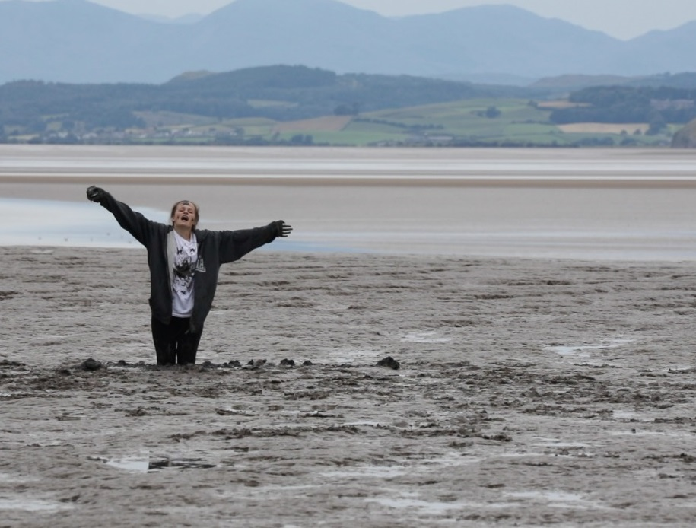
What TO DO if you get stuck?
Try to retrace your steps
If you do become stuck - stop wriggling
Shout for help and call 999 and ask for the Coastguard
Give as much detail as you can about your location and situation
If sinking further and have raised the alarm -
Kneel down to spread the weight on your shins
Sit down
Lie down on your back
Notes:
What TO DO if you get stuck?
As soon as you feel you might be starting to sink try to walk backwards to retrace your steps - the sand/mud should be firm enough for you to walk back to safety.
If you do become stuck - stop wriggling
Shout for help and call 999 if you can – ask for the Coastguard and give as much detail as you can about your location and situation
Make yourself visible - wave your arms about
If sinking further and waiting for help to arrive -
Kneel down to spread the weight on your shins
If that fails, sit down
If that fails, lie down as flat as you can on your back - this will help spread your weight as you are almost in a ‘floating position’
If the Emergency Services have been called and in the meantime you become free and make your way back to safety, wait for them in a safe and visible location to confirm you were the one in trouble and enable them to ‘stand down’ and be available for other emergencies.
Own Notes:

Slide 13
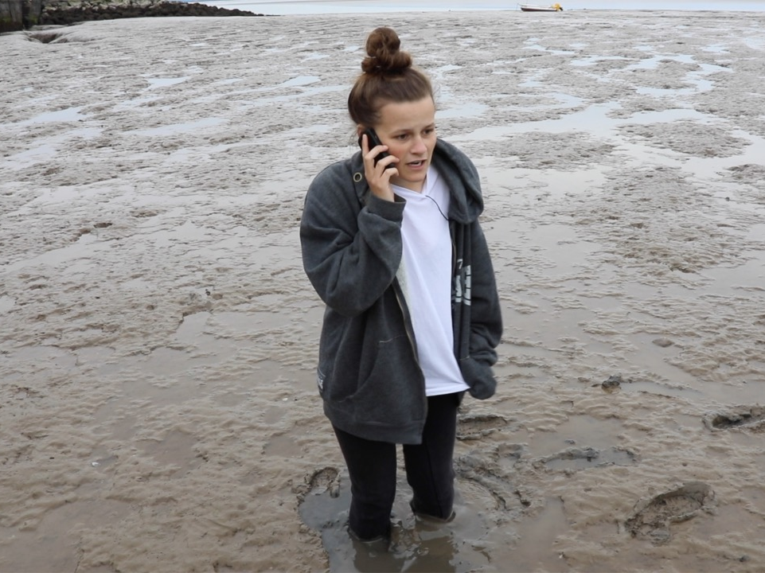
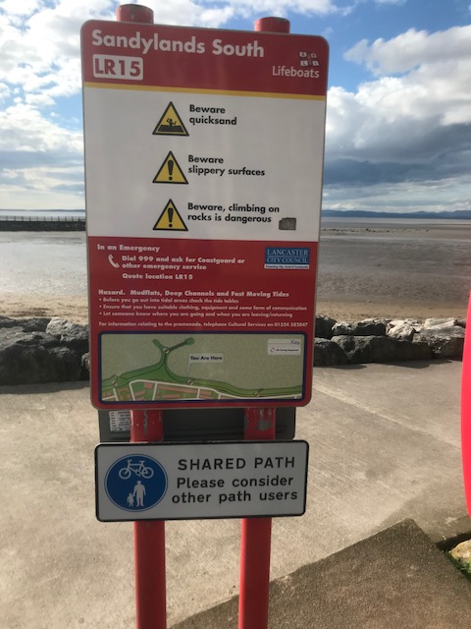
Calling for help
Most of us have a mobile, so call 999 and ask for the Coastguard
Give as much detail as you can about your location and situation - if you are on the coast look out for location reference points
Notes:
Calling for help
Ensure the learners know what number to call 999 if they, or someone else, gets into difficulty. Stress that they should ask for the Coastguard and give as much information about the location and problem as they can.
One of the pictures shows a “Location Reference Point”, which can be found along the coast. They have a code that can be given to the call handler to identify the exact location – this one is LR15. Giving this will help the Emergency Services get to the scene of the incident as soon as possible.
Own Notes:

Slide 14
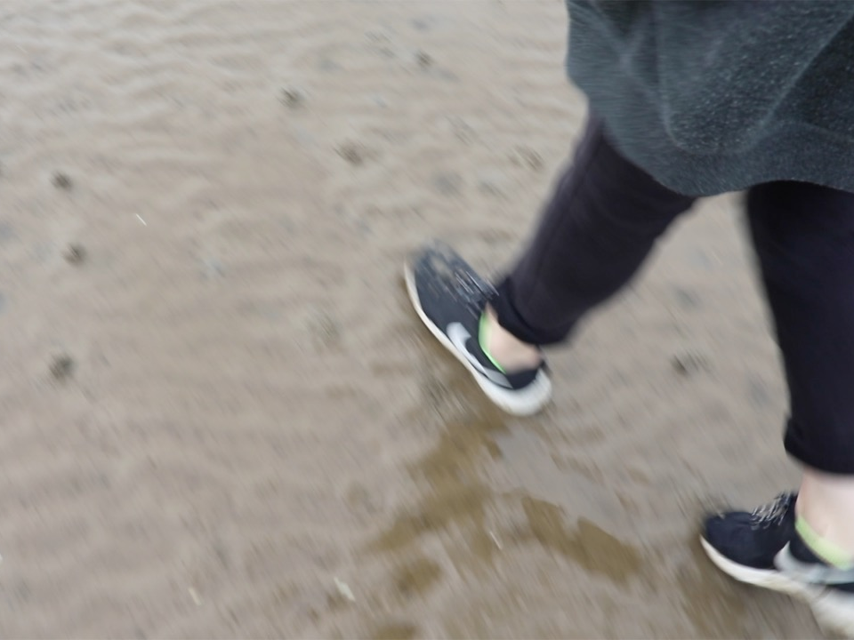
Think are you safe? If something was to go wrong could you get help? If the answer to this is NO then get yourself back to safer ground
Think safety!
Notes:
Think safety!
Stress the following points -
Think are you safe? If something was to go wrong could you get help? If the answer to this is NO then get yourself back to safer ground.
Own Notes:

Slide 15
Summary
Remember:
Be aware of the dangers associated with mud and sand
Tidal areas are very dangerous, both coastal and rivers - you can easily get into difficulty
What to do if you or someone else gets stuck
If in any doubt - keep away!
Notes:
Summary
Summarise the session with reference to the objectives of the session. Click to bring up each point in turn.
Be aware of the dangers associated with mud and sand
Mud and sand mixed with water can cause what is often referred to as ‘quicksand’ and it is very difficult to see danger areas. There are not always noticeable signs to tell you that the area you are about to walk in is dangerous.
Tidal areas are very dangerous and you can easily get into difficulty
Make sure the learners have an understanding of the dangers of tidal movements and how easy it is to become cut off, both on the beach and in the tidal areas of rivers. The lower parts of rivers (near the coast) are tidal, even inland near towns and cities.
In Morecambe Bay, for example, the tide comes in at speed and the water may come in from behind without you being aware, which has the potential to cut you off. Areas of the Bay, which may have been safe the day before, could change significantly during each tidal movement and become very dangerous in terms of the underfoot conditions.
Stress the importance of knowing the types of places where incidents may occur – wherever you get sand, mud and water, such as beaches, rivers, reservoirs and lakes. Try to ensure the learners are aware of local dangers.
What to do if you or someone else gets stuck
Go through what not to do and what to do.
As soon as you feel you might be starting to sink try to walk backwards to retrace your steps
If you do become stuck - don’t panic and stop wriggling
Shout for help and call 999 if you can - give as much detail as you can about your location and situation
Make yourself visible - wave your arms about
If sinking further and waiting for help to arrive -
Kneel down to spread the weight on your shins
If that fails, sit down
If that fails, lie as flat as you can on your back - this will help spread your weight as you are almost in a ‘floating position’
If in any doubt - keep away!
Own Notes:

Slide 16
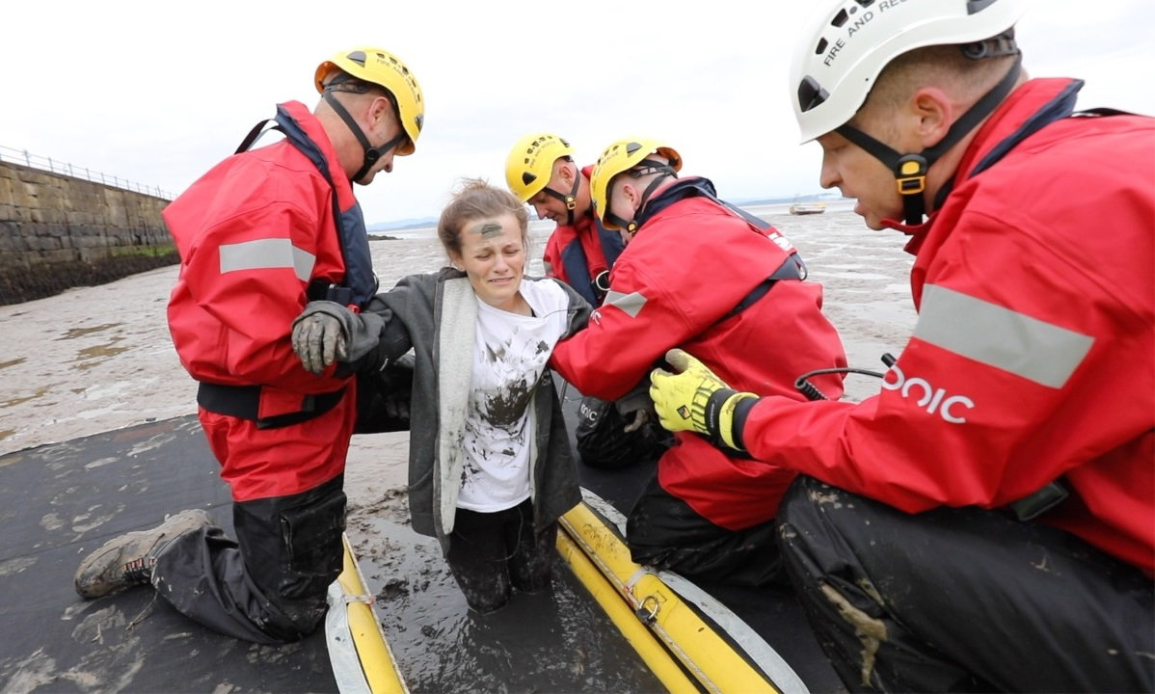
Any questions?
Make the right choice – look after yourselves and everyone else!
Notes:
Any questions?
Follow up any appropriate questions/comments in a sensitive way.
There may be examples of experiences the learners have had or have heard about - it may have been them who became stuck or they may have been involved in getting help.
If this happens try to avoid referring to names and do not dwell on something that could become particularly upsetting.
Own Notes:

