Slide 34
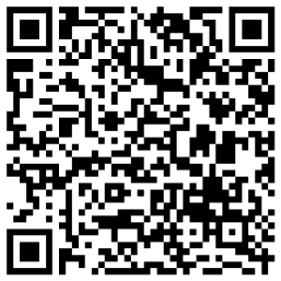
Feedback
A year 6 education package that looks into staying safe whether walking to school, travelling in a car or riding a bicycle. The introduction to this package includes a brief fire safety in the home refresher on the topics covered during the year 2 ChildSafe sessions.
Please provide feedback of this education package by scanning the QR code.

