Slide 1
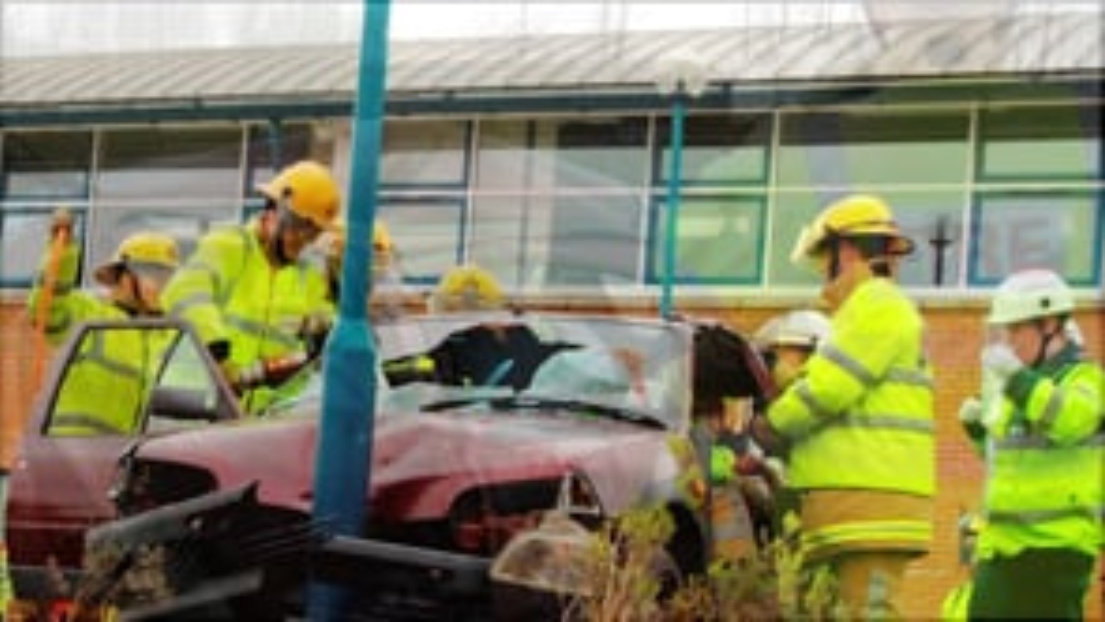

Slide 2


Slide 3


Slide 4
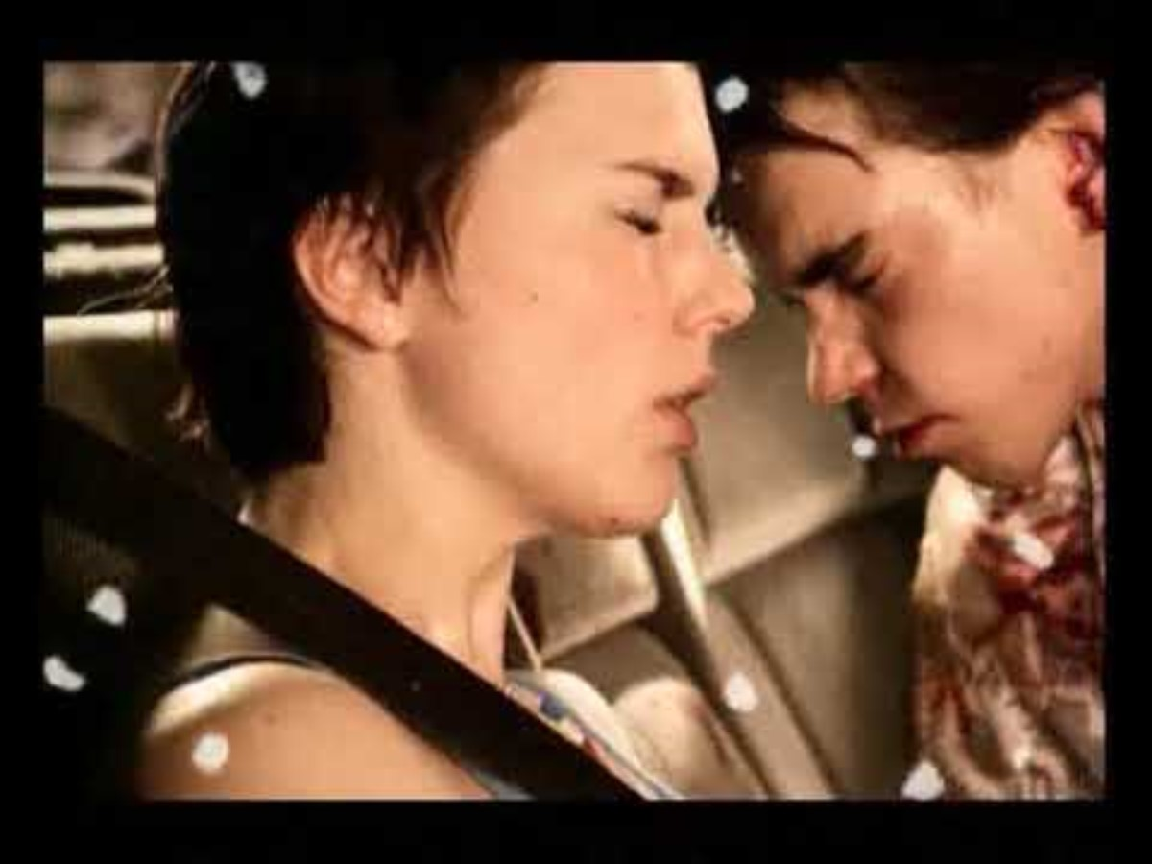

Slide 5
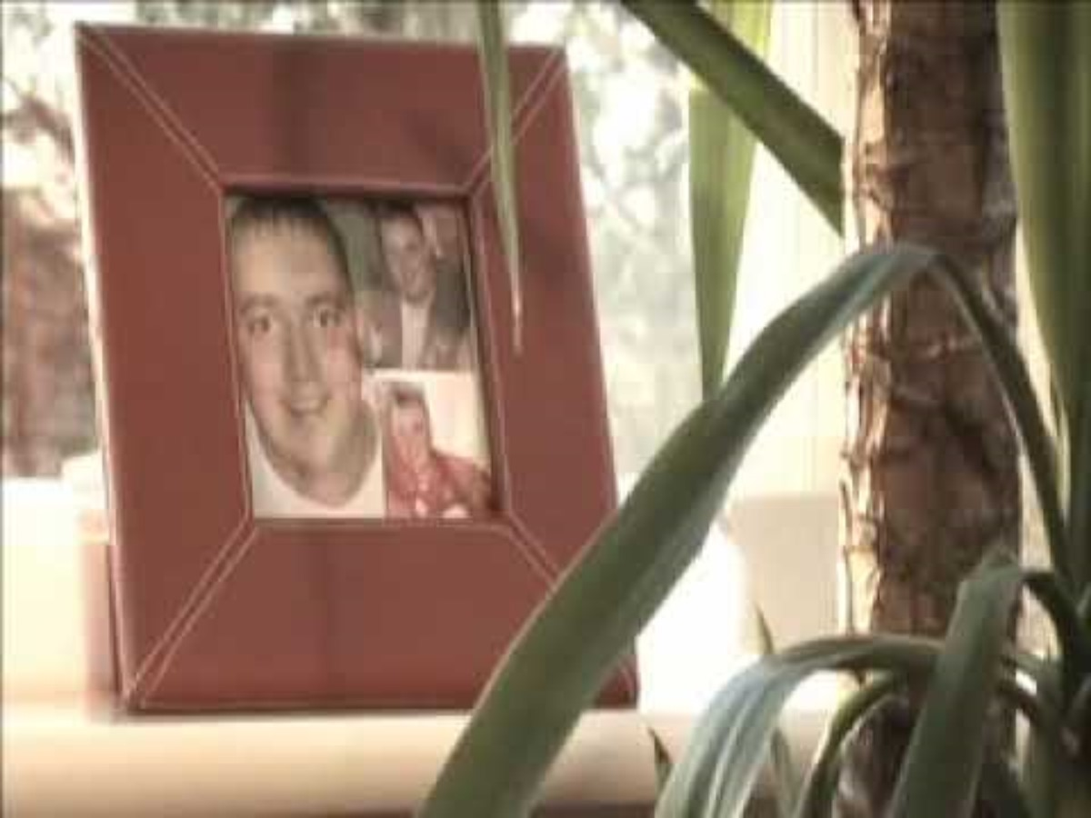

Slide 6


Slide 7
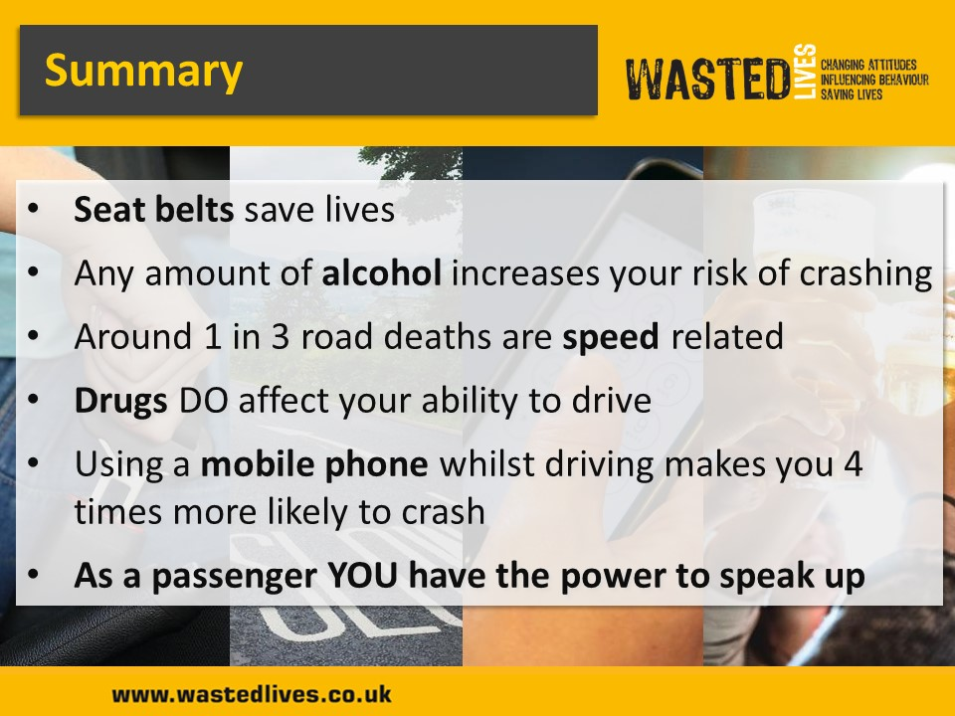

Slide 8


Slide 9
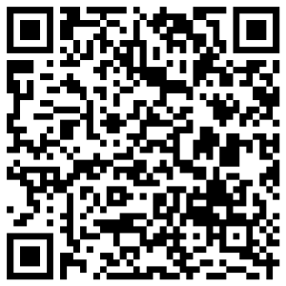
Evaluation
Please provide feedback of this education package by scanning the QR code.

