Slide 1
Water Safety
The situation
Nationally and in Lancashire
July 2023

Slide 2
World Drowning Prevention Day 25 July 2023 (Tues)
What is WDP Day?
WDP Day is a World Health Organisation (WHO) initiative (annually on 25 July)
Adopted by RoSPA, RNLI, RLSS and National Water Safety Forum and supported by Fire & Rescue Services and partners
Why is there a WDP Day?
To raise awareness of Water Safety and the risks associated with being in or near water
It is estimated that on average 236,000 people lose their lives worldwide each year due to drowning, making it the third leading cause of unintentional injury death worldwide. In the UK, there are around 600 water-related fatalities each year.
What is happening in Lancashire?
Organisations with an interest in Water Safety will be promoting the concept that “anyone can drown, no one should”. This will be done via education in-person and through the media and by engaging with the public at risk sites giving safety advice.
We want local landmarks to be lit blue wherever possible to raise awareness of Water Safety. Last year Blackpool Tower went blue, as did other buildings in Lancashire and across the world.

Slide 3
The National Water Safety Situation
Nationally (From 2022 Water Accident Database (WAID) - complied by the National Water Safety Forum)
There were 226 deaths in the UK from accidental fatalities in 2022. Total water-related fatalities - 597,
Of the 226 fatalities, 151 were in England; 45 in Scotland; 22 in Wales; and 8 in Northern Ireland.
Males still make up the majority of the incidents (83 per cent) with those aged 20-29 and 50-59 the highest groups for accidental fatalities.
60% of accidental fatalities happened around inland locations, such as rivers, lakes, reservoirs and quarries.
30% were at the coast/shore/beach. 10% were at other locations (docks, harbours, swimming pools etc).
Recreational activities accounted for 58% of accidental fatalities.
Around 37% of these people were taking part in everyday activities near water such as walking, running, cycling and fishing. This is usually due to tripping, falling or just underestimating the risks associated with being near water.

Slide 4
The National Water Safety Situation
Nationally (From 2022 Water Accident Database (WAID) - complied by the National Water Safety Forum)
There were 226 deaths in the UK from accidental fatalities in 2022. This is a reduction of 51 from the previous year (277). This figure forms part of the total water-related fatalities in the UK – which for 2022 was 597, a decrease of 19 from the previous year.
Of the 226 fatalities, 151 were in England; 45 in Scotland; 22 in Wales; and 8 in Northern Ireland.
Males still make up the majority of the incidents (83 per cent) with those aged 20-29 and 50-59 the highest groups for accidental fatalities.
60% of accidental fatalities happened around inland locations, such as rivers, lakes, reservoirs and quarries.
30% were at the coast/shore/beach.
10% were at other locations (docks, harbours, swimming pools etc).

Slide 5
The National Water Safety Situation
Nationally (From 2022 Water Accident Database (WAID) - complied by the National Water Safety Forum)
Recreational activities accounted for 58% of accidental fatalities.
Around 37% of these people were taking part in everyday activities near water such as walking, running, cycling and fishing. This is usually due to tripping, falling or just underestimating the risks associated with being near water.
This may indicate why middle-aged people are just as likely to lose their lives as younger people undertaking more risky behaviours.
July, June and August recorded the most deaths from accidental drowning (105/226). However, the autumn and winter months remain high too (particularly Dec - Feb), perhaps due to less daylight and slippery underfoot conditions. This suggests it is a year-round issue.
Saturdays and Sundays record the highest number of deaths though Mondays (Bank Holidays?) and Fridays are high too.
26% of accidental drownings in 2022 involved drink and/or drugs (2021 = 25%).
In 2022, there were 212 suicide suspected fatalities at or near water in the UK. This is an increase from last year (195) and above the three-year average baseline (200). 36% of all fatalities were suicide suspected (2021 = 32%)

Slide 6
The Lancashire Situation – Fatalities
2022 Water Accident Database (WAID) - complied by the National Water Safety Forum
(these figures differ from LFRS ones as they include coastal ones which LFRS don’t necessarily attend)
There were 5 deaths recorded as Accidental or Natural Causes. (2021 = 8)
This places Lancs in the top half of the table at = 11th (2021 = 7th)
Devon (12) followed by Greater London (10) and West Midlands (10) had the highest fatality numbers.
Lancashire Fire and Rescue Service (incidents attended by LFRS – there will be some overlap with WAID figures)
2017-2022 – 14 fatalities – all male (2022 – 4)
District – spread across but BwD highest with 4, then Preston and South Ribble both 2
Water Type – River/canal – 7 Lake/pond/reservoir – 5, Other (inc. quarries) – 2
Age band – spread across ages therefore general problem
2023 to date – 6 already (5 male, 1 female). All inland, Various ages

Slide 7
LFRS Incidents (2018 – to date)
Water incidents from the past 5 years (01/01/2018 – to date)
(incidents attended by LFRS – there will be some overlap with WAID figures)
All incidents - 177
These were
Fatalities - 20 incidents (11%)
Rescues with injury - 66 incidents (37%)
Rescues without injury - 63 incidents (36%)
Incidents where LFRS assistance was not required on arrival but still may be considered a near miss - 28 incidents (16%)
Incidents per District
Lancaster - 51 (29%) – 35% of these in one ward (Skerton East)
Preston - 22 (12%) BwD – 18 (10%)
Burnley - 16 (9%) South Ribble – 14 (8%)
Other Districts – 10 incidents or less
At least 28% of incidents female – high considering only 1/20 fatalities were female (5%)

Slide 8
National Messaging
Taken from:
National Fire Chief’s Council (NFCC) national campaign document
Even on a warm day the temperature in open water can remain very cold, causing cold water shock, a physical reaction which can make it difficult to control breathing, cause panic and make it difficult to swim. Gasping can occur leading to possible inhalation of water.
Anyone finding themselves in difficulty in the water are urged not to panic and ‘Float To Live’. This means leaning back in the water and spreading your arms and legs to stay afloat, control your breathing, when the effects of cold water shock have passed call out for help or swim to safety.
If someone is in trouble in water, call 999. At the coast ask for the coastguard. If you are inland, ask for the fire service. It’s important people call for help rather than entering the water to attempt a rescue as this can often result in emergency services needing to find and rescue more people from the water.

Slide 9
Target Audiences - What can we do?
The target audience relates to both age groups and activities and can be explained through key themes:
In an emergency - Who to call and what to do
Activities in water
Activities near water
Away from home
Flooding

Slide 10
In an emergency - who to call and what to do
If you find yourself or someone else unexpectedly in the water - Float to Live
This is agreed national messaging and is suitable for inland and coastal waters
Call 999
Tell them to try not to panic, float on their back and calm down
Throw something to help them float
When calling 999 know who to ask for - the public can be unsure which service to ask for to respond to a water incident.
Ask for coastguard when at the beach/coast and the FRS for inland incidents

Slide 11
Activities in water
Involves both innocent/legal recreational activities and unorganised more risky behaviours, such as swimming and tombstoning in unsupervised and often remote locations, more commonly done by younger people.
Water activities should not be discouraged but rather people must be encouraged to do it in the safest way possible - which the majority do and many of these are our potential local water safety advocates.
Recreational Water Users e.g. open water swimming, paddleboarders, use of inflatables, kayaks.
Do it safely – in ‘safe’ waters, in an organised group or with someone else
Families at home e.g. in paddling pools, baths, near ponds.
Don’t leave young children unsupervised – even around 50% of children who drown have some swimming ability.
Young people (particularly males aged 14 - 25) – particularly entering and attempting to swim in ‘unsupervised’ open water such as at reservoirs, quarries, rivers and canals. In 2022 males accounted for 83% of ‘accidental and natural cause outcome’ deaths. 26% of deaths had a ‘reported presence of alcohol and/or drugs’.
Be aware of the risks; temperature (Cold Water Shock), depth and underwater hazards (tombstoning, currents) and the knock-on effects to family, friends and the emergency services

Slide 12
Activities near water
Involves innocent/legal recreational activities and includes people who are undertaking activities near water but have no intention of entering the water (around 40% of accidental drownings).
60% of accidental drownings - inland waters. 30% - coastal waters. 10% - other
Runners, walkers (inc. with dogs) and anglers – this group has the highest incidents of accidental drowning year on year in the UK. In 2022 this group accounted for around 40% of people who accidentally drowned.
Let someone know where you are going. Avoid water edges, especially when slippery underfoot - after high or recent rainfall and when icy.
People on a night out – 26% of people who accidentally drowned in 2021 had alcohol and/or drugs in their system. Generally, it is males and younger age groups who may have alcohol and/or drugs in their system.
Routes away from water and sticking with friends will be safer. Relevant locations to consider in Lancashire link to student areas such as Lancaster University, Edge Hill University, UCLan and 6th Form Colleges across the county.

Slide 13
Away from home
Many UK nationals lose their lives in drownings abroad. Lack of local knowledge combined with a relaxed holiday outlook can increase the risk of a drowning incident for those visiting areas near water.
Lancashire residents away from home – The risk of drowning can increase when people are less familiar with the area. Spain has high incidence of tourists drowning so people are encouraged to take water safe information and behaviour with them. Young males are particularly susceptible at the coast whilst younger children are more likely to lose their lives at hotel and villa swimming pools, which are often unsupervised.
People coming to Lancashire both day-trippers (e.g. to Blackpool) and those on longer breaks.
Consider taking relevant inland/coastal messages and produce flyer for holiday lets/caravan parks.

Slide 14
Flooding
Driving through flood water is the number one cause of death during flooding
Turn around and take a different route
If a road is flooded, do not drive through the water
You don’t know the depth, can’t see any debris under the surface, and don’t know how quickly the water is rising.
If your vehicle is trapped by flood water but the wheels are still on the ground, and you can make your way to safety, you should do so immediately
If you cannot safety leave your vehicle, call 999 and ask for the fire service.
Riverbanks and towpaths can be eroded or unstable after floods
Pathways may no longer be safe and can put you at risk of falling in. If in doubt, take a different route.

Slide 15
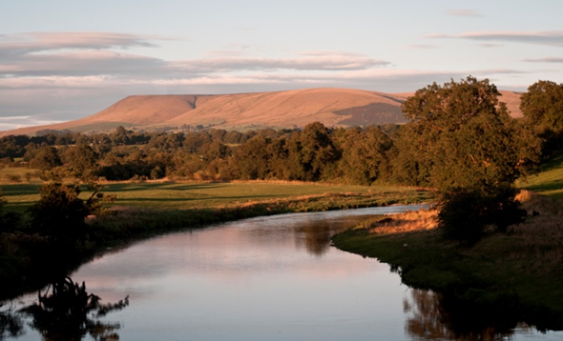
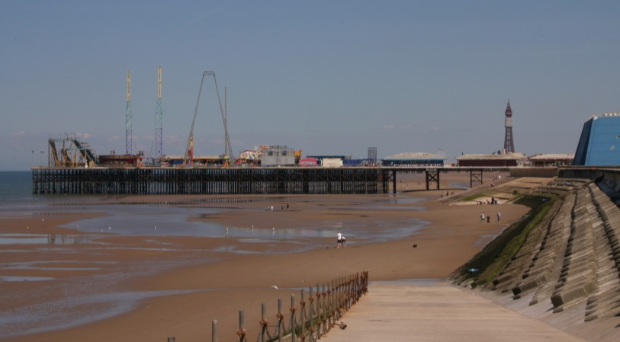
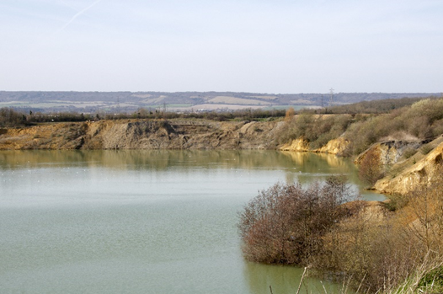
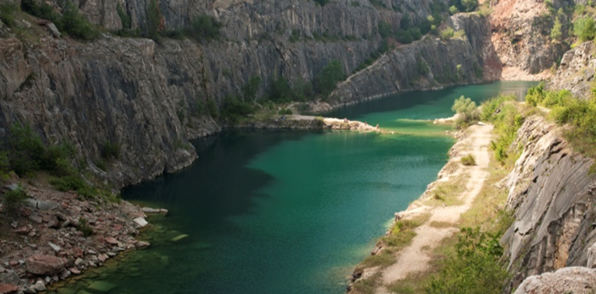
Depth of the water
Cold water
Risk of getting trapped
Difficulty getting out
Hidden currents and strong tides
Rubbish under the waterline
Polluted water
Remote locations
Notes:
‘Open water’ – what is it and what are the dangers?
The open water images and dangers will appear. The images are of –
river
sea
reservoir
Disused/flooded quarry
Canals can also be included here, especially with the dangers of difficulty getting out and rubbish/vegetation under the water line
Help the learners realise that there is quite a lot of overlap between the types of ‘open water’ and the dangers. Reinforce the following:
Depth of the water
It can be very difficult to judge the depth of the water even when the water is clear. The sand/soil (water bed) level under the water may also suddenly drop away.
Cold water (Cold water shock)
The water is likely much colder than you think. As you enter the water you will have an initial deep and sudden gasp followed by hyperventilation that can be as much as 600 - 1000% greater than normal breathing. You must keep your airway clear or run the risk of drowning.
If you fall into cold water unexpectedly, your instinct is to try and swim - fight the water. This will tire you quickly. Cold water shock can also make you panic, gasp, breath in water and you are more likely to drown. If you float the initial effects of cold water shock can pass and you will regain control of your breathing. The best way to do this is to float on your back:
1. Fight your instinct to thrash around.
2. Lean back, extend your arms and legs.
3. If you need to, gently move them around to help you float.
4. Float until you can control your breathing.
5. Only then, call for help, swim to safety or continue floating until help arrives.
Risk of getting trapped/entanglement
Foot and hand entrapments from natural materials, such as weeds and reeds, can occur resulting in a person getting into difficulty and even drowning.
Difficulty getting out
It can be very difficult to get out of the water because of high vertical sides, muddy banks, steep slippery banks, trees and undergrowth.
Hidden currents and strong or unpredictable tides
Coastal water is tidal which can change and move very quickly.
In a coastal bay or wherever the water is tidal, including rivers near the coast, dangers will move from tide-to-tide, day-to-day. One day you might have felt safe and the mud/sand appeared stable, however this does not mean it will be the same the following day. The tide can change quickly and it can become very dangerous in terms of the underfoot conditions. Powerful hidden currents may also run unseen below the surface.
Some of the rivers in Lancashire are tidal and these can also have powerful hidden currents that run unseen below the surface.
Rubbish on or under the water
Fly-tippers, vandals and adverse weather conditions mean that quantities of rubbish, trees, shopping trolleys etc. end up in our water courses including ponds, lakes and canals. As well as landing on something or getting caught up in it when the water is moving, meaning getting out is made more difficult, this rubbish/debris can cause severe injury to a person should they hit it in the water.
Polluted water
There may be different types of pollution in the water. These can include water-borne diseases and bacteria from both human and wildlife. There may also be chemicals in the water.
If appropriate you may refer to the potential illnesses. These include:
Trachoma - an eye infection that turns your eyelashes inside-out and could lead to blindness.
Cryptosporidium (pronounced sip-to-sper-idium) - a parasite that causes severe stomach cramps and diarrhea.
Whipworm - worm eggs which hatch inside the body after being swallowed.
Weil’s disease - an organ damaging disease caused by swallowing animal urine (particularly rats).
Remote locations – no lifeguards or help close at hand
If a person gets into difficulty then unless the area is patrolled by lifeguards or people are out and about the likelihood of them being rescued may be slim and anyone entering the water to rescue them has the potential to become a drowning statistic too. If the location is remote this will have its own problems with access and time for help to arrive. Mobile phone signals could be weak or non-existent.
In addition to the dangers on the slide depending on the audience the following could be mentioned:
Mud and ‘quicksand’
Mud and sand mixed with water can cause what is often referred to as ‘quicksand’ and it is very difficult to see danger areas. There are not always noticeable signs to tell you that the area where you are is dangerous. Some areas of the beach are particularly dangerous and you could start to ‘sink’ very quickly – moving around once your feet have become stuck can make the situation worse. In no time at all you could be up to your knees or waist and unable to free yourself.
Stress that it is highly unlikely you would sink completely, however the danger is that you would become stuck and the tide would come in, potentially rising up over you.
You may wish to stress particular aspects according the circumstances and location of where the session is taking place.

Slide 16
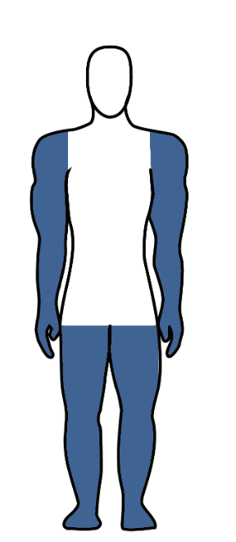
Short Term
Medium Term
Longer Term
Panic
Struggle to breath
Heart rate rises rapidly
Arms and legs will cool quickly
Leads to a loss of strength
Body becomes so cold you can’t control it
Become disorientated and fall unconscious
Notes:
Effects of Cold Water Shock
Go through the effects of entering cold water, Stress that the timings will vary slightly from person to person but they are a good guide.
Short Term (first 5 mins)
Panic and Hyperventilation
On entering the water it is likely to be much colder than the air temperature. You may gasp for air which may increase the chance of inhaling water into your lungs.
If you need to swim, lie on your back and try to float – spread your legs and arms out and, if you need to, gently move them to help float. Try not to use your legs to swim as the large muscles require lots of blood to function, this will draw the blood away from the core part of the body making it cool faster which will increase the chance of hypothermia.
Possible heart related problems - heart rate rises and blood tries to pumps faster.
Your heart rate will rise drastically reducing its efficiency, which this may lead to heart failure.
Medium Term (from around 5 mins to around 30 mins)
Arms and legs start cooling rapidly
The body will start to reduce the blood flow to the extremities and direct it to the core area to protect the vital organs.
Loss of strength and endurance
Over approximately the next 10 minutes you will lose the effective use of your fingers, arms and legs for any meaningful movement.
Longer Term (30 mins +)
Core body temperature drops below 35°c (Hypothermia)
It will be very difficult to try and stay afloat due to having very little energy in the muscles to move adequately.
Disorientation and confusion
Normal decision making will be greatly reduced and rational thought will be difficult.
Fall unconscious
With reduced energy the body will naturally fall unconscious to try and save what energy it has left - this is likely to lead to drowning.

Slide 17
Cooling or ‘Afterdrop’
Body temperature can drop rapidly after leaving the water
This is called ‘afterdrop’ and can be very harmful
After leaving the water, warm yourself gradually
Get dressed quickly, including a hat and gloves if possible
Have a warm drink and eat some food
Notes:
Cooling or ‘Afterdrop’
Explain to the learners that “Afterdrop” is common after swimming in cold water - you get out and feel fine, and then you start to get colder, sometimes growing faint, shivering violently and feeling unwell.
Afterdrop is the phenomenon of your body temperature continuing to drop even after you get out of cold water and into a warmer environment – so that you feel colder 10 to 40 minutes after you exit than you did in the water.
When you swim, your body shuts down circulation to your skin, pooling warm blood in your core. This process helps you stay in the water longer: with reduced circulation to your peripheries skin and sub-cutaneous fat is turned into a thermal layer, similar to a natural wetsuit – hence the wild swimmers’ term bioprene for fat.
But when you exit the water, the cooling process does not stop straight away. Even dry on the banks, this cold layer of skin and muscle continues to cool your core. You can lose up to 4.5°C from your core temperature (according to Golden and Tipton, Essentials of Sea Survival), bringing on shivering, hypothermia, or feeling faint and unwell.
Tips to warm up after you get out of cold water:
Get dressed as soon as you can - put on lots of layers, including a hat and gloves.
Have a warm drink from a flask you brought with you.
Sip the warm drink: this helps warm the body gently from the inside.
Eat something: sugar will help raise body temperature so it’s an excuse to have some chocolate, biscuits or even a cake!

Slide 18
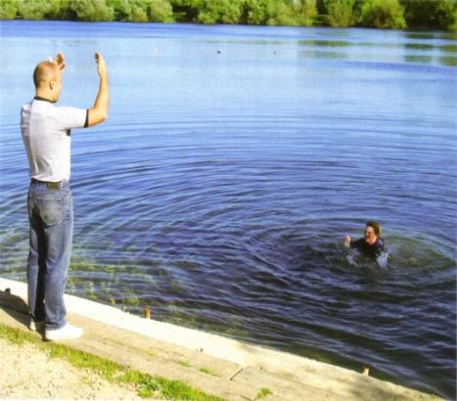
Need help? - What you should do
If you see someone struggling in the water:
Do not enter the water to rescue them.
Shout for help – and shout/signal to them, so that they know you are there.
Call for help on 999 and give your location.
Tell the person to try and stay calm and float on their back.
Try to encourage them to a point of safety.
Notes:
Need help? – What you should do
Go through what to do if someone is struggling in the water and needs help.
Importantly –
Never enter the water to rescue a drowning person – explain why – the dangers are the same for you and it may mean two people are then struggling with no means of getting help. You may be pulled down too as it is common for people struggling in the water to panic. The Fire and Rescue Service and other emergency services have equipment available to them to assist in water rescues.
Instead –
SHOUT - Call 999 and shout for help – Call 999 or shout for help from any passers by and ask them to call 999. Try to give as much information to the call handler as possible and importantly, a location. Have the What3Words app or a similar one downloaded on your phone so you can use this if you need to.
Make contact with the person and encourage them towards you.
Try to reassure them and encourage them to remain calm and not panic. If they are hyperventilating they need to try and calm themselves so they can regulate their breathing.
Encourage the person struggling to a point of safety – keep talking to them.
Get them to try to turn on their back and float by stretching out their arms and legs like a starfish and keep talking to them, reassuring them. In effect, #FloatToLive. This is equally important if it is you struggling in the water yourself.

Slide 19
What3Words App
What3Words can share your exact location with the emergency services:
Download the What3Words app from Google Store/AppStore
Give the app permission to use your location
In an emergency, find your unique three-word location, e.g., ///tells.puddles.punch
Call 999 and give the operator your location, including your three words
They will share your exact location with the emergency services – fire and rescue service and HM Coastguard
Notes:
What3Words App
Street addresses aren’t accurate enough to specify precise locations, such as building entrances, and don’t exist for parks and many rural areas, including more remote water locations. This can make it hard to find places and prevents people from describing exactly where help is needed in an emergency.
There are several Locator Apps which can be downloaded onto mobile phones and which may help guide the emergency services to a location if their help is needed.
What 3 Words is an example of a Locator App. In it the World has been divided into 3 metre squares. Each square has a unique combination of three words separated by full stops. It can be used in two ways, but the first way is usually the most useful in an emergency situation -
View current What3Words address
Tap the icon above satellite mode to view your current location. If your GPS accuracy is low, switch to satellite mode. The What3Words code should automatically appear but to be sure click on the blue arrow in the bottom right corner of the screen. Alternatively, zoom in until you see the grid and tap the correct square.
Find a What3Words address
Enter a place name or street address into the search bar and choose the correct result. Switch to satellite mode and zoom in until you see the grid. Tap on a square to see its what3words address.
Click here for case studies, including of when the What3Words App helped in an emergency situation, including several water safety ones, in particular one from Preston Fire Station -
what3words for emergencies: real-life stories | what3words

Slide 20
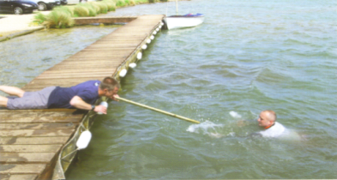
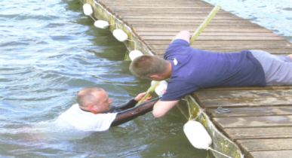
See if there is anyone else around who can assist you and call 999. Tell them where you are – What3Words can help.
If there is something you can use as a rescue aid to reach the casualty:
Get low down to the ground and reach out with it.
Pull the person to the side.
Once they are out of the water, try to keep them warm and monitor them whilst you wait for help.
Notes:
If you can reach
It may be possible to reach out to help the person.
Again, stress not to enter the water to rescue a drowning person.
SHOUT - Call 999 and shout for help – Call 999 or shout for help from any passers by and ask them to call 999. help from any passers by and ask them to call 999. Give as much information to the emergency services call handler as possible and importantly, a location. Use the What3Words app if needs be.
Make contact with the person by shouting and waving to them and encourage them towards you.
Try to reassure them and encourage them to remain calm and not panic. If they are hyperventilating they need to try and calm themselves so they can regulate their breathing.
Encourage the person struggling to a point of safety – keep talking to them.
Then, if you need to and are able to –
REACH
If you think you are able to reach them using a branch, pole or anything else that is close by, do so if it is safe. Ensure you get down low and even on the ground when you do this to prevent you falling or being pulled into the water yourself. Pull the casualty to the side remembering that they may (accidentally) pull you in even as you try to get them on to the water side.
Once the casualty is out, remove wet clothing. Keep them warm and monitor them.

Slide 21
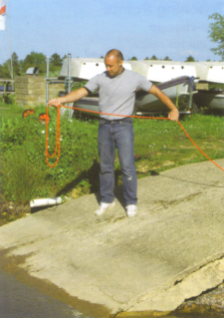
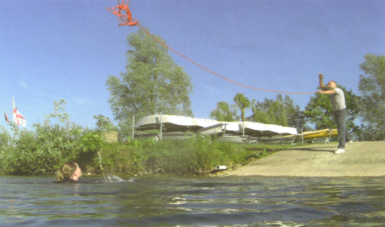
See if there is anyone else around who can assist you and call 999. Tell them where you are – What3Words can help.
Find something that floats and throw it to the person, encouraging them to move towards you if they can.
Throw the object underarm to allow the person to get it. Then ask them to use it to float. If using a rope or similar object, get down low and pull them to safety.
Notes:
Throwing Something
Again, stress not to enter the water to rescue a drowning person.
If the person appears out of reach and/or may not be able to get closer to shore it may be possible to throw something to them to help pull them in or help them float.
SHOUT - Call 999 and shout for help – Call 999 or shout for help from any passers by and ask them to call 999. help from any passers by and ask them to call 999. Give as much information to the emergency services call handler as possible and importantly, a location. Use the What3Words app if needs be.
Make contact with the person by shouting and waving to them. If you can locate a throwing rope (or similar) or something that will float, try to reassure them and tell them what you are going to do to help.
Encourage them to remain calm and not panic. If they are hyperventilating they need to try and calm themselves so they can regulate their breathing.
Coil the rope whilst encouraging the casualty to move towards you if they can.
Throw the rope underarm and when the casualty grabs it, get down low and pull the casualty to safety.
At this point, if appropriate and there is time and space you can carry out an activity where, using a throwline, you get students to practise coiling and throwing a rope out to an object representing the casualty and they will be able to see how difficult it is.
Alternatively - find something that floats and throw it to the person underarm so that they can get it. Tell them to use it to float and encourage them to move towards you if they can or wait until further help arrives.

Slide 22
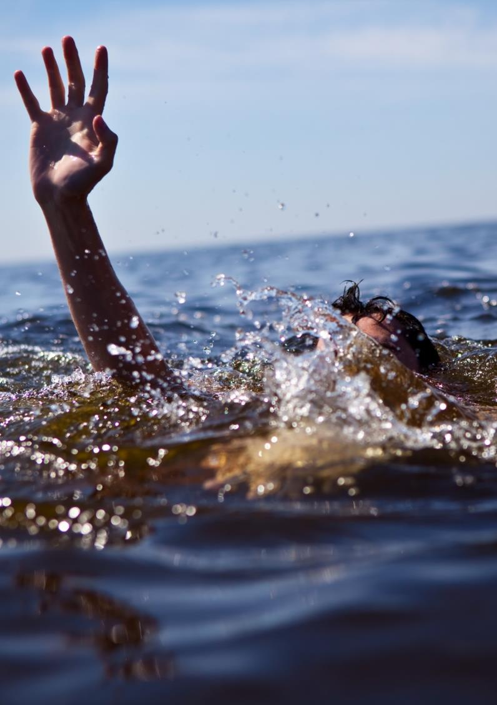
Key Messages – Respect the Water
If someone is struggling in the water…
NEVER enter the water to rescue them
Instead -
CALL 999 – give location ///W3W
TELL – float on back – reassure them
REACH – is safe to do so
THROW – something that floats
Whoever is struggling in the water should try to turn onto their back and #FloatToLive
Notes:
Remember –
Remind the learners what to do if someone is struggling and needs help.
Never enter the water to rescue a drowning person – explain why – the dangers are the same for you and it may mean two people are then struggling with no means of getting help. They may pull you down too as it is common for people struggling in the water to panic. The Fire and Rescue Service and other emergency services have equipment available to them to assist in water rescues.
SHOUT - Call 999 and shout for help – Call 999 or shout for help from any passers by and ask them to call 999. Try to give as much information to the call handler as possible and importantly, a location. Have the What3Words app or a similar one downloaded on your phone so you can use this if you need to.
Make contact with the person and encourage them towards you.
Try to reassure them and encourage them to remain calm and not panic. If they are hyperventilating they need to try and calm themselves so they can regulate their breathing.
Encourage the person struggling to a point of safety – keep talking to them.
Get them to try to turn on their back and float by stretching out their arms and legs like a starfish and keep talking to them, reassuring them. In effect, #FloatToLive. This is equally important if it is you struggling in the water yourself.
REACH - Use a branch, pole or anything else that is at hand if it is safe.
If you think you are able to reach them using a branch, pole or anything else that is close by, do so if it is safe. Ensure you get down low and even on the ground when you do this to prevent you falling or being pulled into the water yourself.
THROW - Use anything available to either pull them to the side or that they can use as a float.
Use anything you can find that could assist in pulling them to the side or they can use as a float.

