Slide 1
Notes:
Water Safety
Introduction
Introduce yourself and go through any housekeeping.
Explain how the session will run.
Throughout, encourage the learners to:
Make the right choice – look after themselves and everyone else.
Consider the audience and situation at the time. Where appropriate, reinforce and expand on this at relevant parts of the presentation.
Own Notes:

Slide 2
Drowning is one of the UK's leading causes of accidental death.
Generally, over 300 people die from drowning in the UK every year.
Males account for over 80% of the deaths
Many of these deaths are males aged between 10 and 18 and are entirely preventable.
It is the third most common cause of death in under 16-year-olds.
Notes:
Water facts and figures
Go through the facts on the slide.
Explain that you are more likely to get into trouble and risk of drowning in uncontrolled situations (e.g. not swimming pools or organised open water events/activities) if you think you are a strong swimmer, because you are more likely to risk going into the water in the first place!
Briefly go through some of the reasons why people would go into the water?
Falling in unexpectedly (e.g. if running or cycling along a canal towpath – quite common amongst adults)
Water sports activities
Trying to save others and pets
Swimming after drinking or taking other substances
Showing off/peer pressure
Own Notes:

Slide 3
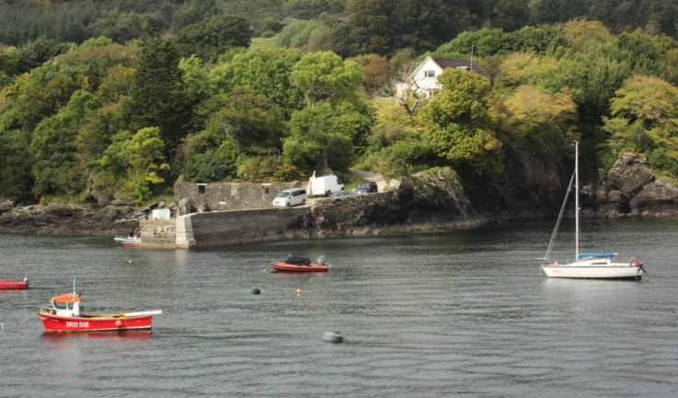
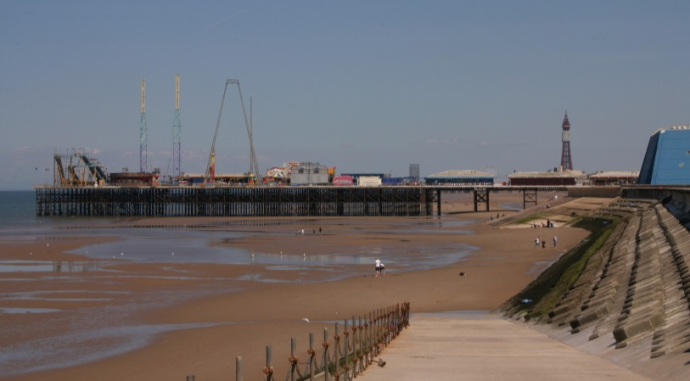
-
Depth of water
Cold water
Hidden currents
Depth of water
Hidden currents
Notes:
‘Open water’ – what is it and what are the dangers?
Coastal areas (sea and mudflats)
Discuss the type of dangers that might exist in coastal areas.
As you go through them help the learners realise that there is quite a lot of overlap between the types of ‘open water’ and the dangers.
Reinforce the following:
Depth of the water
It can be very difficult to judge the depth of the water even when the water is clear.
Temperature of the water
The water is likely much colder than you think. As you enter the water you will have an initial deep and sudden gasp followed by hyperventilation that can be as much as 600 - 1000% greater than normal breathing. You must keep your airway clear or run the risk of drowning. Cold Water Shock will pass in about 1 minute. During that time concentrate on avoiding panic and getting control of your breathing.
Hidden currents
Some of the rivers in Lancashire are tidal and these can have powerful hidden currents that run unseen below the surface.
It may also be worth pointing out that if a location is isolated this can be a real danger too – lack of readily available help, poor or no phone signal etc.
No lifeguards – remote locations
If a person gets into difficulty then unless the area is patrolled by lifeguards the likelihood of them being rescued may be slim and anyone entering the water to rescue them has the potential to become a drowning statistic too. If the location is remote this will have its own problems in terms of access and time for help to arrive. Mobile phone signals could be weak or non-existent.
You may wish to stress particular aspects according the circumstances and location of where the session is taking place.
Own Notes:

Slide 4
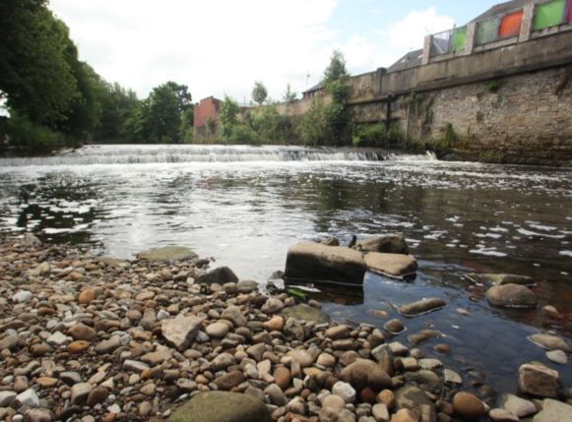
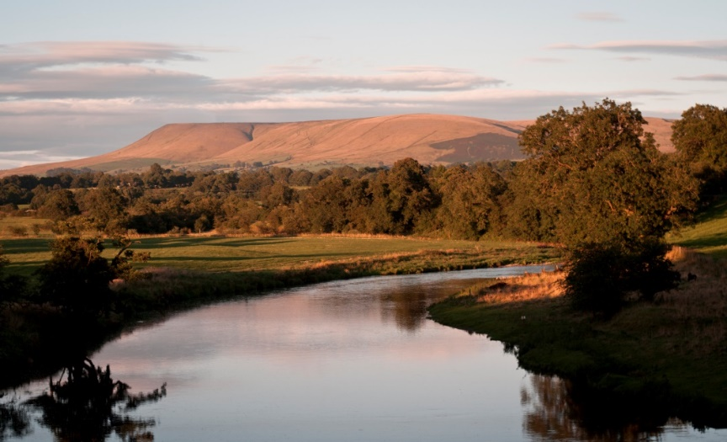
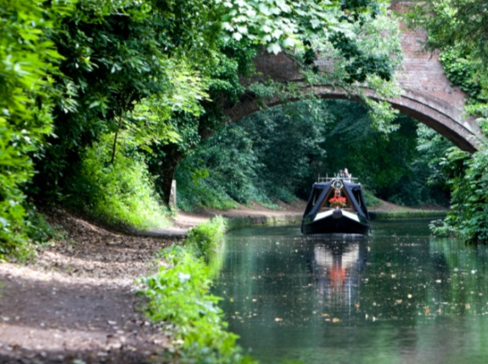
–
Difficulty getting out
Fast moving water and hidden currents
Risk of getting entangled, such as by plants or other items
Rubbish under the waterline
Risk of getting entangled
Polluted water
Difficulty getting out
Notes:
‘Open water’ – what is it and what are the dangers?
Rivers and Canals
Discuss the types of dangers that may be associated with rivers and canals.
Highlight any similarities between these and the previous images, reminding the learners that different areas of water can have similar types of danger.
Difficulty getting out
It can be very difficult to get out of the water because of unstable banks, muddy or steep slippery banks, trees and undergrowth and with canals, high vertical sides.
Fast moving water and hidden currents
Some of the rivers in Lancashire are tidal and these can have powerful hidden currents that run unseen below the surface.
Risk of Entanglement
Foot and hand entrapments can occur resulting in a person getting into difficulty and even drowning.
In addition to the above, the following are also significant risks, particularly with canals
Rubbish on or under the water
Fly-tippers and adverse weather conditions mean that quantities of rubbish, trees, shopping trolleys etc. end up in our water courses, including ponds, lakes and canals. As well as landing on something in the water that could cause severe injury the person could get entangled.
Polluted water
There are likely to be different types of pollution in the water. These can include water-borne diseases and bacteria from both human and wildlife. There may also be chemicals in the water.
You may wish to stress particular aspects according the circumstances and location of where the session is taking place.
Own Notes:

Slide 5
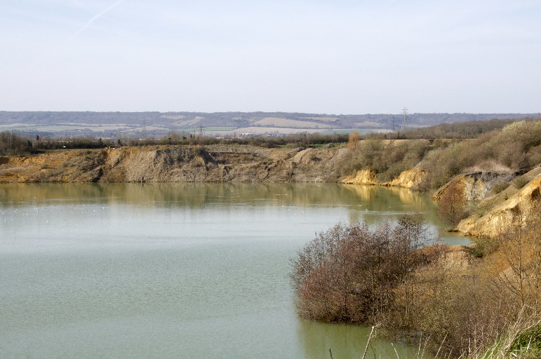
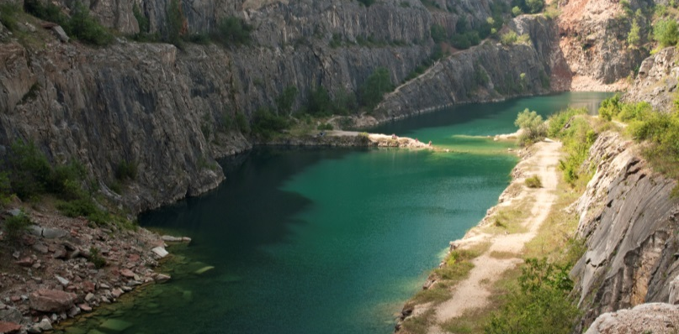
-
Water temperature
Depth of water
Rubbish (or other objects) under the waterline
Polluted water
Difficulty getting out
No lifeguards - remote locations
Water temperature
Depth of water
Difficulty getting out
No lifeguards - remote locations
Notes:
Open water – what is it and what are the dangers?
Reservoirs and quarries
Discuss the types of dangers that may be associated with reservoirs and quarries.
Highlight any similarities between these and the previous images, reminding the learners that different areas of water can have similar types of danger.
Briefly go through the following:
Temperature of the water
The water is likely much colder than you think. As you enter the water you will have an initial deep and sudden gasp followed by hyperventilation that can be as much as 600 - 1000% greater than normal breathing. You must keep your airway clear or run the risk of drowning. Cold Water Shock will pass in about 1 minute. During that time concentrate on avoiding panic and getting control of your breathing.
Depth of the water
It can be very difficult to judge the depth of the water even when the water is clear.
Difficulty getting out
It can be very difficult to get out of the water because of unstable banks, muddy or steep slippery banks, trees and undergrowth and, in many places, high vertical sides.
No lifeguards – remote locations
If a person gets into difficulty, unless the area is patrolled by lifeguards the likelihood of them being rescued may be slim and anyone entering the water to rescue them has the potential to become a drowning statistic too. If the location is remote this will have its own problems in terms of access and time for help to arrive. Mobile phone signals could be weak or non-existent.
Rubbish on or under the water
Fly-tippers and adverse weather conditions mean that quantities of rubbish, trees, shopping trolleys etc. end up in our water course including reservoirs and flooded quarries. As well as landing on something or getting caught up in it when the water is moving this rubbish/debris can cause severe injury to a person should it strike them in the water.
In reservoirs there is usually ‘underwater’ machinery or equipment, which is often hidden and can cause injury if landed on or if in active use - slice gates, pipelines etc.
Polluted water
There will be different types of pollution in the water, particularly in flooded quarries. These can include water-borne diseases and bacteria from both human and wildlife. There may also be chemicals in the water too.
Stress that these locations appear to have the most types of dangers and that in particular many tragic incidents in Lancashire and around the country have occurred in reservoirs and quarries.
You may wish to stress particular aspects according the circumstances and location of where the session is taking place.
Own Notes:

Slide 6
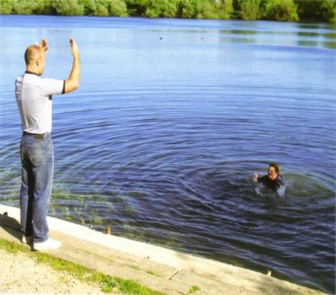
Need help? - What you should do
If you see someone struggling in the water:
Do not enter the water to rescue them.
Shout for help – and shout/signal to them, so that they know you are there.
Call for help on 999 and give your location.
Tell the person to try and stay calm and float on their back.
Try to encourage them to a point of safety.
Notes:
Need help? – What you should do
Go through what to do if someone is struggling in the water and needs help.
Importantly –
Never enter the water to rescue a drowning person – explain why – the dangers are the same for you and it may mean two people are then struggling with no means of getting help. You may be pulled down too as it is common for people struggling in the water to panic. The Fire and Rescue Service and other emergency services have equipment available to them to assist in water rescues.
Instead –
SHOUT - Call 999 and shout for help – Call 999 or shout for help from any passers by and ask them to call 999. Try to give as much information to the call handler as possible and importantly, a location. Have the What3Words app or a similar one downloaded on your phone so you can use this if you need to.
Make contact with the person and encourage them towards you.
Try to reassure them and encourage them to remain calm and not panic. If they are hyperventilating they need to try and calm themselves so they can regulate their breathing.
Encourage the person struggling to a point of safety – keep talking to them.
Get them to try to turn on their back and float by stretching out their arms and legs like a starfish and keep talking to them, reassuring them. In effect, #FloatToLive. This is equally important if it is you struggling in the water yourself.
Own Notes:

Slide 7
What3Words App
What3Words can share your exact location with the emergency services:
Download the What3Words app from Google Store/AppStore
Give the app permission to use your location
In an emergency, find your unique three-word location, e.g., ///tells.puddles.punch
Call 999 and give the operator your location, including your three words
They will share your exact location with the emergency services – fire and rescue service and HM Coastguard
Notes:
What3Words App
Street addresses aren’t accurate enough to specify precise locations, such as building entrances, and don’t exist for parks and many rural areas, including more remote water locations. This can make it hard to find places and prevents people from describing exactly where help is needed in an emergency.
There are several Locator Apps which can be downloaded onto mobile phones and which may help guide the emergency services to a location if their help is needed.
What 3 Words is an example of a Locator App. In it the World has been divided into 3 metre squares. Each square has a unique combination of three words separated by full stops. It can be used in two ways, but the first way is usually the most useful in an emergency situation -
View current What3Words address
Tap the icon above satellite mode to view your current location. If your GPS accuracy is low, switch to satellite mode. The What3Words code should automatically appear but to be sure click on the blue arrow in the bottom right corner of the screen. Alternatively, zoom in until you see the grid and tap the correct square.
Find a What3Words address
Enter a place name or street address into the search bar and choose the correct result. Switch to satellite mode and zoom in until you see the grid. Tap on a square to see its what3words address.
Click here for case studies, including of when the What3Words App helped in an emergency situation, including several water safety ones, in particular one from Preston Fire Station -
what3words for emergencies: real-life stories | what3words
Own Notes:

Slide 8
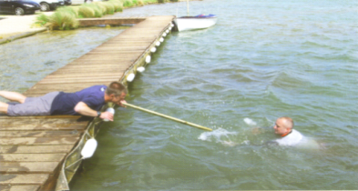
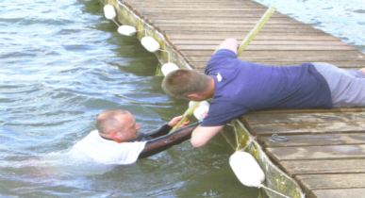
See if there is anyone else around who can assist you and call 999. Tell them where you are – What3Words can help.
If there is something you can use as a rescue aid to reach the casualty:
Get low down to the ground and reach out with it.
Pull the person to the side.
Once they are out of the water, try to keep them warm and monitor them whilst you wait for help.
Notes:
If you can reach
It may be possible to reach out to help the person.
Again, stress not to enter the water to rescue a drowning person.
SHOUT - Call 999 and shout for help – Call 999 or shout for help from any passers by and ask them to call 999. help from any passers by and ask them to call 999. Give as much information to the emergency services call handler as possible and importantly, a location. Use the What3Words app if needs be.
Make contact with the person by shouting and waving to them and encourage them towards you.
Try to reassure them and encourage them to remain calm and not panic. If they are hyperventilating they need to try and calm themselves so they can regulate their breathing.
Encourage the person struggling to a point of safety – keep talking to them.
Then, if you need to and are able to –
REACH
If you think you are able to reach them using a branch, pole or anything else that is close by, do so if it is safe. Ensure you get down low and even on the ground when you do this to prevent you falling or being pulled into the water yourself. Pull the casualty to the side remembering that they may (accidentally) pull you in even as you try to get them on to the water side.
Once the casualty is out, remove wet clothing. Keep them warm and monitor them.
Own Notes:

Slide 9
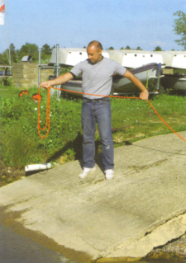
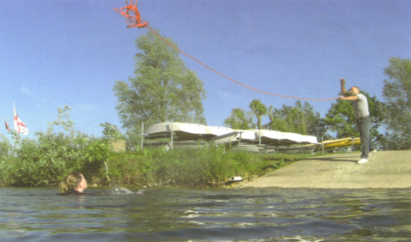
See if there is anyone else around who can assist you and call 999. Tell them where you are – What3Words can help.
Find something that floats and throw it to the person, encouraging them to move towards you if they can.
Throw the object underarm to allow the person to get it. Then ask them to use it to float. If using a rope or similar object, get down low and pull them to safety.
Notes:
Throwing Something
Again, stress not to enter the water to rescue a drowning person.
If the person appears out of reach and/or may not be able to get closer to shore it may be possible to throw something to them to help pull them in or help them float.
SHOUT - Call 999 and shout for help – Call 999 or shout for help from any passers by and ask them to call 999. help from any passers by and ask them to call 999. Give as much information to the emergency services call handler as possible and importantly, a location. Use the What3Words app if needs be.
Make contact with the person by shouting and waving to them. If you can locate a throwing rope (or similar) or something that will float, try to reassure them and tell them what you are going to do to help.
Encourage them to remain calm and not panic. If they are hyperventilating they need to try and calm themselves so they can regulate their breathing.
Coil the rope whilst encouraging the casualty to move towards you if they can.
Throw the rope underarm and when the casualty grabs it, get down low and pull the casualty to safety.
At this point, if appropriate and there is time and space you can carry out an activity where, using a throwline, you get students to practise coiling and throwing a rope out to an object representing the casualty and they will be able to see how difficult it is.
Alternatively - find something that floats and throw it to the person underarm so that they can get it. Tell them to use it to float and encourage them to move towards you if they can or wait until further help arrives.
Own Notes:

Slide 10
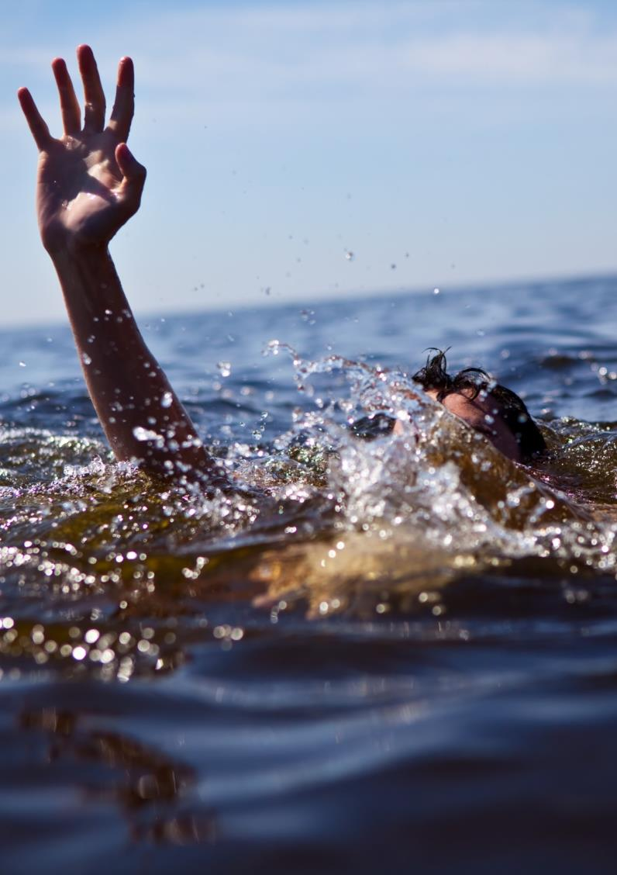
Remember
If someone is struggling in the water…
NEVER enter the water to rescue them
Instead -
SHOUT
REACH
THROW
Whoever is struggling in the water should try to turn onto their back and #FloatToLive
Notes:
Remember –
Remind the learners what to do if someone is struggling and needs help.
Never enter the water to rescue a drowning person – explain why – the dangers are the same for you and it may mean two people are then struggling with no means of getting help. They may pull you down too as it is common for people struggling in the water to panic. The Fire and Rescue Service and other emergency services have equipment available to them to assist in water rescues.
SHOUT - Call 999 and shout for help – Call 999 or shout for help from any passers by and ask them to call 999. Try to give as much information to the call handler as possible and importantly, a location. Have the What3Words app or a similar one downloaded on your phone so you can use this if you need to.
Make contact with the person and encourage them towards you.
Try to reassure them and encourage them to remain calm and not panic. If they are hyperventilating they need to try and calm themselves so they can regulate their breathing.
Encourage the person struggling to a point of safety – keep talking to them.
Get them to try to turn on their back and float by stretching out their arms and legs like a starfish and keep talking to them, reassuring them. In effect, #FloatToLive. This is equally important if it is you struggling in the water yourself.
REACH - Use a branch, pole or anything else that is at hand if it is safe.
If you think you are able to reach them using a branch, pole or anything else that is close by, do so if it is safe. Ensure you get down low and even on the ground when you do this to prevent you falling or being pulled into the water yourself.
THROW - Use anything available to either pull them to the side or that they can use as a float.
Use anything you can find that could assist in pulling them to the side or they can use as a float.
Own Notes:

Slide 11
Remember:
The consequences of entering ‘open water’ can be serious and could even lead to you losing your life
‘Open water’ can have many dangers
- it is likely to be incredibly cold which can lead to ‘cold water shock’
- there may be hidden dangers under the surface
- the water is often untreated which could lead to some nasty illnesses
- sites are often remote so getting help quickly may be difficult
If someone is in trouble - raise the alarm - Shout, Reach and Throw
Try to float on your back - #Float To Live
You are more likely to drown in ‘open water’ if you are a strong swimmer because you are more likely to take risks and go into the water
Download What3Words or a similar app to share your exact location with the emergency services
Notes:
Summary – Be Water Aware
Summarise the session with reference to the objectives of the session.
Reinforce these and stress any other key points that may have arisen during the session but that are not featured on the slide.
What is ‘Open water’?
“Open water” is any large body of still or moving water such as a lake, reservoir, flooded quarry, canal, river and the sea. In most cases these will not have any supervision or life-saving equipment nearby. They are often quite isolated, which means help may take quite some time to arrive and access may be difficult.
The dangers of open water
The water will be colder than expected, even on a hot sunny day.
The water could be very deep or, if shallow, there could be hidden dangers below the surface such as vegetation, debris, machinery, rocks or currents.
Consequences
If jumping into water, even it appears safe, serious injury could occur.
Ultimately, anyone entering cold water could die due to the effects of ‘Cold Water Shock’ on the body.
If someone is in trouble - Never enter the water to rescue a drowning person but let the person know you are there to help
Raise the alarm - Call 999 and shout for help
Tell the person to try not to panic - but instead remain calm. Encourage them to float on their back with their arms and legs spread out like a starfish #Float toLive.
Try to use something to reach the person and/or throw something to either pull them to the side or that they can use as a float.
Download What3Words or a similar app to share your exact location with the emergency services.
Own Notes:

