Slide 1
Notes:
Water Safety
Introduction
Introduce yourself and go through any housekeeping.
Explain how the session will run.
The Key Learning Objectives are to –
Know what ‘open water’ is
Recognise the dangers of ‘open water’
Understand possible consequences of entering ‘open water’
Know what to do if you or someone else needs help
As the session develops -
consider the audience and situation at the time, where appropriate, reinforce and expand on this at relevant parts of the presentation.
if appropriate, try to refer to local hazards and others in Lancashire, including places where incidents may have occurred (be sensitive to the situation). In effect, this can be wherever you get open water, both inland and coastal.
encourage the learners to
Make the right choice – look after themselves and everyone else.
Own Notes:

Slide 2
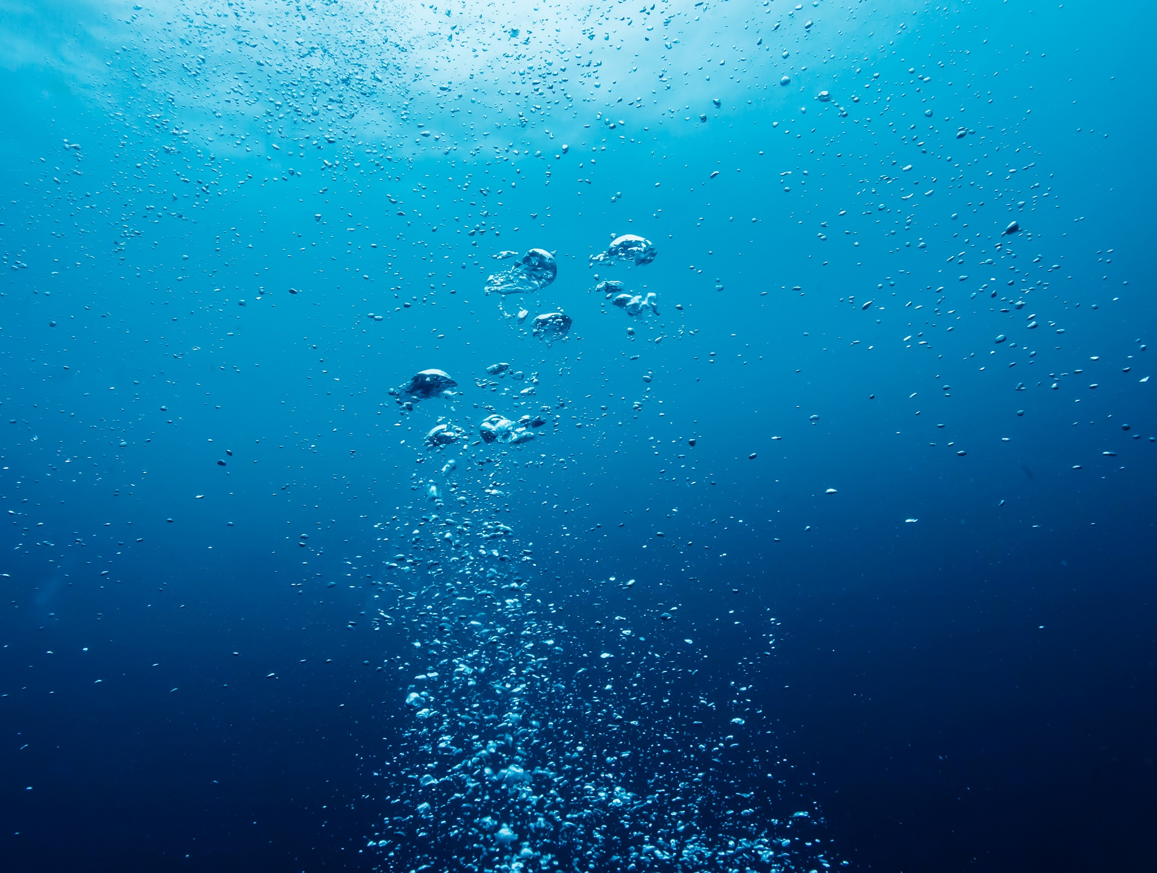
Drowning is one of the UK's leading causes of accidental death.
Generally, over 300 people die from drowning in the UK every year.
Males account for over 80% of the deaths
Many of these deaths are males aged between 10 and 18 and are entirely preventable.
It is the third most common cause of death in under 16-year-olds.
Notes:
Water facts and figures
Go through the facts on the slide.
Explain that you are more likely to get into trouble and risk of drowning in uncontrolled situations (e.g. not swimming pools) if you think you are a strong swimmer, because you are more likely to risk going into the water in the first place!
Briefly go through some of the reasons why people would go into the water? –
Saving others and pets
Falling in unexpectedly
Water sports activities
Swimming after drinking
Showing off/peer pressure
Own Notes:

Slide 3
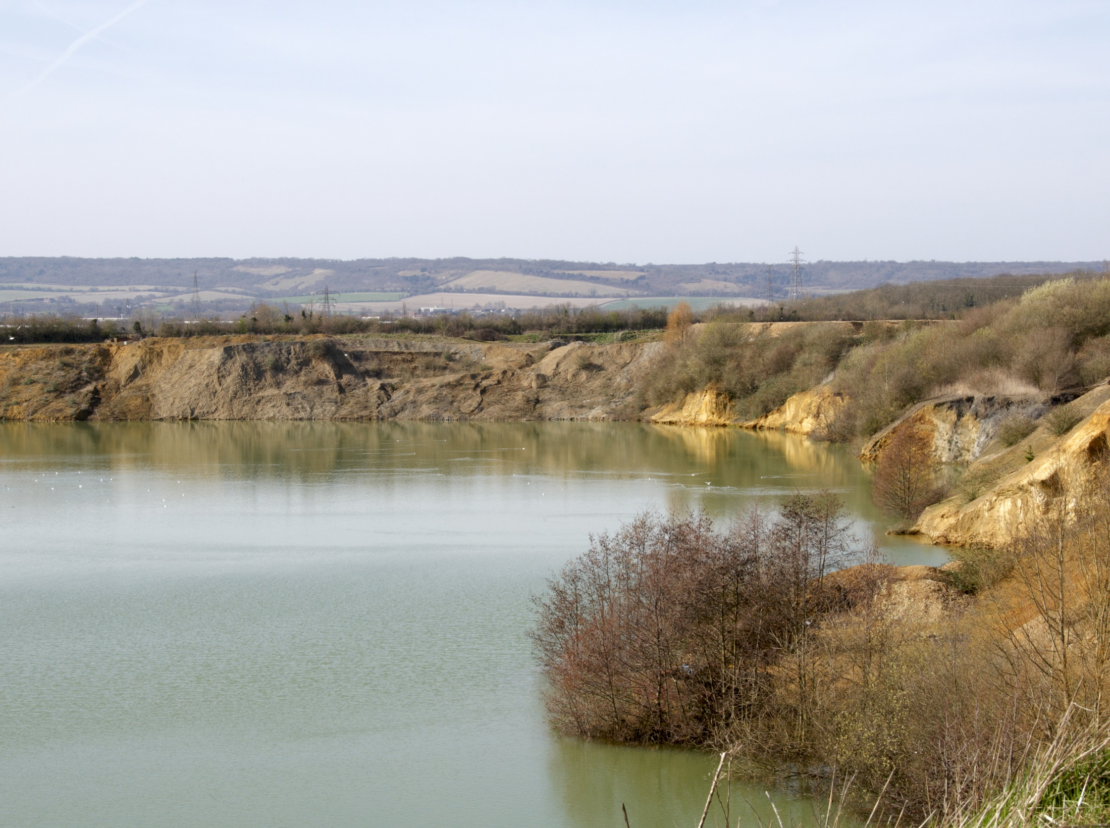
‘Open Water’ is any large body of still or moving water such as lakes, reservoirs, flooded quarries, canals, rivers and the sea.
Limited or no supervision and usually no life-saving equipment.
Often quite isolated – no help close by.
Notes:
‘Open water’ – what is it?
Reinforce the information on the slide checking that the learners know what is meant by ‘open water’.
‘Open Water’ is any large body of still or moving water such as lakes, reservoirs, flooded quarries, canals, rivers and the sea.
Stress that in many cases these locations will not have any supervision or life saving equipment nearby. They are often quite isolated, which means the phone signal may be poor or non-existent, help may take quite some time to arrive and access may be difficult. This will be covered later in the presentation.
Own Notes:

Slide 4
Organised Open Water Swimming
Organised – other people about
Safe location and risk assessed – safe swim zones
Non-polluted water
Help on hand – likely to be supervision or a lifeguarding service.
Notes:
Organised ‘Open Water Swimming’
State that whilst the session will mention the dangers of ‘open water’ it is important to understand that water can be enjoyed safely too – so try to #BeWaterAware
Refer to the concept of organised ‘open water swimming’ (and other organised water-based activities, such as paddleboarding or kayaking) and how joining a group or club, rather than just going to a random outdoor location with friends, is likely to be much safer.
Expand on the slide as appropriate to explain the benefits of organised open water activities -
Organised - there will be other people about – most of who will be experienced open water swimmers.
Safe location and risk assessed - strict safety checks are likely to have been done on the location. Safe swim zones are likely to exist to ensure people don’t get injured or get out of their depth without help being close by.
Non-polluted water - no group would want to swim in water that could knowingly cause illness or injury.
Help on hand – likely to be supervision or a lifeguarding service, which should include qualified first-aiders.
In addition to the information on the slide you may also be able to get –
Advice about training your body to get adjusted to the conditions - this is an important concept, especially when the water is colder. Stress that just because the weather is nice and the temperature appears warm, it doesn’t necessarily mean that the water is (particularly where the water is deeper).
Access to appropriate safety equipment - some groups will provide or lend wetsuits, buoyancy aids etc.
Own Notes:

Slide 5
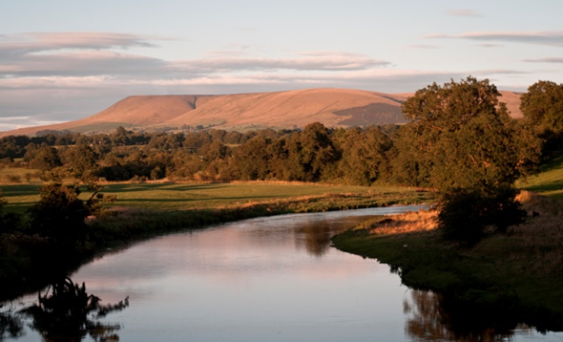
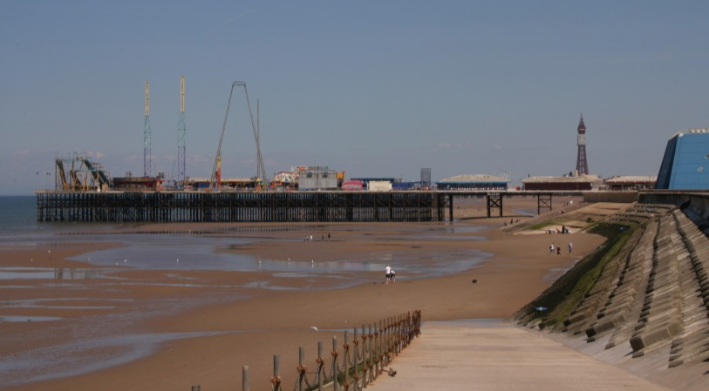
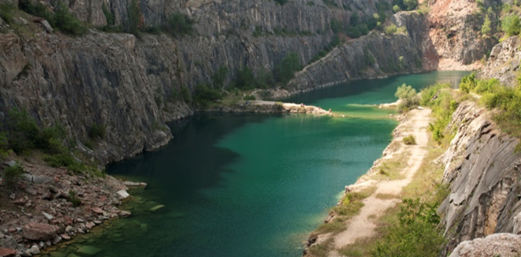
Depth of the water
Cold water
Risk of getting trapped
Difficulty getting out
Hidden currents and strong tides
Rubbish under the waterline
Polluted water
Remote locations
Notes:
‘Open water’ – what is it and what are the dangers?
The open water images and dangers will appear. The images are of –
river
sea
reservoir
Disused/flooded quarry
Canals can also be included here, especially with the dangers of difficulty getting out and rubbish/vegetation under the water line
Help the learners realise that there is quite a lot of overlap between the types of ‘open water’ and the dangers. Reinforce the following:
Depth of the water
It can be very difficult to judge the depth of the water even when the water is clear. The sand/soil (water bed) level under the water may also suddenly drop away.
Cold water (Cold water shock)
The water is likely much colder than you think. As you enter the water you will have an initial deep and sudden gasp followed by hyperventilation that can be as much as 600 - 1000% greater than normal breathing. You must keep your airway clear or run the risk of drowning.
If you fall into cold water unexpectedly, your instinct is to try and swim - fight the water. This will tire you quickly. Cold water shock can also make you panic, gasp, breath in water and you are more likely to drown. If you float the initial effects of cold water shock can pass and you will regain control of your breathing. The best way to do this is to float on your back:
1. Fight your instinct to thrash around.
2. Lean back, extend your arms and legs.
3. If you need to, gently move them around to help you float.
4. Float until you can control your breathing.
5. Only then, call for help, swim to safety or continue floating until help arrives.
Risk of getting trapped/entanglement
Foot and hand entrapments from natural materials, such as weeds and reeds, can occur resulting in a person getting into difficulty and even drowning.
Difficulty getting out
It can be very difficult to get out of the water because of high vertical sides, muddy banks, steep slippery banks, trees and undergrowth.
Hidden currents and strong or unpredictable tides
Coastal water is tidal which can change and move very quickly.
In a coastal bay or wherever the water is tidal, including rivers near the coast, dangers will move from tide-to-tide, day-to-day. One day you might have felt safe and the mud/sand appeared stable, however this does not mean it will be the same the following day. The tide can change quickly and it can become very dangerous in terms of the underfoot conditions. Powerful hidden currents may also run unseen below the surface.
Some of the rivers in Lancashire are tidal and these can also have powerful hidden currents that run unseen below the surface.
Rubbish on or under the water
Fly-tippers, vandals and adverse weather conditions mean that quantities of rubbish, trees, shopping trolleys etc. end up in our water courses including ponds, lakes and canals. As well as landing on something or getting caught up in it when the water is moving, meaning getting out is made more difficult, this rubbish/debris can cause severe injury to a person should they hit it in the water.
Polluted water
There may be different types of pollution in the water. These can include water-borne diseases and bacteria from both human and wildlife. There may also be chemicals in the water.
If appropriate you may refer to the potential illnesses. These include:
Trachoma - an eye infection that turns your eyelashes inside-out and could lead to blindness.
Cryptosporidium (pronounced sip-to-sper-idium) - a parasite that causes severe stomach cramps and diarrhea.
Whipworm - worm eggs which hatch inside the body after being swallowed.
Weil’s disease - an organ damaging disease caused by swallowing animal urine (particularly rats).
Remote locations – no lifeguards or help close at hand
If a person gets into difficulty then unless the area is patrolled by lifeguards or people are out and about the likelihood of them being rescued may be slim and anyone entering the water to rescue them has the potential to become a drowning statistic too. If the location is remote this will have its own problems with access and time for help to arrive. Mobile phone signals could be weak or non-existent.
In addition to the dangers on the slide depending on the audience the following could be mentioned:
Mud and ‘quicksand’
Mud and sand mixed with water can cause what is often referred to as ‘quicksand’ and it is very difficult to see danger areas. There are not always noticeable signs to tell you that the area where you are is dangerous. Some areas of the beach are particularly dangerous and you could start to ‘sink’ very quickly – moving around once your feet have become stuck can make the situation worse. In no time at all you could be up to your knees or waist and unable to free yourself.
Stress that it is highly unlikely you would sink completely, however the danger is that you would become stuck and the tide would come in, potentially rising up over you.
You may wish to stress particular aspects according the circumstances and location of where the session is taking place.
Own Notes:

Slide 6
Cold water carries heat away from the body 25 times faster than air of the same temperature.
Jumping into cold water causes immediate physiological responses, the first of which is a “gasp” reflex.
Water with a temperature of less than 15°C can trigger this REFLEX reaction.
Reservoir temperatures rarely get above 12°C!
Notes:
Effects of Cold Water Shock
Explain that if you are suddenly immersed in cold water the cold water will carry heat away from the body 25 times faster than air of the same temperature. As a result you may struggle to function properly; become disorientated and eventually unconscious.
Jumping into cold water can cause immediate physiological responses, the first of which is a “gasp” reflex.
A reflex action is involuntary - if this happens when your head is under water, you are in deep trouble.
Even in the summer, reservoir and quarry temperatures rarely get above 12°C. Even if it feels warm near the shoreline, it might drop dramatically the further out you go and that’s when your body might start reacting to the cold and you find yourself getting into trouble.
Cold Water Shock also means that even strong swimmers can drown in ‘open water’ as they are more likely to take risks and/when entering the water.
Own Notes:

Slide 7
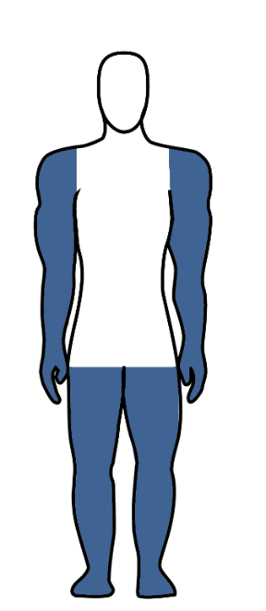
Short Term
Medium Term
Longer Term
Panic
Struggle to breath
Heart rate rises rapidly
Arms and legs will cool quickly
Leads to a loss of strength
Body becomes so cold you can’t control it
Become disorientated and fall unconscious
Notes:
Effects of Cold Water Shock
Go through the effects of entering cold water, Stress that the timings will vary slightly from person to person but they are a good guide.
Short Term (first 5 mins)
Panic and Hyperventilation
On entering the water it is likely to be much colder than the air temperature. You may gasp for air which may increase the chance of inhaling water into your lungs.
If you need to swim, lie on your back and try to float – spread your legs and arms out and, if you need to, gently move them to help float. Try not to use your legs to swim as the large muscles require lots of blood to function, this will draw the blood away from the core part of the body making it cool faster which will increase the chance of hypothermia.
Possible heart related problems - heart rate rises and blood tries to pumps faster.
Your heart rate will rise drastically reducing its efficiency, which this may lead to heart failure.
Medium Term (from around 5 mins to around 30 mins)
Arms and legs start cooling rapidly
The body will start to reduce the blood flow to the extremities and direct it to the core area to protect the vital organs.
Loss of strength and endurance
Over approximately the next 10 minutes you will lose the effective use of your fingers, arms and legs for any meaningful movement.
Longer Term (30 mins +)
Core body temperature drops below 35°c (Hypothermia)
It will be very difficult to try and stay afloat due to having very little energy in the muscles to move adequately.
Disorientation and confusion
Normal decision making will be greatly reduced and rational thought will be difficult.
Fall unconscious
With reduced energy the body will naturally fall unconscious to try and save what energy it has left - this is likely to lead to drowning.
Own Notes:

Slide 8
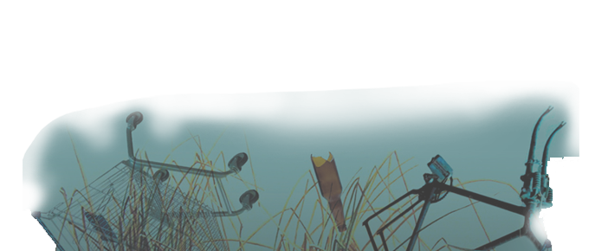
Tombstoning is a term given to a high-risk activity involving people jumping from heights into water.
Serious injuries and deaths as a result of tombstoning remain a real concern.
DON’T JUMP INTO THE UNKNOWN - CONSIDER THE DANGERS.
Notes:
Tombstoning
Ask the learners to briefly consider the following -
What is ‘tombstoning’?
Click for a definition of tombstoning to appear
Tombstoning is a term given to a high-risk activity involving people jumping from heights into water. The heights could include cliffs or bridges.
Consider why would people choose to do it?
Give, or expand on, reasons why people take part in tombstoning -
Peer pressure
Adrenaline
Curious
Not aware of the dangers
See other people doing it
Explain that Tombstoning is incredibly dangerous because:
The water depth could alter with the tide, and it might be shallower than you think.
There may be submerged objects like rocks that aren’t visible from the surface of the water.
Even if the water is deeper the cold temperature of the water can cause your body to go into shock causing hyperventilation, disorientation and cramps making it very difficult to swim.
There may be strong currents in the water, which could sweep you away.
Many people have been killed due to tombstoning and thousands more have required rescuing and had to have treatment for serious injuries. People who have been affected by Tombstoning, both families and friends of those injured or killed or those seriously injured themselves, have described it as a “minute of madness that changed our lives forever”.
Stress - Don’t jump into the unknown - consider the dangers
Own Notes:

Slide 9
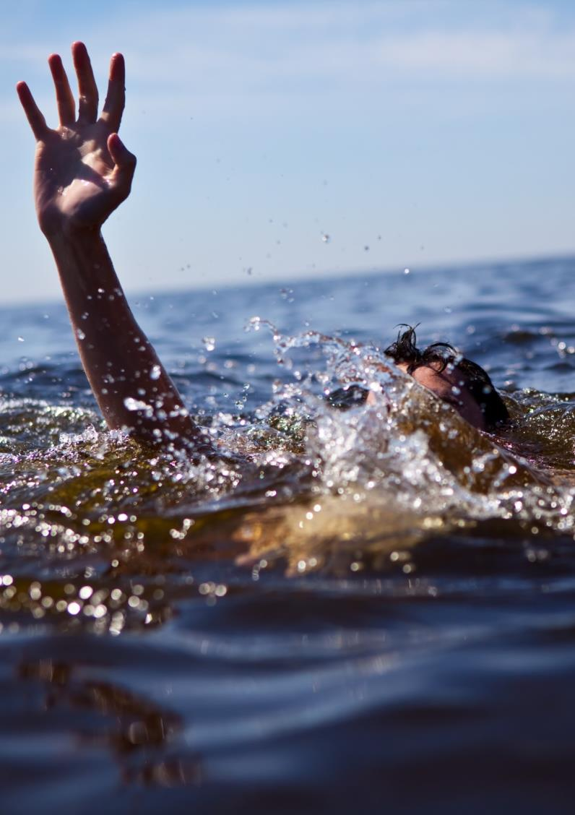
If someone else is struggling in the water:
Never enter the water to rescue a drowning person
Instead –
Shout Reach Throw
Whoever is struggling in the water should try to turn on their back and #FloatToLive
Notes:
What should you do?
Explain what to do if someone is struggling and needs help.
Call 999 and shout for help – try to give as much information to the call handler as possible and importantly, a location.
Never enter the water to rescue a drowning person – explain why – the dangers are the same for you and it may mean two people are then struggling with no means of getting help. They may pull you down too.
SHOUT - make contact with the person and encourage them towards you.
Gain their attention by shouting and waving to them.
Try to reassure them and encourage them to remain calm and not panic. If they are hyperventilating they need to try and calm themselves so they can regulate their breathing.
Encourage the person struggling to a point of safety. Get them to try to turn on their back and float by stretching out their arms and legs and keep talking to them reassuring them. In effect, #FloatToLive. This is equally important if it is you struggling in the water yourself.
REACH - Use a branch, pole or anything else that is at hand if it is safe.
If you think you are able to reach them using a branch, pole or anything else that is close by, do so if it is safe. Ensure you get down low and even on the ground when you do this to prevent you falling or being pulled into the water.
THROW - Use anything available to either pull them to the side or that they can use as a float.
Use anything you can find that could assist in pulling them to the side or they can use as a float.
Own Notes:

Slide 10
What3Words App
What3Words can share your exact location with the emergency services:
Download the What3Words app from Google Store/AppStore
Give the app permission to use your location
In an emergency, find your unique three-word location, e.g., ///tells.puddles.punch
Call 999 and give the operator your location, including your three words
They will share your exact location with the emergency services – fire and rescue service and HM Coastguard
Notes:
What3Words App
Street addresses aren’t accurate enough to specify precise locations, such as building entrances, and don’t exist for parks and many rural areas, including more remote water locations. This can make it hard to find places and prevents people from describing exactly where help is needed in an emergency.
There are several Locator Apps which can be downloaded onto mobile phones and which may help guide the emergency services to a location if their help is needed.
What 3 Words is an example of a Locator App. In it the World has been divided into 3 metre squares. Each square has a unique combination of three words separated by full stops. It can be used in two ways, but the first way is usually the most useful in an emergency situation -
View current What3Words address
Tap the icon above satellite mode to view your current location. If your GPS accuracy is low, switch to satellite mode. The What3Words code should automatically appear but to be sure click on the blue arrow in the bottom right corner of the screen. Alternatively, zoom in until you see the grid and tap the correct square.
Find a What3Words address
Enter a place name or street address into the search bar and choose the correct result. Switch to satellite mode and zoom in until you see the grid. Tap on a square to see its what3words address.
Click here for case studies, including of when the What3Words App helped in an emergency situation, including several water safety ones, in particular one from Preston Fire Station -
what3words for emergencies: real-life stories | what3words
Own Notes:

Slide 11
The consequences of entering ‘open water’ can be serious and could even lead to you losing your life
‘Open water’ can have many dangers
- can lead to ‘cold water shock’
- hidden dangers under the surface
- untreated water - nasty illnesses
- remote locations
If someone is in trouble - raise the alarm - Shout, Reach and Throw
Try to float on your back - #Float To Live
Download What3Words or a similar app in case you need help
Notes:
Summary – Be Water Aware
Summarise the session with reference to the objectives of the session.
Reinforce these and stress any other key points that may have arisen during the session but that are not featured on the slide.
What is ‘Open water’?
“Open water” is any large body of still or moving water such as a lake, reservoir, flooded quarry, canal, river and the sea. In most cases these will not have any supervision or life-saving equipment nearby. They are often quite isolated, which means help may take quite some time to arrive and access may be difficult.
The dangers of open water
The water will be colder than expected, even on a hot sunny day.
The water could be very deep or, if shallow, there could be hidden dangers below the surface such as vegetation, debris, machinery, rocks or currents.
Consequences
If jumping into water, even it appears safe, serious injury could occur.
Ultimately, anyone entering cold water could die due to the effects of ‘Cold Water Shock’ on the body.
If someone is in trouble - Never enter the water to rescue a drowning person but let the person know you are there to help
Raise the alarm - Call 999 and shout for help
Tell the person to try not to panic - but instead remain calm. Encourage them to float on their back with their arms and legs spread out like a starfish #Float toLive.
Try to use something to reach the person and/or throw something to either pull them to the side or that they can use as a float.
Download What3Words or a similar app to share your exact location with the emergency services.
Own Notes:

